Slide 1
Creating a Zoom Account and Scheduling a Meeting
iCON Digital Health Literacy, 2021
(Author unknown, n.d.)

Slide 2
Acknowledgements
This digital health literacy curriculum was developed by The University of British Columbia’s interCultural Online health Network (iCON).
iCON is supported by the B.C. Ministry of Health’s Patients as Partners initiative.
iCON has been working with multicultural communities for over 10 years.
iCON helps people with chronic disease self-management.
iCON also helps people develop digital literacy in order to access, assess, and use health resources online.
Thank you to the BC Ministry of Health Patients as Partners Initiative for their support.

Slide 3
Webinar Outline:
Creating a Zoom Account
Creating a Zoom Meeting Now
Scheduling a Meeting for Later
Summary
(Sugiharto, n.d.)

Slide 4
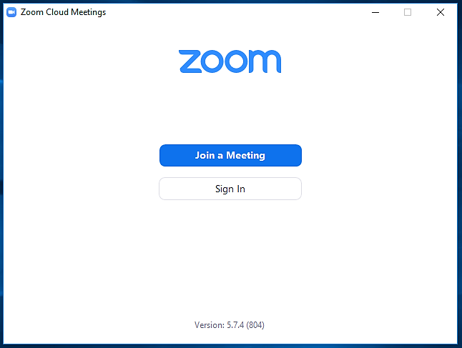
Creating a Zoom Account
(Author unknown, n.d.)
Creating a Zoom Account | Creating a Zoom Meeting | Scheduling a Meeting | Summary

Slide 5
Benefits of Creating a Zoom Account
While you don’t need a Zoom account to join a meeting, creating an account allows you to:
Create your own meeting link
Schedule your own meeting for a later date and time
Keep track of your past and upcoming meetings
This can be very helpful for health management, such as individuals setting up a meeting with their caregiver to discuss health management goals.
Creating a Zoom Account | Creating a Zoom Meeting | Scheduling a Meeting | Summary

Slide 6
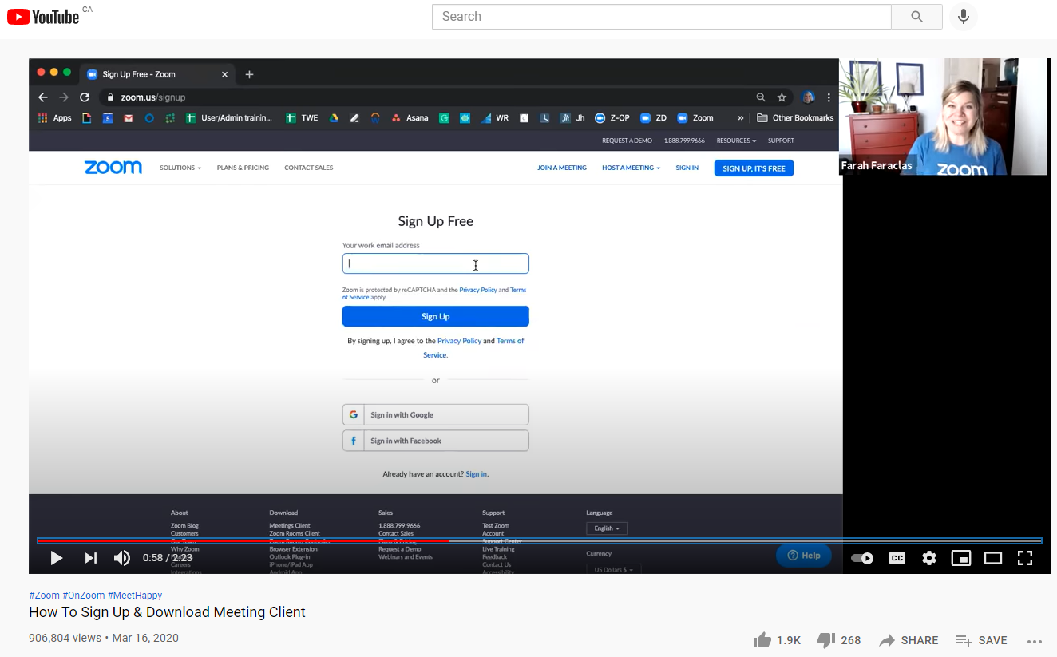
Video: Sign Up and Download Meeting Client
Creating a Zoom Account | Creating a Zoom Meeting | Scheduling a Meeting | Summary

Slide 7
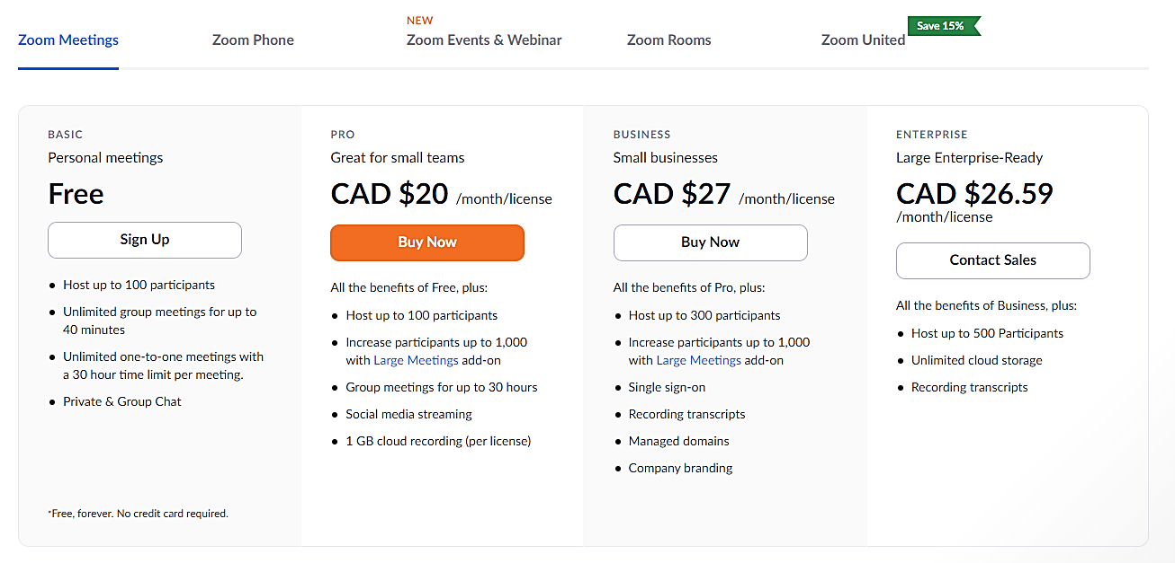
Choose an account type or plan.
Zoom Free works well for most people.
Creating a Zoom Account | Creating a Zoom Meeting | Scheduling a Meeting | Summary

Slide 8
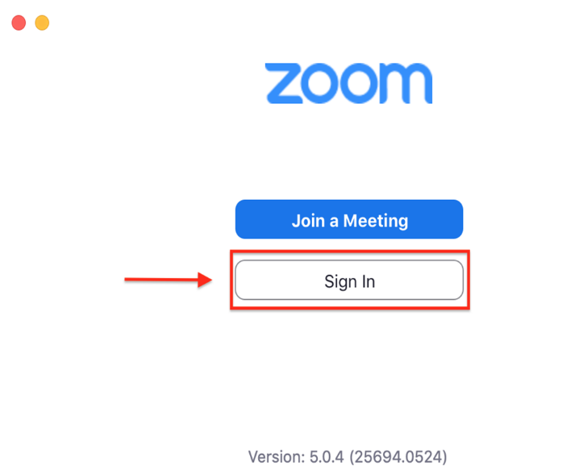
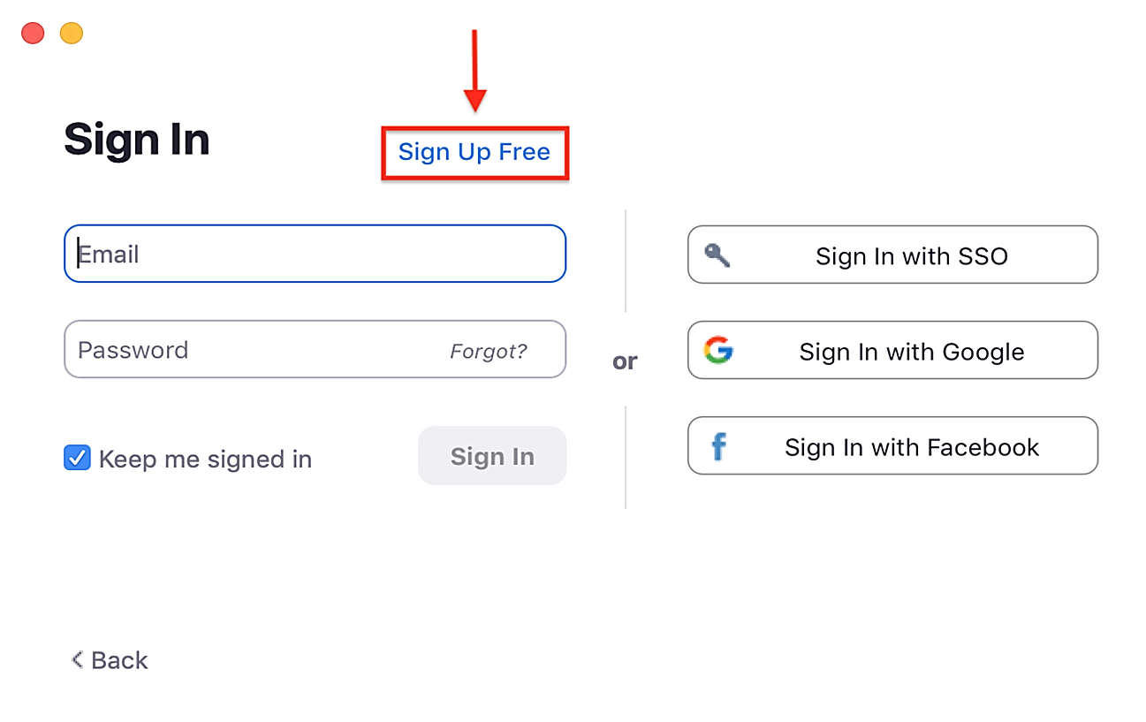
1. Open Zoom. Click “Sign In”.
2. Click “Sign Up Free”.
Add photo credit.
Add photo credit.
Creating a Zoom Account | Creating a Zoom Meeting | Scheduling a Meeting | Summary

Slide 9
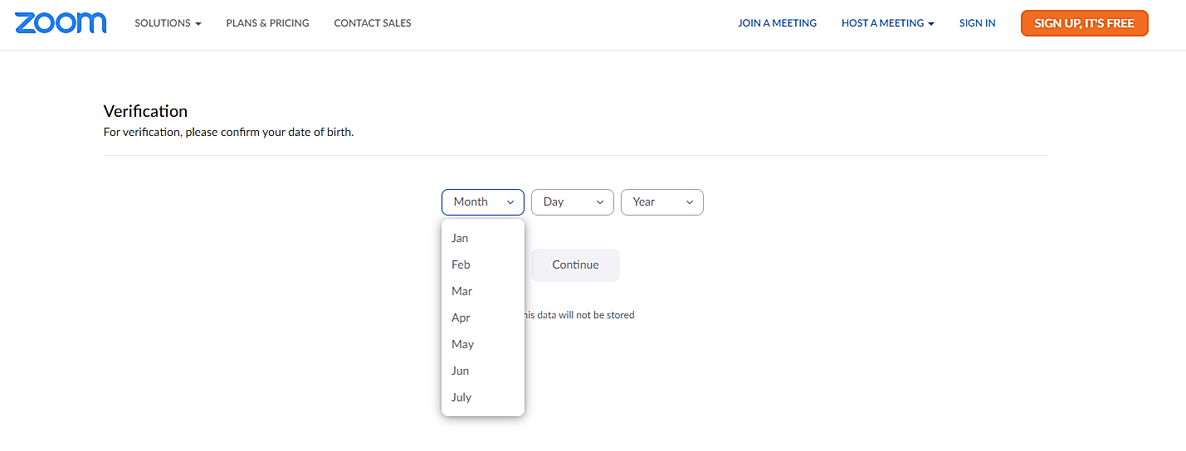
3. Enter a date of birth, then click “Continue”.
Creating a Zoom Account | Creating a Zoom Meeting | Scheduling a Meeting | Summary

Slide 10
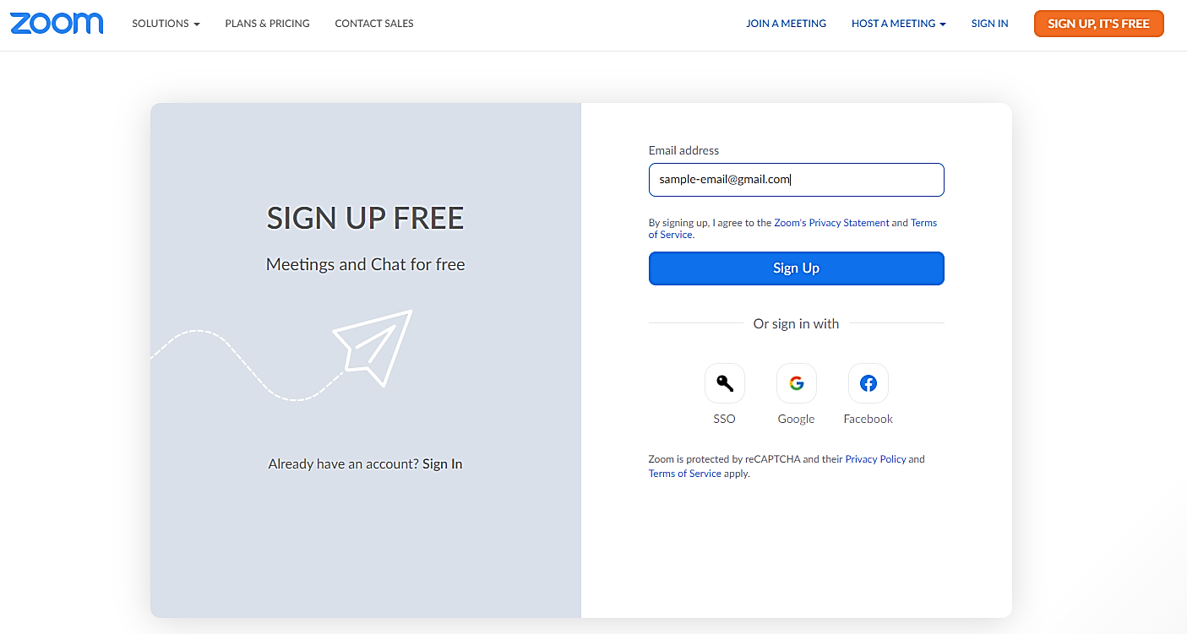
4. Enter an Email Address, then click “Sign Up”.
Creating a Zoom Account | Creating a Zoom Meeting | Scheduling a Meeting | Summary

Slide 11
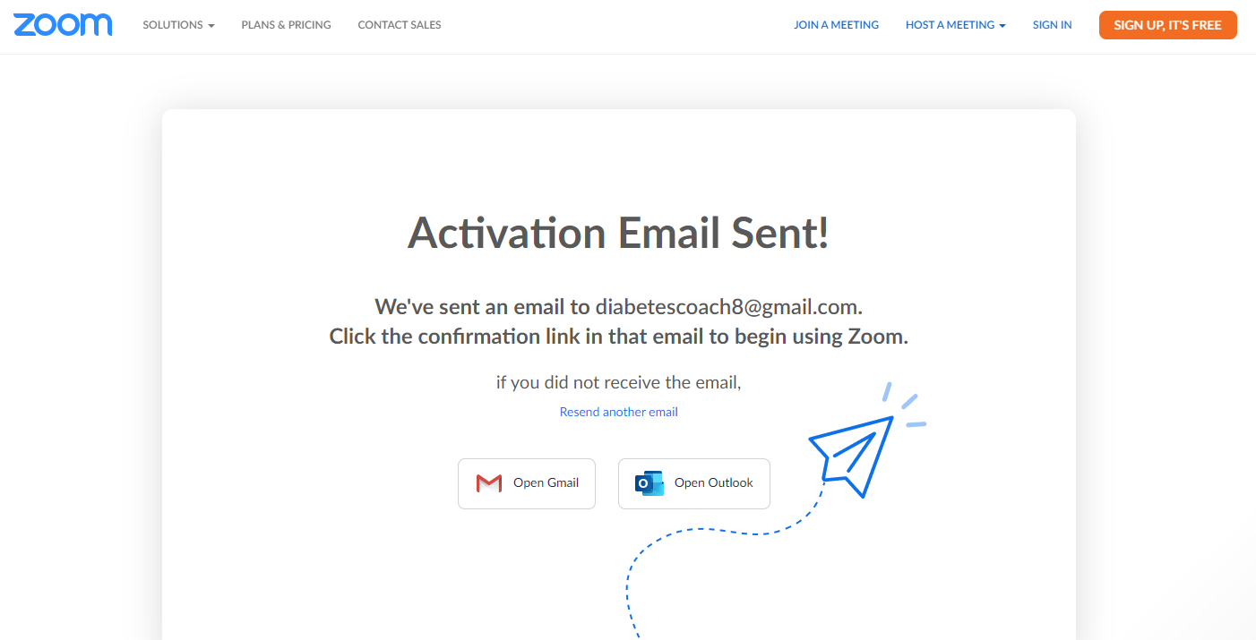
5. A confirmation email will be sent to you. Click “Open Gmail” or “Open Outlook”, depending on your Email service.
sample-email@gmail.com.
Creating a Zoom Account | Creating a Zoom Meeting | Scheduling a Meeting | Summary

Slide 12
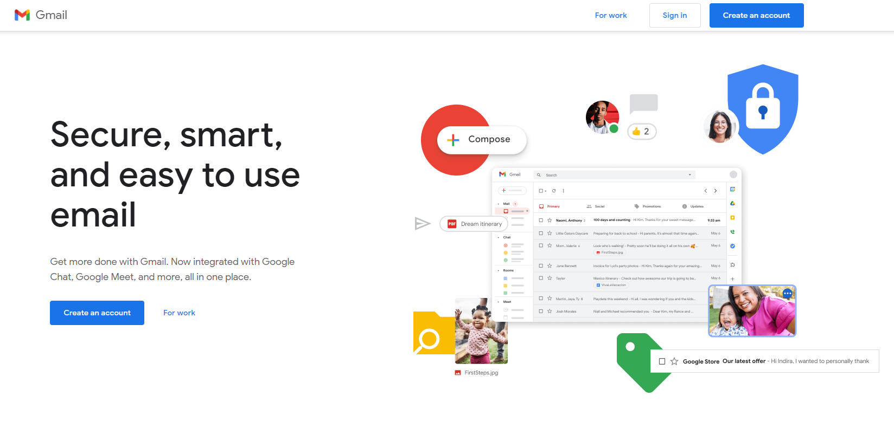
6. Your Email service will open in a new tab. Click “Sign in”.
sample-email@gmail.com.
Creating a Zoom Account | Creating a Zoom Meeting | Scheduling a Meeting | Summary

Slide 13
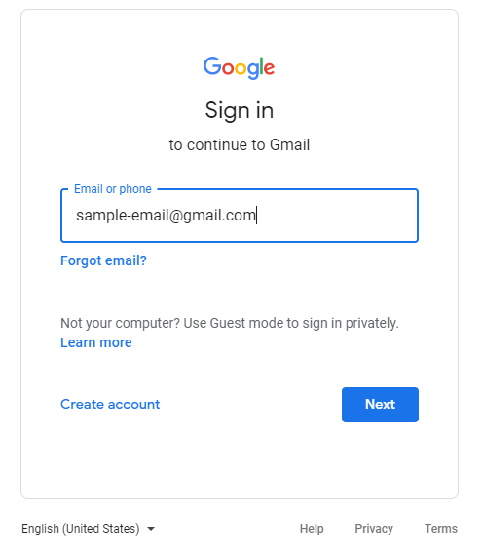
7. Sign in to your Email. Type your Email Address, then click “Next” to enter your password.
Creating a Zoom Account | Creating a Zoom Meeting | Scheduling a Meeting | Summary

Slide 14
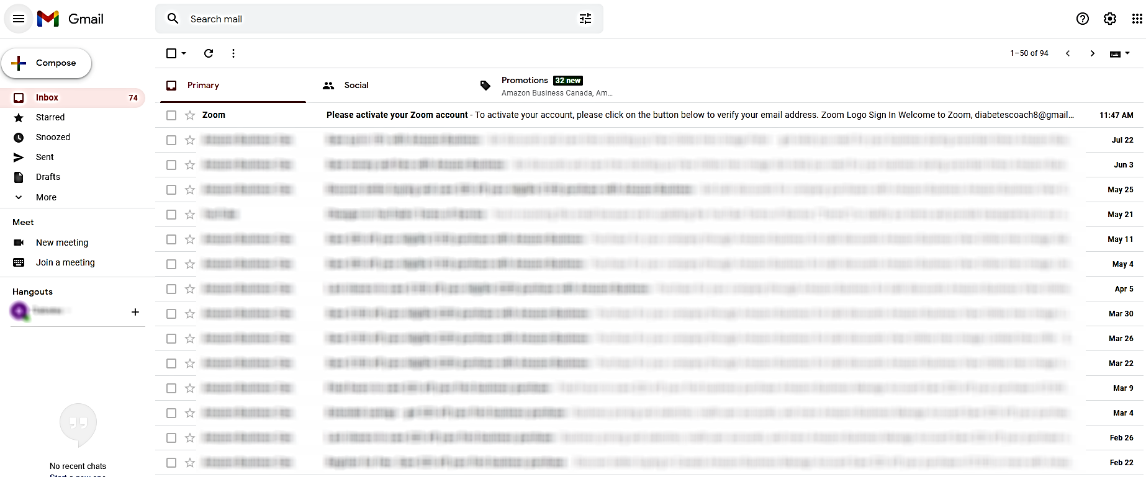
8. Click the Zoom activation email that you just received.
Creating a Zoom Account | Creating a Zoom Meeting | Scheduling a Meeting | Summary

Slide 15
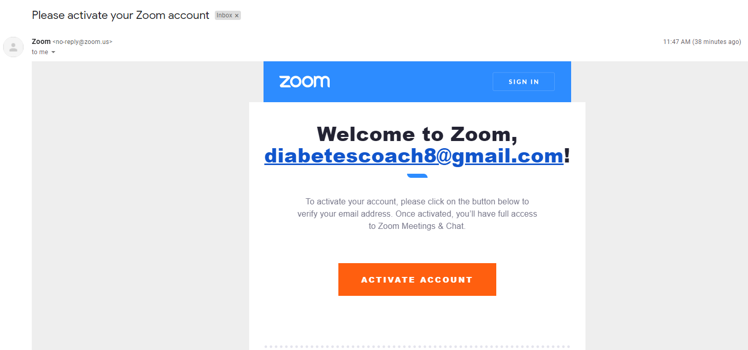
9. Click “Activate Account”.
sample-email@gmail.com!
Creating a Zoom Account | Creating a Zoom Meeting | Scheduling a Meeting | Summary

Slide 16
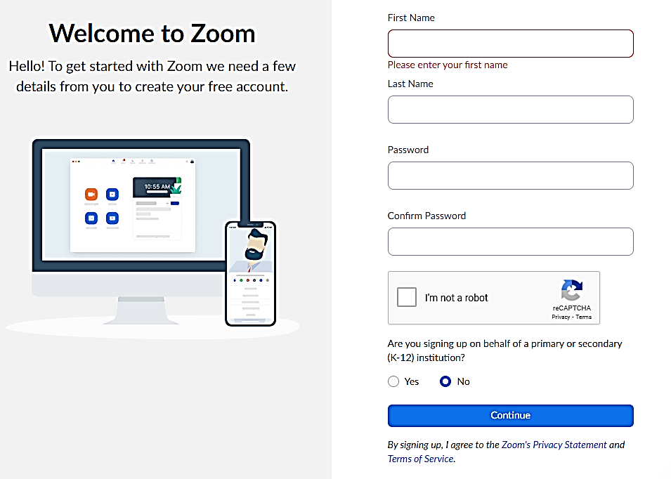
10. Enter your first and last name, create a password, click “I’m not a robot”, and then click “Continue”.
Creating a Zoom Account | Creating a Zoom Meeting | Scheduling a Meeting | Summary

Slide 17
Your password is a secret. Do not give your password to anyone.
Tips for remembering your password:
Write it down and store it in a safe location
If applicable, store it in your phone using the Notes app
If neither are possible, share it with ONLY one trusted person (e.g. a spouse or a child)
Creating a Zoom Account | Creating a Zoom Meeting | Scheduling a Meeting | Summary

Slide 18
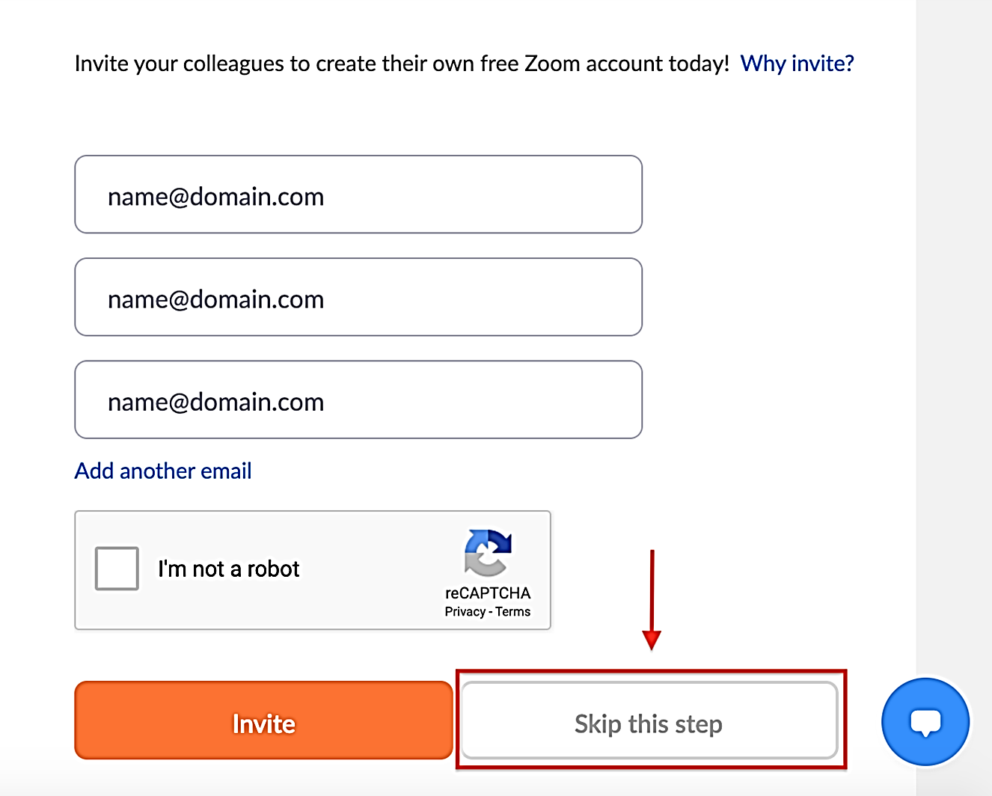
Click “Skip this step”.
✗ Do not give
other people’s
Email Addresses.
Creating a Zoom Account | Creating a Zoom Meeting | Scheduling a Meeting | Summary

Slide 19
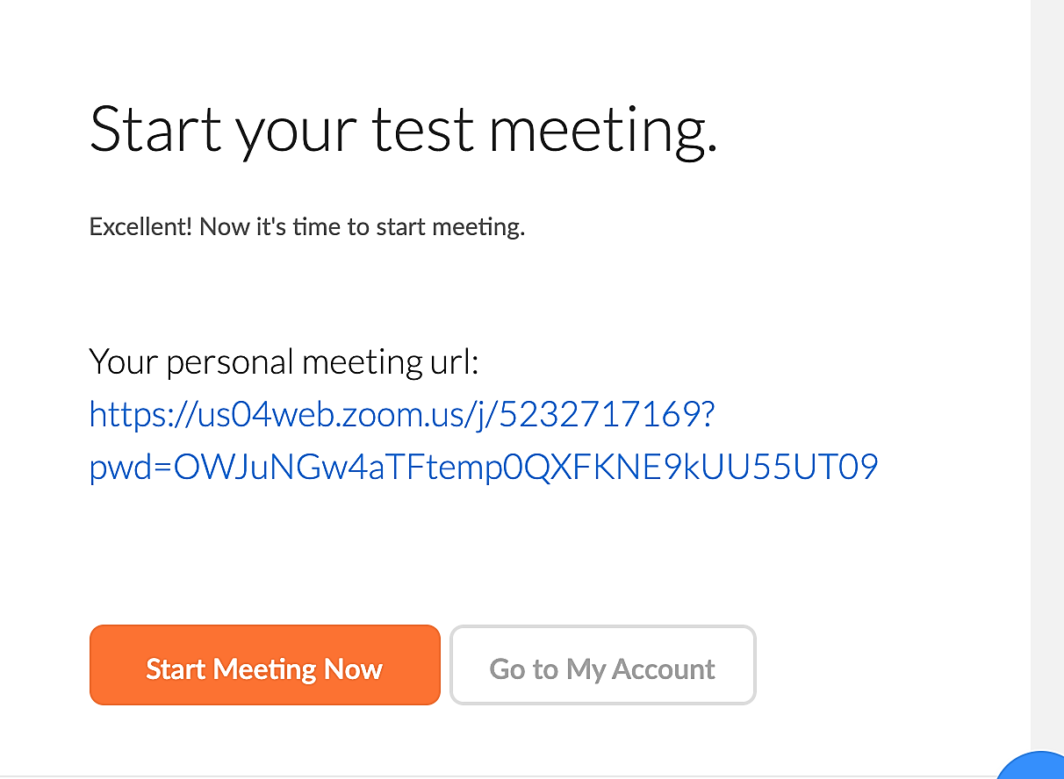
Your Zoom Account is now set up!
From here you may:
1. Start a meeting immediately
2. Visit your account
Creating a Zoom Account | Creating a Zoom Meeting | Scheduling a Meeting | Summary

Slide 20
Creating a Zoom Account: Summary
Download and install Zoom
Creating a Zoom Account | Creating a Zoom Meeting | Scheduling a Meeting | Summary

Slide 21
Creating a Zoom Account: Summary
Download and install Zoom
Choose a Zoom plan
Creating a Zoom Account | Creating a Zoom Meeting | Scheduling a Meeting | Summary

Slide 22
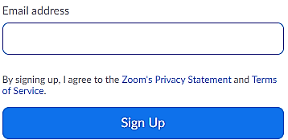
Creating a Zoom Account: Summary
Download and install Zoom
Choose a Zoom plan
Fill out the form to sign up
Creating a Zoom Account | Creating a Zoom Meeting | Scheduling a Meeting | Summary

Slide 23
Creating a Zoom Account: Summary
Download and install Zoom
Choose a Zoom plan
Fill out the form to sign up
Activate the account from your email
Creating a Zoom Account | Creating a Zoom Meeting | Scheduling a Meeting | Summary

Slide 24
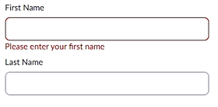
Creating a Zoom Account: Summary
Download and install Zoom
Choose a Zoom plan
Fill out the form to sign up
Activate the account from your email
Add your information to your account details (not private details)
Creating a Zoom Account | Creating a Zoom Meeting | Scheduling a Meeting | Summary

Slide 25
Creating a Zoom Account: Summary
Download and install Zoom
Choose a Zoom plan
Fill out the form to sign up
Activate the account from your email
Add your information to your account details (not private details)
You are ready to start a meeting!
Creating a Zoom Account | Creating a Zoom Meeting | Scheduling a Meeting | Summary

Slide 26
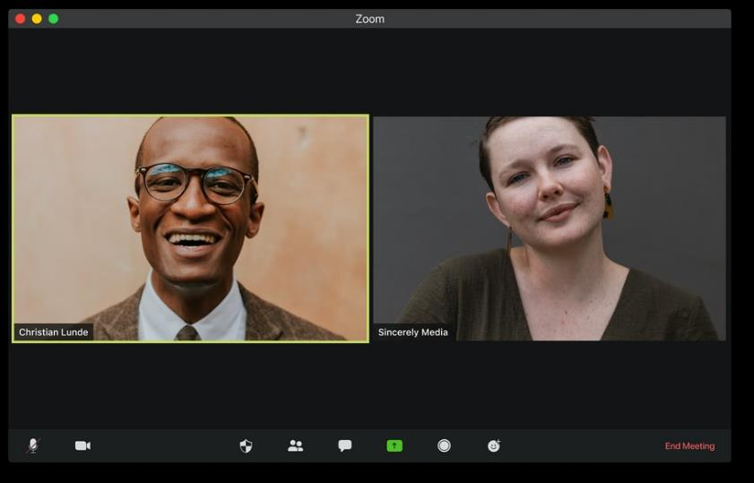
How to Create a Meeting Now
(Visuals, 2020)
Creating a Zoom Account | Creating a Zoom Meeting | Scheduling a Meeting | Summary

Slide 27
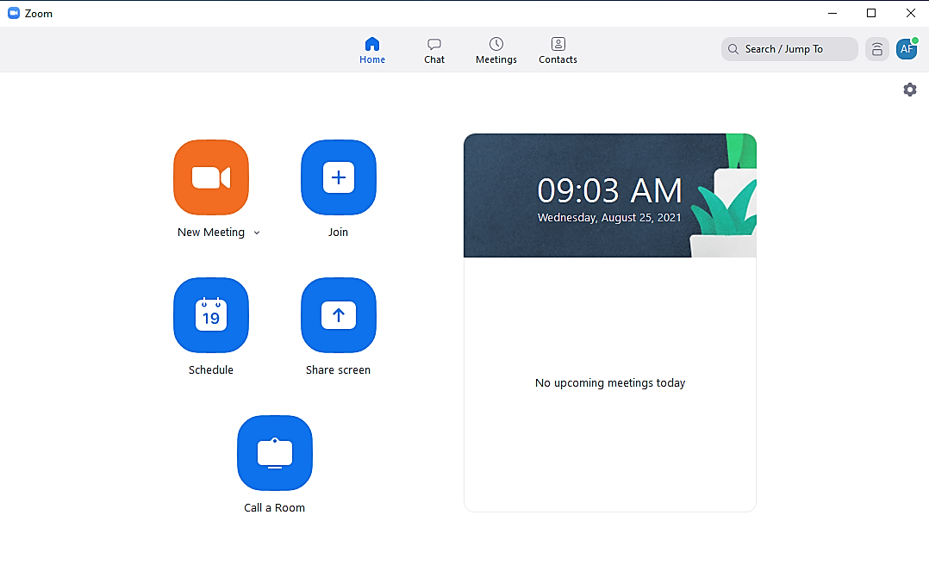
You can create 2 types of meetings:
A new meeting starts right away.
You can schedule a meeting to start any day or time.
For example, individuals could schedule a meeting next week with their caregiver to discuss health management goals.
Creating a Zoom Account | Creating a Zoom Meeting | Scheduling a Meeting | Summary

Slide 28
To start a meeting now, open Zoom.

Creating a Zoom Account | Creating a Zoom Meeting | Scheduling a Meeting | Summary

Slide 29
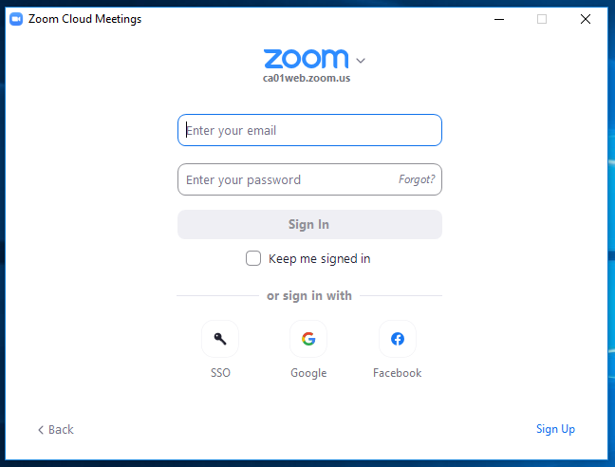
Sign in.
Creating a Zoom Account | Creating a Zoom Meeting | Scheduling a Meeting | Summary

Slide 30
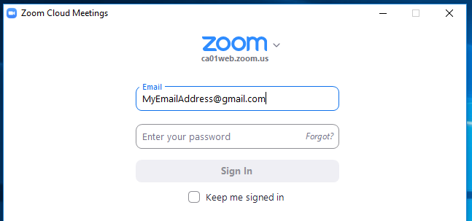
Type your email address.
Creating a Zoom Account | Creating a Zoom Meeting | Scheduling a Meeting | Summary

Slide 31
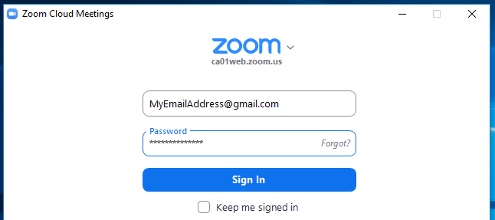
Type your password.
Creating a Zoom Account | Creating a Zoom Meeting | Scheduling a Meeting | Summary

Slide 32
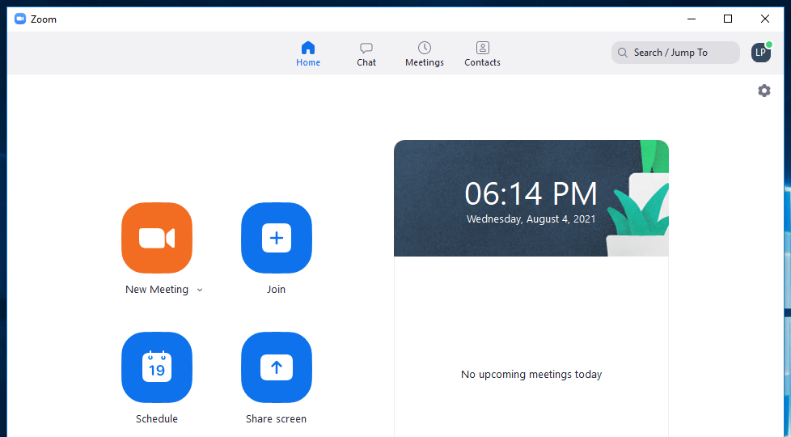
To start a meeting now, click “New Meeting”.
Creating a Zoom Account | Creating a Zoom Meeting | Scheduling a Meeting | Summary

Slide 33
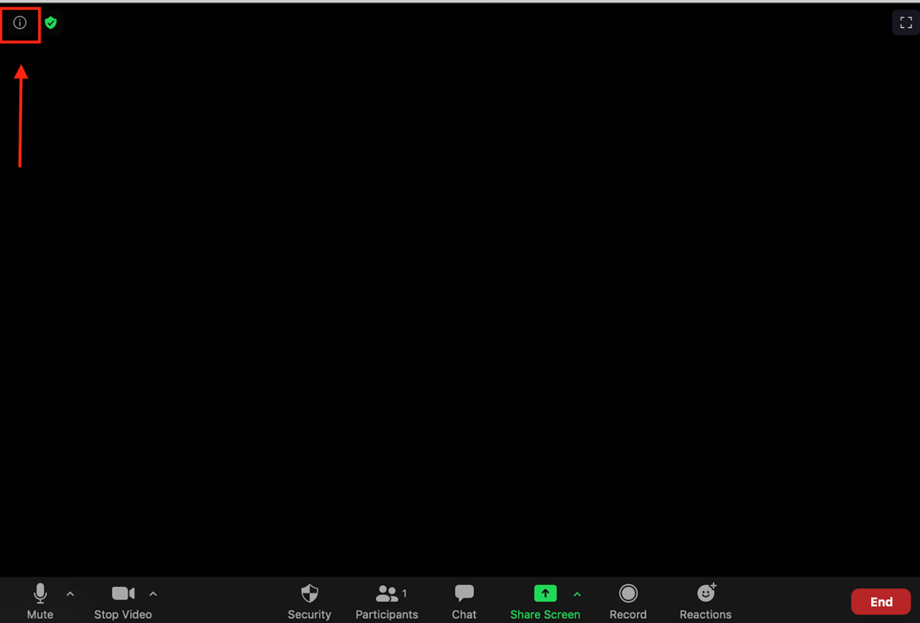
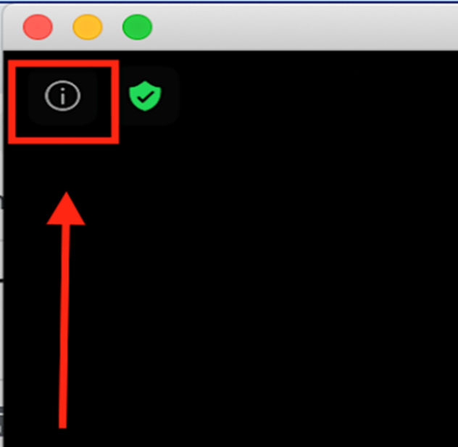
In the top left of your screen, you can see an info button. ⓘ
Click the information button.
Creating a Zoom Account | Creating a Zoom Meeting | Scheduling a Meeting | Summary

Slide 34
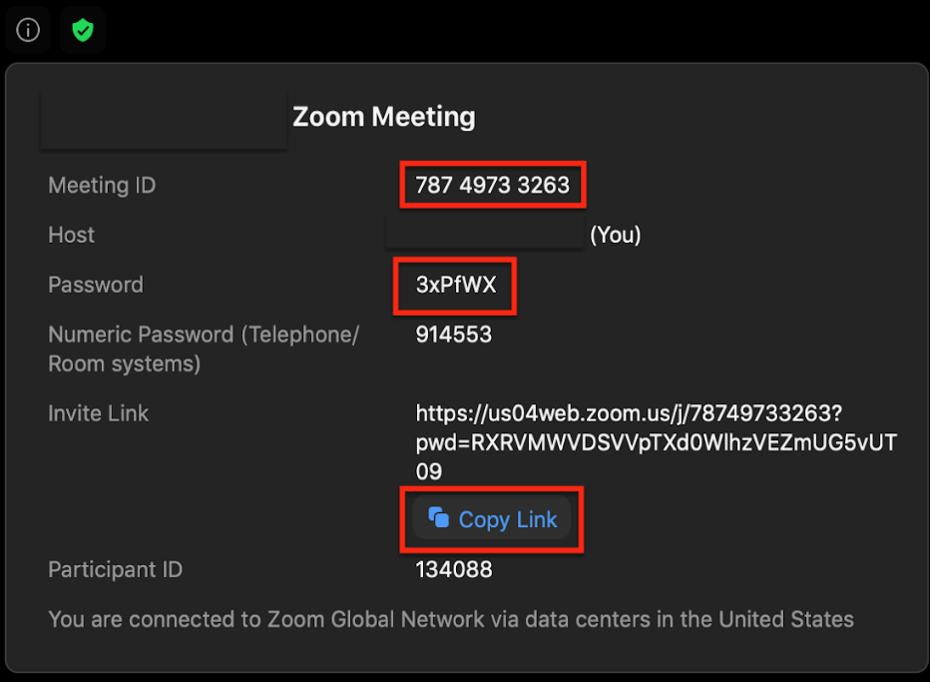
Copy the Zoom link. It will save the:
Link
Meeting ID
Password
Now you can email the link to other people!
Creating a Zoom Account | Creating a Zoom Meeting | Scheduling a Meeting | Summary

Slide 35
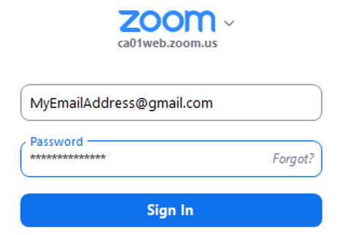
Creating a Zoom Meeting Now: Summary
Download, install and sign into your Zoom account
Creating a Zoom Account | Creating a Zoom Meeting | Scheduling a Meeting | Summary

Slide 36
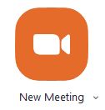
Creating a Zoom Meeting Now: Summary
Download, install and sign into your Zoom account
Select New Meeting
Creating a Zoom Account | Creating a Zoom Meeting | Scheduling a Meeting | Summary

Slide 37
Creating a Zoom Meeting Now: Summary
Download, install and sign into your Zoom account
Select New Meeting
Copy your meeting link
Creating a Zoom Account | Creating a Zoom Meeting | Scheduling a Meeting | Summary

Slide 38
Creating a Zoom Meeting Now: Summary
Download, install and sign into your Zoom account
Select New Meeting
Copy your meeting link
Email the meeting link to other people
Creating a Zoom Account | Creating a Zoom Meeting | Scheduling a Meeting | Summary

Slide 39
How to Schedule a Meeting for Later
Creating a Zoom Account | Creating a Zoom Meeting | Scheduling a Meeting | Summary

Slide 40
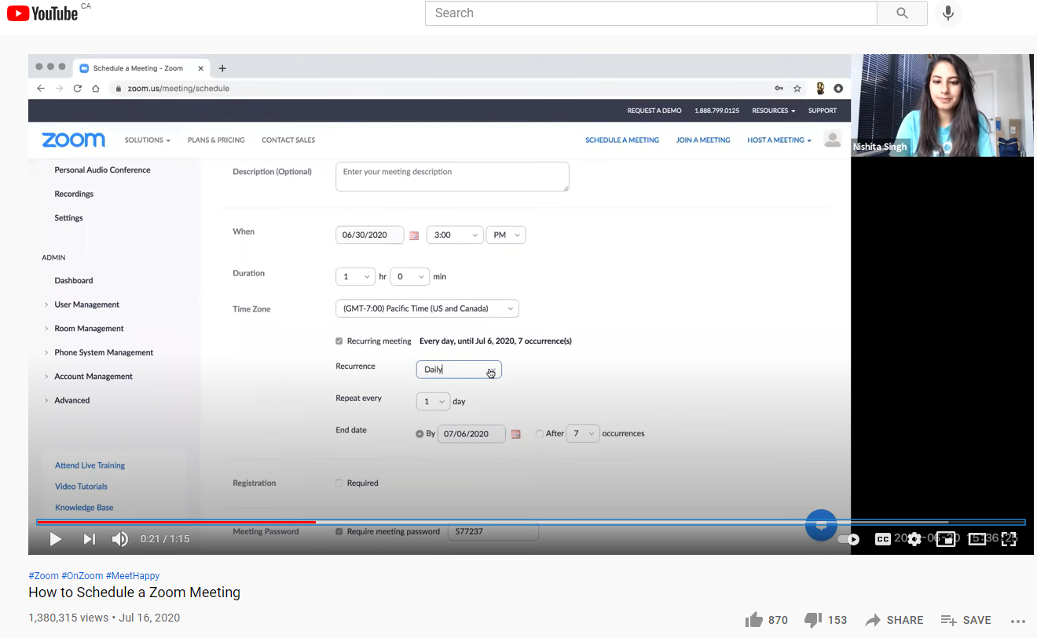
Video: How to Schedule a Zoom Meeting
Creating a Zoom Account | Creating a Zoom Meeting | Scheduling a Meeting | Summary
Notes:
https://www.youtube.com/watch?v=LE2w9tRpF4I

Slide 41
Scheduling a Meeting for Later: Summary
Open and sign in to Zoom
Creating a Zoom Account | Creating a Zoom Meeting | Scheduling a Meeting | Summary
Notes:
Please refer to the Beginner’s Guide to Zoom within the iCON Digital Health Literacy toolkit for more detailed guidelines on how to create Zoom meetings!

Slide 42
Scheduling a Meeting for Later: Summary
Open and sign in to Zoom
Select on Schedule to create a meeting and set the date and time
Creating a Zoom Account | Creating a Zoom Meeting | Scheduling a Meeting | Summary
Notes:
Please refer to the Beginner’s Guide to Zoom within the iCON Digital Health Literacy toolkit for more detailed guidelines on how to create Zoom meetings!

Slide 43
Scheduling a Meeting for Later: Summary
Open and sign in to Zoom
Select on Schedule to create a meeting and set the date and time
Copy your meeting link
Creating a Zoom Account | Creating a Zoom Meeting | Scheduling a Meeting | Summary
Notes:
Please refer to the Beginner’s Guide to Zoom within the iCON Digital Health Literacy toolkit for more detailed guidelines on how to create Zoom meetings!

Slide 44
Scheduling a Meeting for Later: Summary
Open and sign in to Zoom
Select on Schedule to create a meeting and set the date and time
Copy your meeting link
Email the meeting link to other people
Creating a Zoom Account | Creating a Zoom Meeting | Scheduling a Meeting | Summary
Notes:
Please refer to the Beginner’s Guide to Zoom within the iCON Digital Health Literacy toolkit for more detailed guidelines on how to create Zoom meetings!

Slide 45
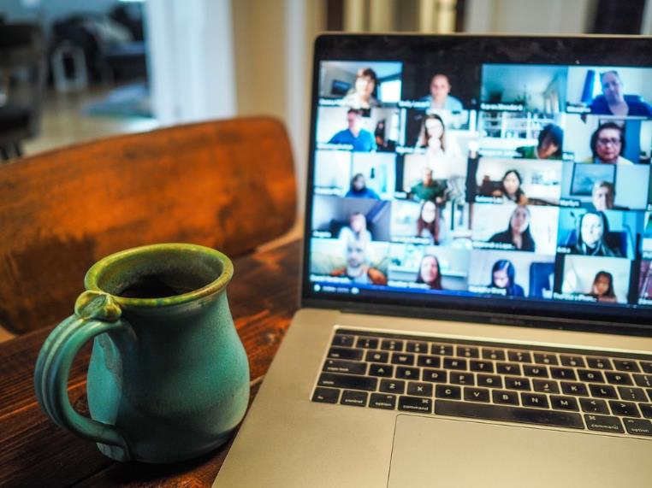
Summary
(Montgomery, 2020)
What is Zoom ? | Installing Zoom | Joining and Leaving | Join Without Installing | Summary

Slide 46
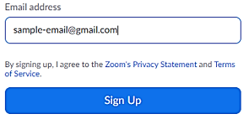
We learned :
Creating a Zoom Account
Creating a Meeting Now
Scheduling a Meeting for Later
What is Zoom ? | Installing Zoom | Joining and Leaving | Join Without Installing | Summary

Slide 47
We learned :
Creating a Zoom Account
Creating a Meeting Now
Scheduling a Meeting for Later
These skills can be very helpful if you are interested in organizing Zoom meetings. This could include meetings such as a discussion with your caregiver or group calls with friends from a support group.
What is Zoom ? | Installing Zoom | Joining and Leaving | Join Without Installing | Summary

Slide 48
Questions? Here are some examples of Free Resources for Health Management using Zoom:
iCON chronic disease management Zoom webinars (https://iconproject.org/events/)
Visit our website for upcoming events! Past webinar health topics include coping with chronic conditions at home, arthritis and osteoporosis, stroke, cardiovascular disease and diabetes, health eating, and many more!
Self Management BC virtual programs (https://www.selfmanagementbc.ca/virtualself-managementprograms)
A series of 6 Zoom workshops on self management topics including chronic conditions, chronic pain, diabetes, and cancer
Pain BC online pain support and wellness groups (https://painbc.ca/about/programs/pain-support-wellness-groups)
Zoom support groups hosted by a peer facilitator that support participants in feeling empowered by being in a community of people with a shared experience and provide information and learning about pain and coping
Family Caregivers of BC virtual support groups (https://www.familycaregiversbc.ca/family-caregiver-support-groups/)
Zoom support groups that connect people across BC twice a month around a mutual experience of caregiving for a family member or friend

Slide 49
Sources
Bernazzani, S. (2020, March 5). Everything You Need to Know About Using Zoom. Retrieved November 20, 2020, from https://www.owllabs.com/blog/zoom
Boyarsky, K. (2020) Everything You Need to Know About Hosting Zoom Webinars. OWLLabs. Retrieved November 30, 2020 from https://www.owllabs.com/blog/zoom-webinar
Osborne, C. (2020, May 15). The complete Zoom guide: From basic help to advanced tricks. Retrieved November 20, 2020, from https://www.zdnet.com/article/zoom-101-a-starter-guide-for-beginners-plus-advanced-tips-and-tricks-for-pros/
Tillman, M. (Ed.). (2020, November 26). What is Zoom and how does it work? Plus tips and tricks. Retrieved November 20, 2020, from https://www.pocket-lint.com/apps/news/151426-what-is-zoom-and-how-does-it-work-plus-tips-and-tricks
Zoom. (2020). Get More Out of Your Zoom Meetings. Retrieved November 30, 2020 from https://zoom.us/features
Zoom. (n.d.). Upgrade / update to the latest version. Retrieved November 20, 2020, from https://support.zoom.us/hc/en-us/articles/201362233-Upgrade-update-to-the-latest-version

Slide 50
Image Credit List
Author unknown. (n.d.). Zoom Clip Art Video Conferencing. Retrieved from: https://www.pinclipart.com/pindetail/ibhxxJb_fa-c-b-zoom-clip-art-video-conferencing/.
Montgomery, C. (2020.) Zoom call with coffee. Retrieved from: https://unsplash.com/photos/smgTvepind4.
Sugiharto, I. (2021). [No title]. Retrieved from: https://unsplash.com/photos/Eh1xd5xDE-s.
Visuals. (2020). Zoom (Video chat). Retrieved from: https://unsplash.com/photos/Y4qzW3AsvqI.
Note: screen captures were provided by Peteherych, L on slides 4-5, 27-33.
Note: screen captures were provided by iCON on slides 6-26, 34-43, 45.

Slide 51
Thank you again to :
Thank you to the BC Ministry of Health Patients as Partners Initiative for their support.

Slide 52
© 2020 The University of British Columbia.
The work is licensed under Creative Commons Attribution-Non-Commercial-No Derivatives 4.0 International License
(http://creativecommons.org/licenses/by-nc-nd/4.0/).
It was created by UBC Digital Emergency Medicine. For permissions to use this work for commercial purposes please contact The University of British Columbia’s University-Industry Liaison Office.

