Slide 1
How to Access Care Providers Virtually
iCON Digital Health Literacy, 2021
(Tia Health, n.d.)

Slide 2
Acknowledgements
This digital health literacy curriculum was developed by The University of British Columbia’s interCultural Online health Network (iCON).
iCON is supported by the B.C. Ministry of Health’s Patients as Partners initiative.
iCON has been working with multicultural communities for over 10 years.
iCON helps people with chronic disease self-management.
iCON also helps people develop digital literacy in order to access, assess, and use health resources online.
Thank you to the BC Ministry of Health Patients as Partners Initiative for their support.

Slide 3
Learning Objectives
Understand what “virtual care” means
Understand what can and cannot be done in a virtual care visit
Know resources to access care providers virtually
(Author unknown, n.d.)

Slide 4
What is Virtual Care?
(Tankilevitch, 2020)
What is Virtual Care? | How to Access Virtual Care | Protecting Your Privacy | Summary

Slide 5
Virtual Care
Virtual care is the direct delivery of care between a patient and a provider, at distance, using information and communication technology.
What is Virtual Care? | How to Access Virtual Care | Protecting Your Privacy | Summary

Slide 6
Virtual Care
Virtual care is the direct delivery of care between a patient and a provider, at distance, using information and communication technology
Virtual care can also refer to the communication between providers regarding the care of a patient.
What is Virtual Care? | How to Access Virtual Care | Protecting Your Privacy | Summary

Slide 7
Virtual Care
Virtual care is the direct delivery of care between a patient and a provider, at distance, using information and communication technology
Virtual care can also refer to the communication between providers regarding the care of a patient
Some care providers are offering a combination of in-person and virtual care visits, which is helpful for self-management of many health conditions
What is Virtual Care? | How to Access Virtual Care | Protecting Your Privacy | Summary

Slide 8
Virtual Care
Virtual care can be provided through different communication technologies, including, but is not limited to:
Video conferencing
Telephone
Text messaging
Email
What is Virtual Care? | How to Access Virtual Care | Protecting Your Privacy | Summary

Slide 9
What can be done virtually?
Some examples include:
Acute illness diagnosis
Prescriptions
Diagnostic procedures
Referrals to specialists
Managing chronic health conditions
What is Virtual Care? | How to Access Virtual Care | Protecting Your Privacy | Summary

Slide 10
Benefits of Virtual Care
Saves time
Can avoid visiting the ER for minor health problems
Decreases patient exposure to potential health risks
Easily accessible
What is Virtual Care? | How to Access Virtual Care | Protecting Your Privacy | Summary
Notes:
Some benefits of virtual care include:
Saving time (no travelling or waiting in the wait room). Often times you can book virtual appointments ahead of time by calling in.
Prevents crowding the Emergency room, allowing for more serious medical ailments to be focused on
Allows for health care without compromising the patients health in a high-risk environment (Risk factors for COVID19 include being over the age of 65, compromised immunity, or underlying medical conditions)
More accessible, removes certain barriers such as lack of mobility and distance. (especially for individuals that have trouble with transportation)

Slide 11
Limitations of Virtual Care
Reduced care continuity if you do not see your usual provider (similar to going to a walk-in clinic)
Dealing with emergencies
Clinical appropriateness
What is Virtual Care? | How to Access Virtual Care | Protecting Your Privacy | Summary
Notes:
Reduced Care Continuity
If you use on-demand virtual care services (i.e. seeking virtual care from any provider that is available the soonest), you are missing out on the care continuity found with your primary care provider
NOTE: If your primary care provider is accessible virtually, they should be seen first!
Dealing with emergencies
If a medical emergency arises, the care provider would need to direct you to a medical professional that can see you in-person
Clinical Appropriateness
Patients may use virtual care if it is clinically appropriate ( if no in person assessment is needed), but for certain things, providers will need to see patients in person

Slide 12
Emergencies
In a medical emergency, seek immediate medical attention by going to the Emergency Room OR call 911.
Some examples of medical emergencies:
Chest pain
Shortness of breath
Severe pain
Weakness
Severe bleeding
(Pixabay, 2015)
What is Virtual Care? | How to Access Virtual Care | Protecting Your Privacy | Summary

Slide 13
Virtual Care and Cultural Safety
Virtual care can facilitate cultural safety.
This can include health care providers and patients discussing what services and cultural practices may be included, as appropriate, safe, and possible, such as a discussion of traditional medicines.
(Hanlon, 2017)
What is Virtual Care? | How to Access Virtual Care | Protecting Your Privacy | Summary

Slide 14
Virtual Care and Cultural Safety
Virtual care can facilitate cultural safety.
This can also include family, community members, and interpreters in the virtual care visit as specified by the patient when booking an appointment.
(Fairytale, 2020)
What is Virtual Care? | How to Access Virtual Care | Protecting Your Privacy | Summary

Slide 15
How to Access Virtual Care:
Primary Care Providers (Family Physicians and Nurse Practitioners)
(Author unknown, n.d.)
What is Virtual Care? | How to Access Virtual Care | Protecting Your Privacy | Summary

Slide 16
Primary Care Providers
Many primary care providers (family physicians and nurse practitioners) now offer virtual care. You can call or email your provider to confirm if he or she provides virtual care.
Your provider will still have access to your medical files.
What is Virtual Care? | How to Access Virtual Care | Protecting Your Privacy | Summary

Slide 17
How to Access Virtual Care:
Urgent and Primary Care Centres (UPCC) and Walk-in Clinics
(Author unknown, n.d.)
What is Virtual Care? | How to Access Virtual Care | Protecting Your Privacy | Summary

Slide 18
Clinics: Important Notes
If you have a primary care provider (family physician or nurse practitioner), it is recommended that you see him or her for your health care needs.
(Author unknown, n.d.)
What is Virtual Care? | How to Access Virtual Care | Protecting Your Privacy | Summary

Slide 19
Clinics: Important Notes
If you have a primary care provider (family physician or nurse practitioner), it is recommended that you see him or her for your health care needs.
If you choose to visit a walk-in clinic, the provider at the urgent primary care centre or walk-in clinic does not have access to your health records.
(Author unknown, n.d.)
What is Virtual Care? | How to Access Virtual Care | Protecting Your Privacy | Summary

Slide 20
Clinics: Important Notes
If you have a primary care provider (family physician or nurse practitioner), it is recommended that you see him or her for your health care needs.
If you choose to visit another clinic, the provider does not have access to your health records.
You might not see the same provider even if you visit the same another clinic more than once. If you are seeking ongoing care, it is best to find a primary care provider who can follow your care long-term.
(Author unknown, n.d.)
What is Virtual Care? | How to Access Virtual Care | Protecting Your Privacy | Summary

Slide 21
How to Access Clinics
The HealthLink B.C. website can display a list of urgent and primary care centres or walk-in clinics.
What is Virtual Care? | How to Access Virtual Care | Protecting Your Privacy | Summary

Slide 22
How to Access Walk-in Clinics
The HealthLink B.C. website can display a list of urgent and primary care centres and walk-in clinics.
You may review this list to locate centre closer to your community.
What is Virtual Care? | How to Access Virtual Care | Protecting Your Privacy | Summary

Slide 23
How to Access Walk-in Clinics
The HealthLink B.C. website can display a list of walk-in clinics.
You may review this list to locate a walk-in clinic closer to your community.
After finding a clinic or provider on the website, you can call or email them to ask if they offer virtual care, in-person care, or a combination of both.
What is Virtual Care? | How to Access Virtual Care | Protecting Your Privacy | Summary

Slide 24
How to Access Walk-in Clinics
Let’s practice finding a clinic in Vancouver!
What is Virtual Care? | How to Access Virtual Care | Protecting Your Privacy | Summary

Slide 25
How to Access Virtual Care:
British Columbia Health Care Directory
What is Virtual Care? | How to Access Virtual Care | Protecting Your Privacy | Summary

Slide 26
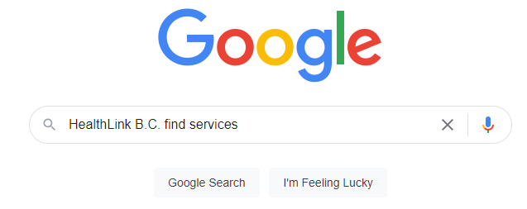
British Columbia Health Care Directory
Go to the internet using your browser.
Type “HealthLink B.C. find services” in the search bar.
Click “Google Search”.
What is Virtual Care? | How to Access Virtual Care | Protecting Your Privacy | Summary

Slide 27
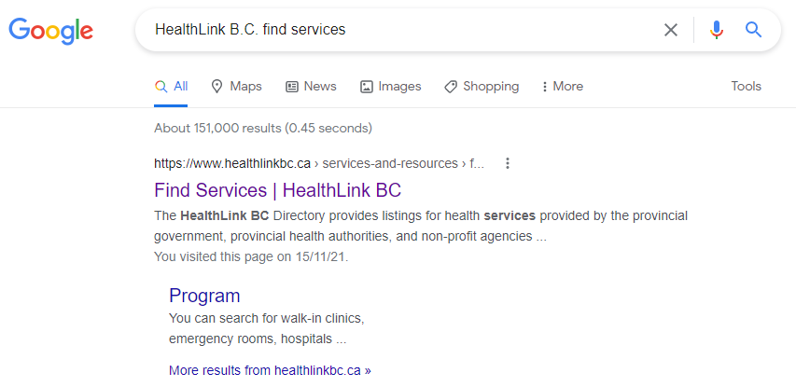
HealthLink B.C. Directory
4. Click “Find Services | HealthLink BC”.
What is Virtual Care? | How to Access Virtual Care | Protecting Your Privacy | Summary

Slide 28
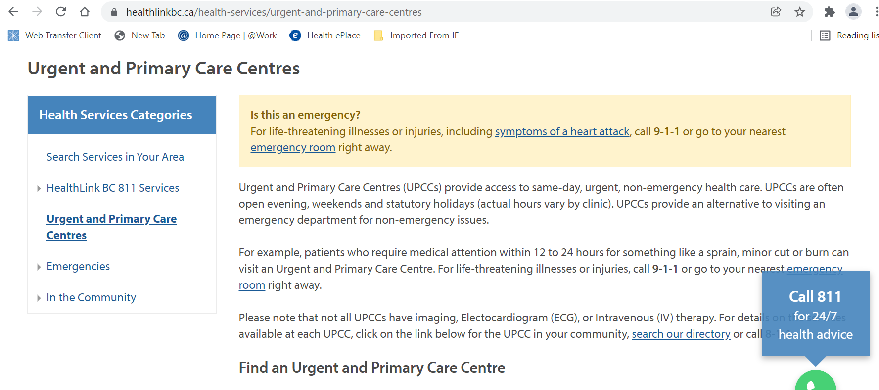
HealthLink B.C. Directory
5. Enter the type of facility you require (walk in clinic, hospital, etc.).
6. Select your region and city. The Postal Code is optional.
7. Click “Search”.
What is Virtual Care? | How to Access Virtual Care | Protecting Your Privacy | Summary

Slide 29
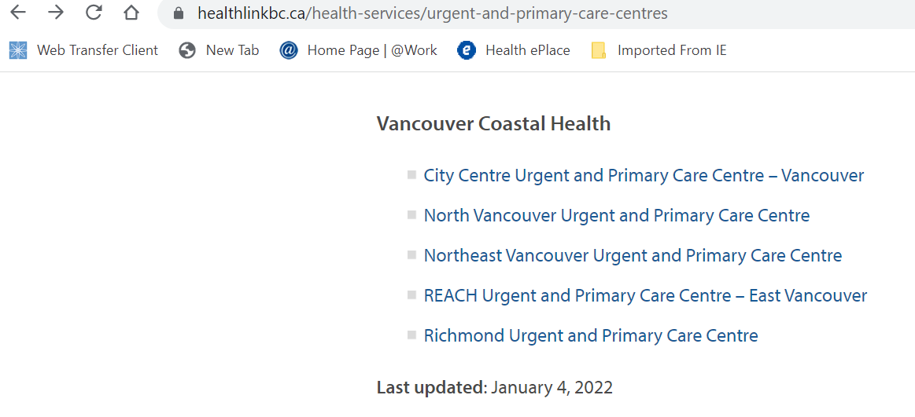
HealthLink B.C. Directory
8. Choose the facility you prefer and click on the facility for more details.
What is Virtual Care? | How to Access Virtual Care | Protecting Your Privacy | Summary

Slide 30
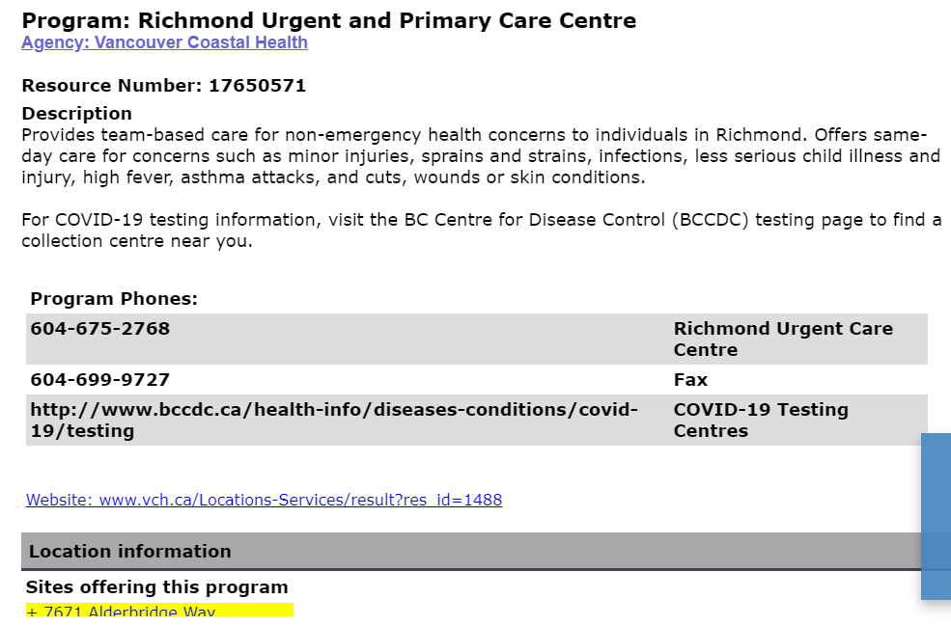
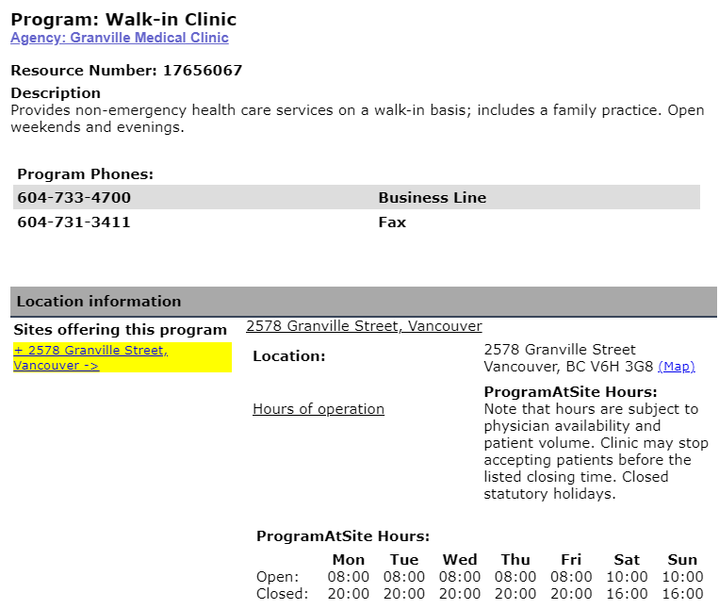
HealthLink B.C. Directory
9. You can call the number and ask if they provide virtual care.
What is Virtual Care? | How to Access Virtual Care | Protecting Your Privacy | Summary

Slide 31
HealthLink B.C. Directory
You can also follow the same steps to search for walk-in clinics
What is Virtual Care? | How to Access Virtual Care | Protecting Your Privacy | Summary

Slide 32
How to Access Virtual Care:
Pathways Medical Care Directory
What is Virtual Care? | How to Access Virtual Care | Protecting Your Privacy | Summary
Notes:
The Pathways Medical Care Directory also provides an online directory to find information about doctors and medical clinics in B.C.
It can also help patients find details of how to connect with doctors for virtual care by phone or video

Slide 33
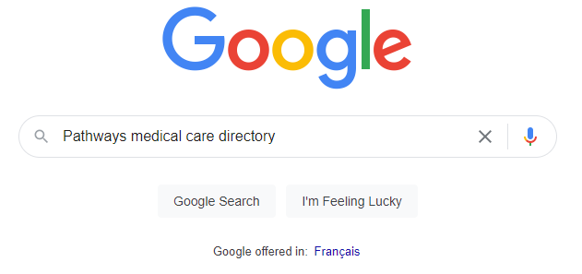
Pathways Medical Care Directory
Go to the internet using your browser.
Type “Pathways medical care directory” in the search bar.
Click “Google Search”.
What is Virtual Care? | How to Access Virtual Care | Protecting Your Privacy | Summary

Slide 34
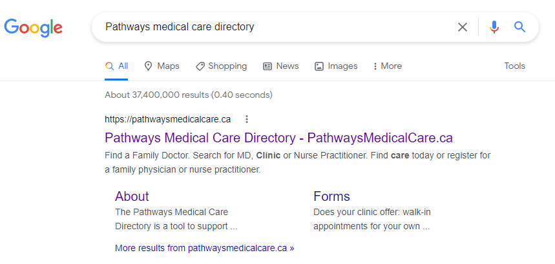
Pathways Medical Care Directory
4. Click on “Pathways Medical Care Directory – PathwaysMedicalCare.ca”
What is Virtual Care? | How to Access Virtual Care | Protecting Your Privacy | Summary

Slide 35
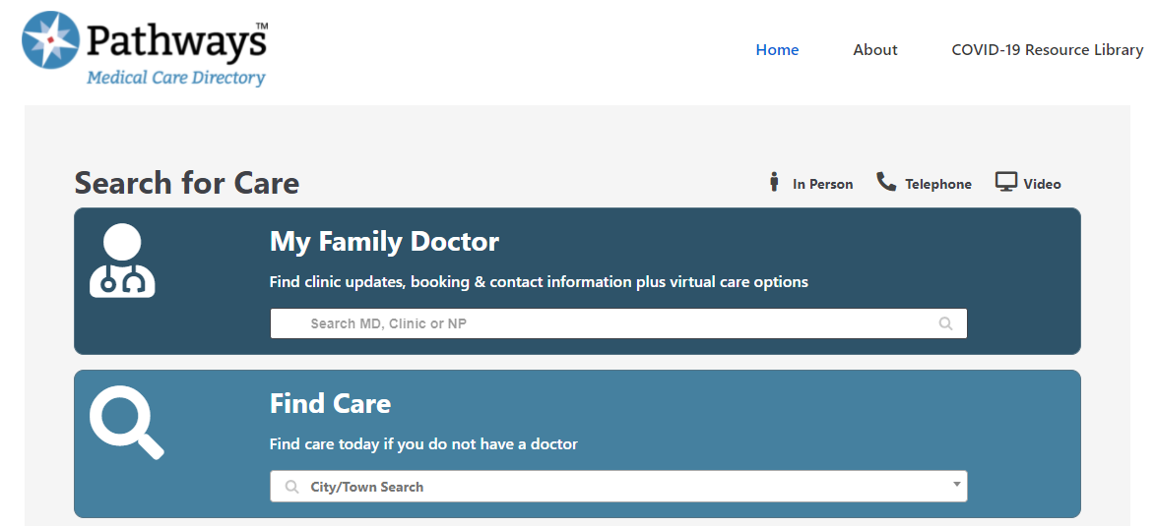
Pathways Medical Care Directory
5. Enter the name of your provider/clinic OR enter a city to find a provider
What is Virtual Care? | How to Access Virtual Care | Protecting Your Privacy | Summary

Slide 36
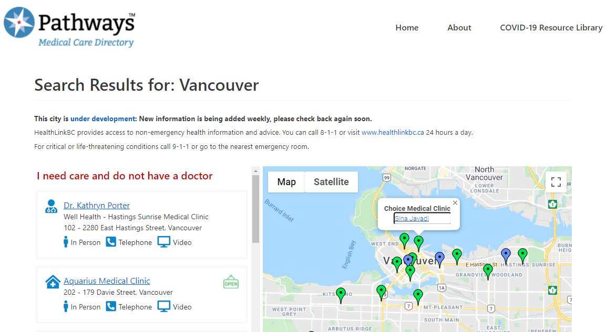
Pathways Medical Care Directory
6. Choose a provider or clinic and click on the hyperlink to view more information.
What is Virtual Care? | How to Access Virtual Care | Protecting Your Privacy | Summary

Slide 37
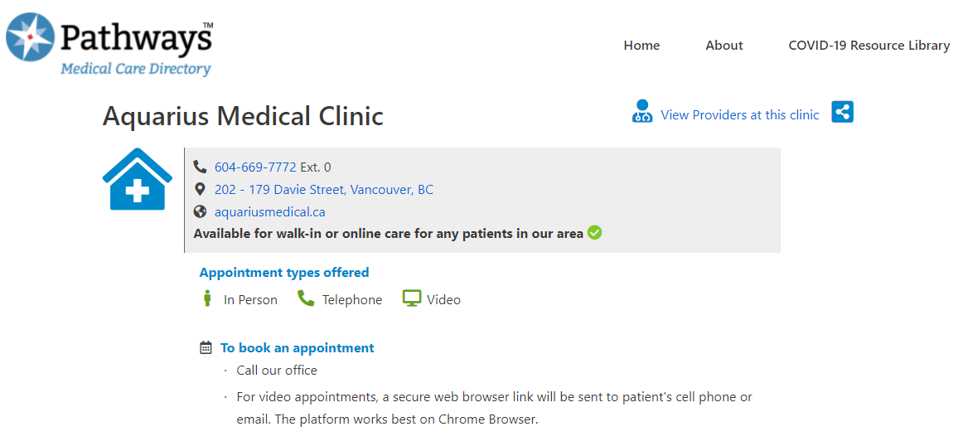
Pathways Medical Care Directory
7. You can find details on in-person and virtual care offerings, ways to book an appointment, and hours of operation.
What is Virtual Care? | How to Access Virtual Care | Protecting Your Privacy | Summary

Slide 38
Protecting Your Privacy:
Virtual Care Guidelines
(Author unknown, n.d.)
What is Virtual Care? | How to Access Virtual Care | Protecting Your Privacy | Summary

Slide 39
Protecting Your Privacy
Health care providers follow requirements of their colleges, associations, and B.C. laws regarding in-person and virtual care.
What is Virtual Care? | How to Access Virtual Care | Protecting Your Privacy | Summary
Notes:
British Columbia sets rules and regulations to ensure the safety of patients and provide quality healthcare.
A 22-page guidelines by Provincial Health Services Authority (PHSA) keeps patients informed with information related to telemedicine.
example of one of the guidelines is provided one the slide
For the complete list, you can visit: http://www.phsa.ca/Documents/Telehealth/TH_Clinical_Guidelines_Sept2015.pdf
This link (optional to open) provides a detailed structure of all the practice standards that have been enforced by the College of Physicians and Surgeons of British Columbia in relation to telemedicine. If an individual wishes to speak about any issues, they can contact the College and can speak to a member of the College to seek medical advice. The link to access the document is - https://www.cpsbc.ca/files/pdf/PSG-Telemedicine.pdf

Slide 40
Protecting Your Privacy
Health care providers follow requirements of their colleges, associations, and B.C. laws regarding in-person and virtual care.
For example, British Columbia Medical Association provides guidelines for physicians providing virtual care, including resources that:
What is Virtual Care? | How to Access Virtual Care | Protecting Your Privacy | Summary
Notes:
British Columbia sets rules and regulations to ensure the safety of patients and provide quality healthcare.
A 22-page guidelines by Provincial Health Services Authority (PHSA) keeps patients informed with information related to telemedicine.
example of one of the guidelines is provided one the slide
For the complete list, you can visit: http://www.phsa.ca/Documents/Telehealth/TH_Clinical_Guidelines_Sept2015.pdf
This link (optional to open) provides a detailed structure of all the practice standards that have been enforced by the College of Physicians and Surgeons of British Columbia in relation to telemedicine. If an individual wishes to speak about any issues, they can contact the College and can speak to a member of the College to seek medical advice. The link to access the document is - https://www.cpsbc.ca/files/pdf/PSG-Telemedicine.pdf

Slide 41
Protecting Your Privacy
Health care providers follow requirements of their colleges, associations, and B.C. laws regarding in-person and virtual care.
For example, British Columbia Medical Association provides guidelines for physicians providing virtual care, including resources that:
Identify security safeguards to use when providing virtual care
What is Virtual Care? | How to Access Virtual Care | Protecting Your Privacy | Summary
Notes:
British Columbia sets rules and regulations to ensure the safety of patients and provide quality healthcare.
A 22-page guidelines by Provincial Health Services Authority (PHSA) keeps patients informed with information related to telemedicine.
example of one of the guidelines is provided one the slide
For the complete list, you can visit: http://www.phsa.ca/Documents/Telehealth/TH_Clinical_Guidelines_Sept2015.pdf
This link (optional to open) provides a detailed structure of all the practice standards that have been enforced by the College of Physicians and Surgeons of British Columbia in relation to telemedicine. If an individual wishes to speak about any issues, they can contact the College and can speak to a member of the College to seek medical advice. The link to access the document is - https://www.cpsbc.ca/files/pdf/PSG-Telemedicine.pdf

Slide 42
Protecting Your Privacy
Health care providers follow requirements of their colleges, associations, and B.C. laws regarding in-person and virtual care.
For example, British Columbia Medical Association provides guidelines for physicians providing virtual care, including resources that:
Identify security safeguards to use when providing virtual care
Summarize the risks and benefits of using mobile devices to provide health care services
What is Virtual Care? | How to Access Virtual Care | Protecting Your Privacy | Summary
Notes:
British Columbia sets rules and regulations to ensure the safety of patients and provide quality healthcare.
A 22-page guidelines by Provincial Health Services Authority (PHSA) keeps patients informed with information related to telemedicine.
example of one of the guidelines is provided one the slide
For the complete list, you can visit: http://www.phsa.ca/Documents/Telehealth/TH_Clinical_Guidelines_Sept2015.pdf
This link (optional to open) provides a detailed structure of all the practice standards that have been enforced by the College of Physicians and Surgeons of British Columbia in relation to telemedicine. If an individual wishes to speak about any issues, they can contact the College and can speak to a member of the College to seek medical advice. The link to access the document is - https://www.cpsbc.ca/files/pdf/PSG-Telemedicine.pdf

Slide 43
Protecting Your Privacy
Health care providers follow requirements of their colleges, associations, and B.C. laws regarding in-person and virtual care.
For example, British Columbia Medical Association provides guidelines for physicians providing virtual care, including resources that:
Identify security safeguards to use when providing virtual care
Summarize the risks and benefits of using mobile devices to provide health care services
Identify requirements and best practices for using mobile devices
What is Virtual Care? | How to Access Virtual Care | Protecting Your Privacy | Summary
Notes:
British Columbia sets rules and regulations to ensure the safety of patients and provide quality healthcare.
A 22-page guidelines by Provincial Health Services Authority (PHSA) keeps patients informed with information related to telemedicine.
example of one of the guidelines is provided one the slide
For the complete list, you can visit: http://www.phsa.ca/Documents/Telehealth/TH_Clinical_Guidelines_Sept2015.pdf
This link (optional to open) provides a detailed structure of all the practice standards that have been enforced by the College of Physicians and Surgeons of British Columbia in relation to telemedicine. If an individual wishes to speak about any issues, they can contact the College and can speak to a member of the College to seek medical advice. The link to access the document is - https://www.cpsbc.ca/files/pdf/PSG-Telemedicine.pdf

Slide 44
Summary:
(Kamleshverm, 2021)
What is Virtual Care? | How to Access Virtual Care | Protecting Your Privacy | Summary

Slide 45
Summary
You can access virtual care through:
Family Physicians (or other Primary Care Providers)
Pathways Medical Care Directory
HealthLink B.C. Directory
UPCC and Walk-in Clinics
What is Virtual Care? | How to Access Virtual Care | Protecting Your Privacy | Summary

Slide 46
Summary
For any health issue usually addressed by your primary care provider:
Call or email to book an appointment with your provider
What is Virtual Care? | How to Access Virtual Care | Protecting Your Privacy | Summary

Slide 47
Summary
For any health issue usually addressed by your primary care provider:
Call or email to book an appointment with your provider
If virtual care is offered, your provider will share details on how to join your appointment (for example, clicking a link or receiving a phone call from your doctor)
What is Virtual Care? | How to Access Virtual Care | Protecting Your Privacy | Summary

Slide 48
Summary
For any health issue usually addressed by your primary care provider:
Call or email to book an appointment with your provider
If virtual care is offered, your provider will share details on how to join your appointment (for example, clicking a link or receiving a phone call from your doctor)
Although some health care needs can be met virtually, if you prefer to see your provider in-person, you should tell your provider
What is Virtual Care? | How to Access Virtual Care | Protecting Your Privacy | Summary

Slide 49
Summary
Remember, in case of a medical emergency:
Seek IMMEDIATE assistance
Go to the Emergency Room OR call 911
What is Virtual Care? | How to Access Virtual Care | Protecting Your Privacy | Summary

Slide 50
Questions?
HealthLink B.C. Directory https://www.healthlinkbc.ca/services-and-resources/find-services
Pathways Medical Care Directory https://pathwaysmedicalcare.ca/
What is Virtual Care? | How to Access Virtual Care | Protecting Your Privacy | Summary

Slide 51
Image Credits
Fairytale, E. (2020). Portrait Of A Mother And Daughter Together. Retrieved from: https://www.pexels.com/photo/portrait-of-a-mother-and-daughter-together-3893723/
Hanlon, K. (2017). [No title]. Retrieved from: https://unsplash.com/photos/9-Hgi9w9bDM
Kamleshverm. (2021). [No title]. Retrieved from: https://pixabay.com/photos/online-consultation-virtual-laptop-5901524/
Pixabay. (2015). Emergency Signage. Retrieved from: https://www.pexels.com/photo/ambulance-architecture-building-business-263402/
Tankilevitch, P. (2020). Side View of a Person Holding an iPad. Retrieved from: https://www.pexels.com/photo/side-view-of-a-person-holding-an-ipad-5234505/
Author unknown. (n.d.). Talk To Doctor On Mobile Clipart. Retrieved from: https://www.pinclipart.com/pindetail/ibiTRxm_talk-to-doctor-on-mobile-clipart/
Author unknown. (n.d.). Clinical Trial Icon Clipart. Retrieved from: https://www.pinclipart.com/pindetail/ibxbwRR_clinical-trial-icon-clipart/
Author unknown. (n.d.). Open Clinic - Transparent Background Doctor Icon Png Clipart. Retrieved from: https://www.pinclipart.com/pindetail/ibTmToh_open-clinic-transparent-background-doctor-icon-png-clipart/
Author unknown. (n.d.). Learn Icon - Easy To Learn Icon Clipart. Retrieved from: https://www.pinclipart.com/pindetail/iTJoTxx_learn-icon-easy-to-learn-icon-clipart/
Note: screen captures were provided by iCON on slides 24-35, 43, 48.

Slide 52
Thank you again to :
Thank you to the BC Ministry of Health Patients as Partners Initiative for their support.

Slide 53
© 2020 The University of British Columbia.
The work is licensed under Creative Commons Attribution-Non-Commercial-No Derivatives 4.0 International License
(http://creativecommons.org/licenses/by-nc-nd/4.0/).
It was created by UBC Digital Emergency Medicine. For permissions to use this work for commercial purposes please contact The University of British Columbia’s University-Industry Liaison Office.

