Slide 1
如何上網查看個人健康記錄
iCON Digital Health Literacy, 2023

Slide 2
鳴謝
該數碼健康知識課程由卑詩大學的「安康」健康網絡 (iCON) 製作
「安康」健康網絡得到卑詩省衛生廳的「患者為伴」計劃的支持
「安康」健康網絡與各多元文化社區合作已超過十年
「安康」健康網絡幫助慢性病患者進行自我管理
「安康」健康網絡亦幫助大家普及數碼知識，以便他們獲取、評估和使用網上的健康資源
Thank you to the BC Ministry of Health Patients as Partners Initiative for their support.

Slide 3
學習目標
了解什麼是個人健康資訊以及如何上網查看個人健康記錄
瞭解您的網上個人健康記錄是如何被保護
了解電子健康紀錄及其使用方法
(Author unknown, n.d.)

Slide 4
大綱
什麼是個人健康資訊？
如何上網查看您的個人健康資訊？
例如：上網查看檢驗結果
如何保護您的網上個人健康資訊？ 例如：Health Gateway電子健康紀錄
(Author unknown, n.d.)

Slide 5
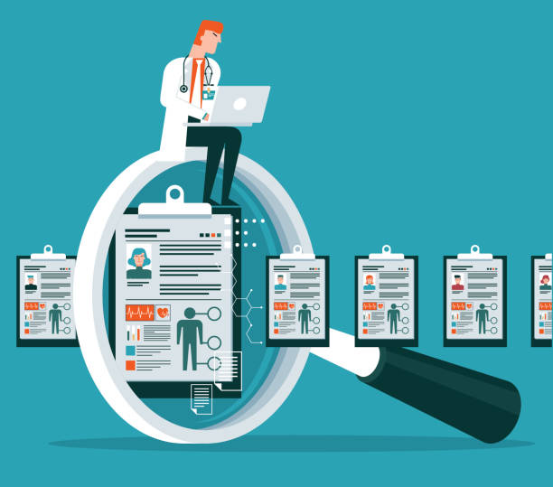
什麼是個人健康資訊？

Slide 6
什麼是個人健康資訊？
個人健康資訊是任何可用於識別您的身份，並能連結有關您個人醫療記錄的敏感資訊

Slide 7
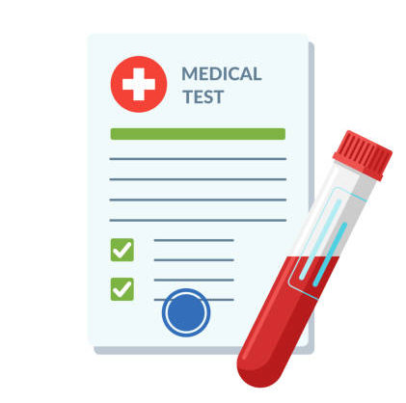
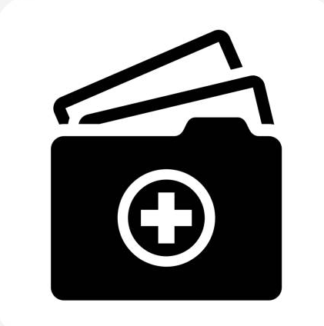
什麼是個人健康資訊？
病歷
藥物
檢驗結果
疫苗接種紀錄
保健服務
識別個人資料

Slide 8
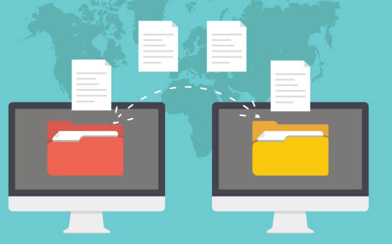
您的個人健康資訊是如何被儲存的？
您的個人健康資訊通常會被診所、醫院或其他醫療機構儲存為健康紀錄。醫療機構會利用這些健康紀錄來助您管理健康或了解您的病歷
Notes:
Note regarding records being stored convenient location: Each of your health care provider might store your health records in their own system. For example, your family doctor and cardiologist each have their own records. Pictures to cue speaker: Traditionally, your health records are stored as physical files at your health care provider’s office for them to access while providing care. The manner of storing data this way makes it challenging to keep track of your records, especially if you switch providers, or access alternative points of care.

Slide 9
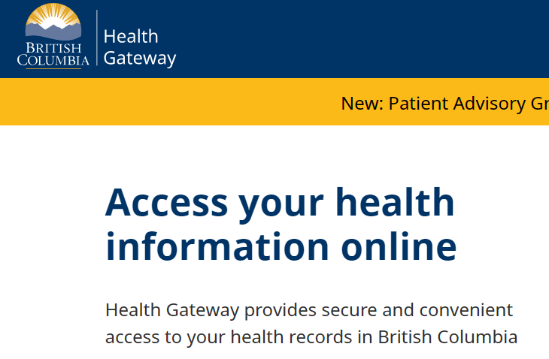
您曾經嘗試過上網查看您的個人健康資訊嗎？
Notes:
Used by care providers: speaker to elaborate
Used by patients/caregivers: Have you ever gone online to check your lab report? If you have, you are already using health data platforms. Depending on which health data platform you use, you can assess a range of information, like your test results, immunization records, prescription etc

Slide 10
如何上網查看個人健康記錄?

Slide 11
如何上網查看個人健康記錄?
您能使用一系列的網上健康資訊平台和健康資訊工具來查看您的個人健康資訊。這些平台和工具能儲存和整理您的個人健康資訊。
健康資訊平台是由值得信賴的健康機構提供，用於瀏覽網上個人健康資訊，例如測試結果和病歷。
健康資訊工具讓您能在自己的電子設備上輸入及管理您的個人健康資訊。
Notes:
Speaker should mention that the focus of the presentation will be on health information platforms.
Note: Speaker should refrain from interchanging the terms health information tools and health information platform during the presentation

Slide 12
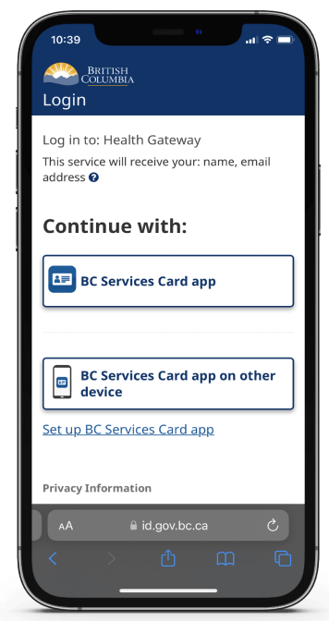
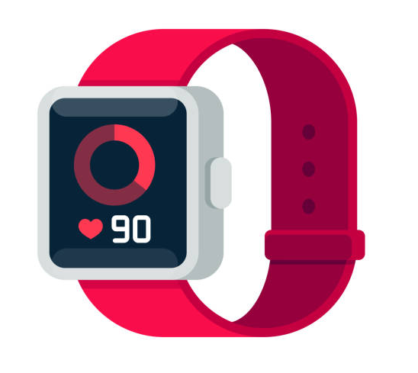
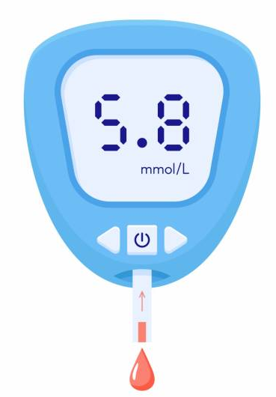
上網查看您的個人健康資訊
平台
工具
Notes:
Highlight differences between health information platforms and health information tools using the example on the slides

Slide 13
上網查看您的個人健康資訊
平台
工具
Notes:
Emphasis that the focus of the presentation will be on health information platforms
As a user of the health information platforms, your view of the platform looks different than that of your health care provider. While your version of the platform allows you to view a summary of your heath records, your health care provider has complete access to your health records and will have the ability to change your health record (example: add a prescription to your records)

Slide 14
上網查看您的個人健康資訊的好處
輕鬆快捷地存取您的個人健康資訊
十分方便，因所有資訊都存在一個位置
由於容易存取更多您的個人健康資訊 ，故有助您管理健康
鼓勵患者參與管理健康的過程

Slide 15
上網查看您的個人健康資訊的限制
電子平台仍在擴展中，從而包含更多類型的健康資訊。所以目前未必能夠找到所有健康資訊。
隨著平台不斷更新，需要持續學習如何使用。
當您在網上查看結果時，缺乏臨床指導和解釋（在與醫療保健提供者討論結果之前）。
與實體健康記錄相比，您需要採取不同的防護措施來保個人健康資訊 。
Notes:
Some examples during the presentation to illustrate this: E.g. imaging may be available in the future, having no clinical guidance and explanation can sometimes cause anxiety in patients and patients starting to use Dr. Google, doctors now need to stay even more updated on what the general public may know about diagnoses/treatment; elaborate on what is meant by the different precautions needed to protect personal health information e.g. privacy concerns

Slide 16
例子：上網查看您的檢測結果
(Tankilevitch, 2020)

Slide 17
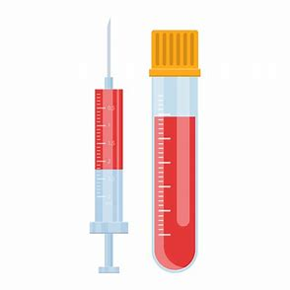
哪些檢測結果可上網取得？
視乎您在那裏完成檢測，有多個平台讓你查看結果。
其中包括：
尿液及血液測試
宮頸癌或結腸癌篩查
病理學測試
Notes:
Give examples of the different platforms available to view your lab results: mycarecompass, health gateway etc

Slide 18
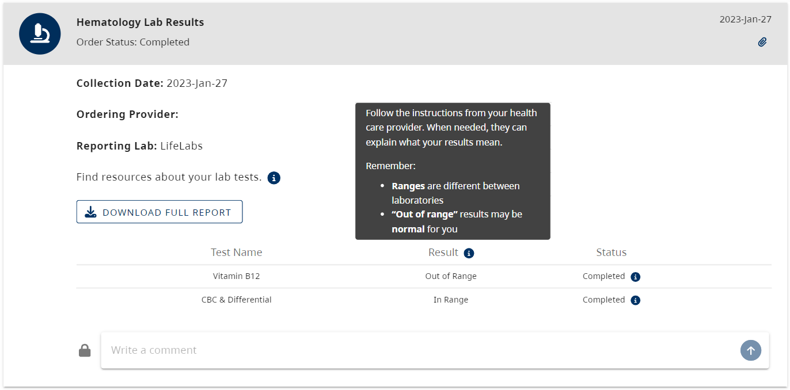
您能看到檢測結果的哪些資訊？
請按照您的醫療服務提供者的指示。如有需要，他們可協助解釋您的檢測結果。
請留意：
不同實驗室定義正常範圍可能不同
根據您身體的狀況，“超出範圍”的結果有可能是正常的
下載完整報告
結果
進展
Notes:
Speaker to explain information marked with arrow
Emphasize that by downloading the full report users can see the detailed numbers/values of their results

Slide 19
瞭解您的測試報告結果
平台通常會提供一些有關如何理解測試報告結果的說明。
您的醫療服務提供者也會收到您的測試報告結果。如需加倍注意或採取進一步行動，您的醫療服務提供者將盡快與您聯繫以採取任何必要的跟進。
我們鼓勵您下次複診時，與您的醫療保健提供者討論測試結果，以了解結果代表什麼。
Notes:
Sometimes patients view their results even faster than their provider can read them e.g. patients see their urine culture results are positive and send emails and calls to their health care provider. This can increase the workload for your health care provider and slow down their ability to respond to you.

Slide 20
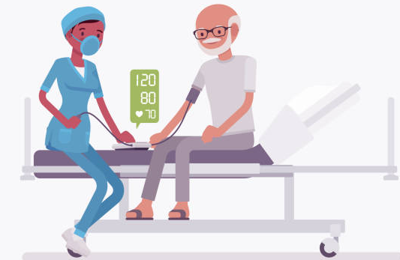
瞭解您的測試報告結果
70歲
男性
心臟病
Notes:
Screenshot of bloodwork – senior as a case study
Case study: Meet Joe – 70 year old, male with a heart condition. Due to his condition, the doctor is expecting his BP to be high. Use this to discuss next slide: multiple factors influence your results, and importance of looking at the trend of your results

Slide 21
瞭解您的測試報告結果
每個人的健康基線都是不同的
不同因素，如：年齡、性別、健康狀況、既往病史（糖尿病、高血壓等等）也會影響您的健康
對您來說，就算您的結果超出範圍，也可能是正常的。您的醫療保健提供者會能夠解釋結果對您代表什麼
Notes:
Since unique factors can influence your results, the means used to monitor your “out of range” levels may vary person to person. Though for some patients tracking value of their results work, for other patients, it may be more important to look at the trend of their levels over time. For example, using data tracking apps to record blood sugar.

Slide 22
如何保護您的網上個人健康資訊？

Slide 23
如何保護您的網上個人健康資訊？
根據法律，儲存個人健康資訊的機構須遵守規則和政策，以確保您的資訊安全。
您可以信任可靠的組織，例如政府機構和地區衛生當局，以確保您的個人健康資訊安全無虞。
Notes:
Examples of government institutions- Msp, Health Gateway
Example of health authorities and agencies: Vancouver Coastal Health, BC cancer, Fraser Health

Slide 24
如何保護您的網上個人健康資訊？
您可以採取以下措施來保護您的網上個人健康資訊：
選擇可靠的平台
小心共用敏感資訊
用高強度密碼
設置多重身份驗證
Notes:
Speaker to elaborate on Point 1 (Being careful about sharing sensitive information) and provide an example.

Slide 25
保護自己：選擇可靠的平台
☺
更為可靠:
不太可靠：

Slide 26
保護自己：選擇可靠的平台
☺
更為可靠:
主要供民眾瀏覽個人健康資訊，不是為了賺錢或售賣產品
來自於有信譽的機構.
經由其他專家認可
嘗試教育民眾資料是如何被政策保護的
不太可靠：
主要為了賺錢或售賣產品
不是來自於有信譽的機構
沒有經由其他專家認可
沒有清楚表明資料是如何被保護的，也可能沒有私隱政策
Notes:
Less trustworthy sites may have malicious intents – For example, they may try to get you to pay for accessing your personal health information. However, this may not apply to all services that require pay because some credible services also require payment for medical records, such as immigration documents. Therefore it is important to exercise caution and careful judgements when making assessments.
Speaker to elaborate on how these trustworthy indicators/green flags look different across platforms. For example LifeLabs My Care Compass and Health Gateway would differ with regard to website ending (links to next slide), but both websites are endorsed by health professionals

Slide 27
保護自己：選擇可靠的平台
以如下字母結尾的網站可能更為可靠
website.gov = 政府資訊
website.org = 通常為非牟利機構
website.edu = 教育機構，例如大學
☺
以如下字母結尾的網站可能不太可靠
website.com = 商業生意
Notes:
Speaker emphasize that .gov as a generalized example
Website with .gov ending is a generalized ending for government website. Depending on the country/ province the government website belongs to, the .gov ending might have other extensions added to it (Example a website ending from the B.C. provincial government is .gov.bc.ca
When assessing websites, consider whether the websites are from a reputable organization, such as a health authority, and whether the websites were endorsed or suggested to you by a health professional you trust, such as your family physician.

Slide 28
保護自己：選擇可靠的平台
☺
☺
比較不可靠
可能可靠
也可能不可靠
更可靠
☺
綠旗 : 更可靠 紅旗 : 比較不可靠
Notes:
While websites with certain endings might seem more credible, it is helpful to use more than one measure to assess trustworthiness of a website. It is good practice to read through the website and check the number of green flags against the number of red flags that come up, and then decide on the overall credibility of the website.

Slide 29
保護自己：選擇可靠的平台
https://www.lifelabs.com/
Notes:
Example of assessing the credibility of a website: This website ends with a .com, so it is good practice to pause and look for other red/green flags before deciding on it’s credibility.

Slide 30
保護自己：選擇可靠的平台
關於我們
私隱聲明
☺
Notes:
Look for and read the “about us”, “terms of service” or “privacy” sections of the website to assess the trustworthiness of the website. Additionally, this website belongs to LifeLabs, which is likely endorsed by health professionals you trust (e.g. recommended by your family physician).

Slide 31
保護自己：選擇可靠的平台
如果您不確定平台是否可靠，您可以詢問身邊信賴的人來決定平台是否安全。

Slide 32
如何保護您的網上個人健康資訊？
您可以採取以下措施來保護您的網上個人健康資訊：
選擇可靠的平台
小心共用敏感資訊
用高強度密碼
設置多重身份驗證

Slide 33
保護自己：小心共用敏感資訊
如您被要求分享以下敏感信息，請多加留意：
出生日期
地址
個人衛生號碼 PHN
社會保險號碼 SIN
身分證明文件，如護照或駕駛執照
個人財務資料
Notes:
Sensitive information should only be shared with organizations or individuals that you trust, as it could be used for malicious intent.

Slide 34
如何保護您的網上個人健康資訊？
您可以採取以下措施來保護您的網上個人健康資訊：
選擇可靠的平台
小心共用敏感資訊
用高強度密碼
設置多重身份驗證

Slide 35
保護自己：用高強度密碼
要設置高強度密碼，跟隨以下步驟:
盡量設置一個不能被容易猜到的密碼（避免使用個人資料）
在不同帳號和裝置使用不同密碼.
勿讓別人知道密碼
使用至少15個字元
採用大寫和小寫字母
使用至少一個數字和符號，如 !, # or $.

Slide 36
如何保護您的網上個人健康資訊？
您可以採取以下措施來保護您的網上個人健康資訊：
選擇可靠的平台
小心共用敏感資訊
用高強度密碼
設置多重身份驗證

Slide 37
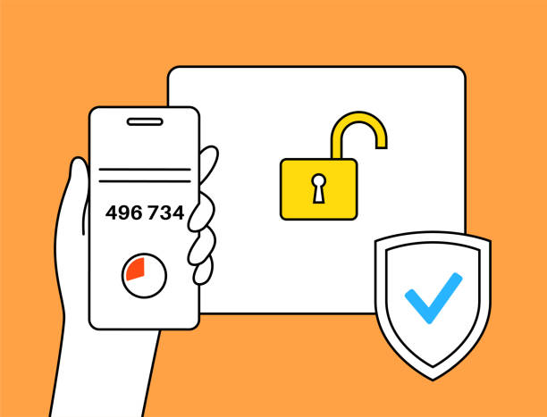
保護自己：設置多重身分驗證
多重身分驗證要求您除了輸入密碼以外，還要利用其他驗證方法來登入您的帳號。
驗證身分方法包括：
向您的裝置發送提醒
要求您輸入由電子郵件，訊息或電話發送的一次性密碼
要求您用指紋或裝置密碼來解鎖設備
Notes:
After entering your password as the first form of identity verification, websites may ask you to verify your identity by sending an alert to your device through email, text, phone call, or notification, or by asking for your fingerprint or device passcode.
This provides an extra level of security.

Slide 38
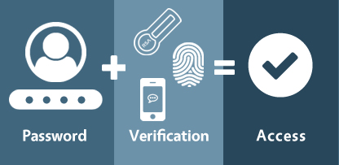
保護自己：設置多重身分驗證
https://www.anetworks.com/what-is-multifactor-authentication/
密碼
驗證
成功登入
Notes:
After entering your password as the first form of identity verification, websites may ask you to verify your identity by sending an alert to your device through email, text, phone call, or notification, or by asking for your fingerprint or device passcode.
This provides an extra level of security.

Slide 39
例如：Health Gateway 電子健康紀錄
(Author unknown, n.d.)

Slide 40
什麼是Health Gateway 電子健康紀錄?
卑詩省政府製作的平台供使用者網上瀏覽個人健康資訊。
允許您在一個地方存取多項個人健康資訊。

Slide 41
Health Gateway 電子健康紀錄可查看哪些內容？
通過 Health Gateway電子健康紀錄，您可以查看：
醫院就診
藥物
檢測結果
疫苗接種史
新冠肺炎疫苗接種證明
還有更多
Notes:
“And more” is a cue to explain that health gateway is being constantly developed

Slide 42
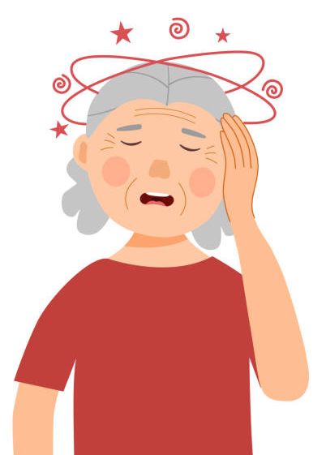
什麼時候使用Health Gateway 電子健康紀錄？
Notes:
Emily was having dizzy spells, so she had an appointment with her health care provider. During her visit, the doctor recommended she get her bloodwork done to check for possible causes. After completing her test, she can either wait for her health care provider to call her with the results, or she can visit the Health Gateway platform.

Slide 43
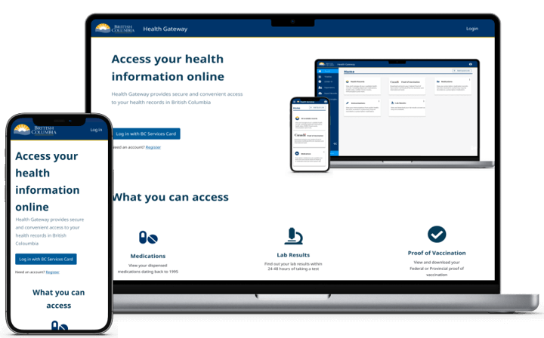
如何瀏覽Health Gateway 電子健康紀錄?
您可以使用電子健康紀錄應用程式或瀏覽其網站：https://www.healthgateway.gov.bc.ca/

Slide 44
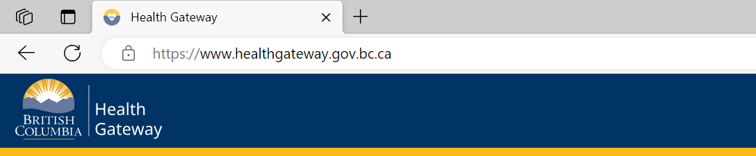
瀏覽Health Gateway 電子健康紀錄
https://www.healthgateway.gov.bc.ca/

Slide 45
瀏覽Health Gateway 電子健康紀錄：登入
您需要跟隨幾個步驟來登入Health Gateway 電子健康紀錄。這些步驟確保只有您才能登入您的帳號。
以下有兩種方法來驗證您的身分：
使用手機的B.C. Services Card 應用程式
輸入用戶名稱，密碼，以及B.C. Token顯示的代號
(有關更多信息: https://id.gov.bc.ca/account/setup-instruction/)

Slide 46
Health Gateway 電子健康紀錄：使用平台
Notes:
Talk through the different features, add caveat that screenshot might look different as it is constantly being updated

Slide 47
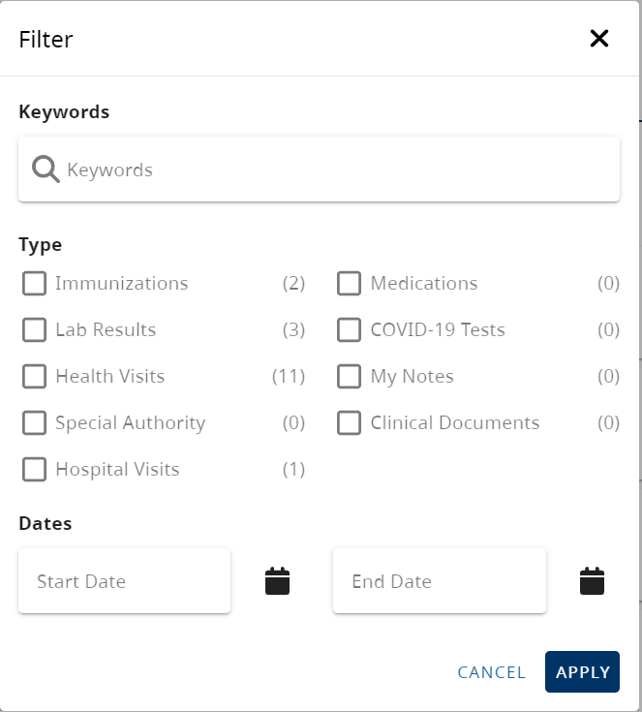
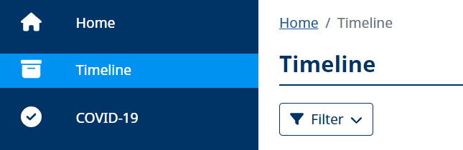
Health Gateway 電子健康紀錄：使用平台
您可以點擊“Timeline”來篩選您想找的紀錄

Slide 48
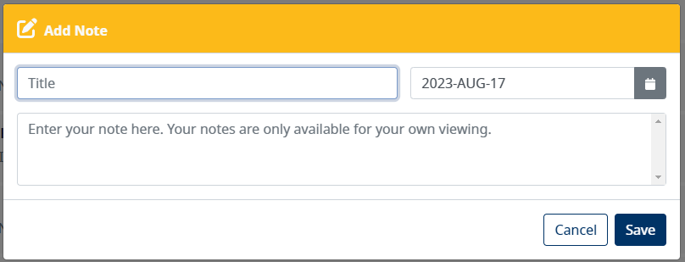
Health Gateway 電子健康紀錄：使用平台
您可以為您的時間線及健康紀錄添加注釋。這能幫助您追蹤需要用作管理健康的信息。
只有您能看見您添加的注釋（您的醫療保健提供者並不會看到你的注釋）
Notes:
Cue speaker to mention of examples of notes they might want to add. Some example includes instruction for taking medication, questions for your doctors, additional details provided by your care provider during your appointment, any health readings to track/discuss with your doctor at your appointments

Slide 49
Health Gateway 電子健康紀錄：使用平台
您可以下載健康紀錄的副本到您的裝置作打印用途。這令您可以於Health Gateway 電子健康紀錄外的地方儲存您的健康資訊。

Slide 50
備註
Health Gateway 電子健康紀錄是一個健康管理平台，這代表您不能刪除，編輯或新增任何醫療紀錄。
Health Gateway 電子健康紀錄依然在拓展中。這代表您未必能在此刻尋找到所有您的網上健康紀錄。

Slide 51
總結

Slide 52
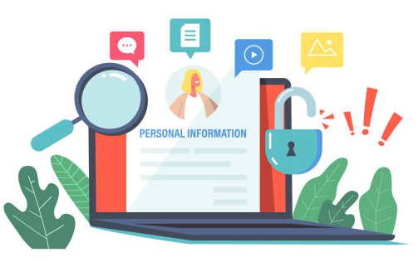
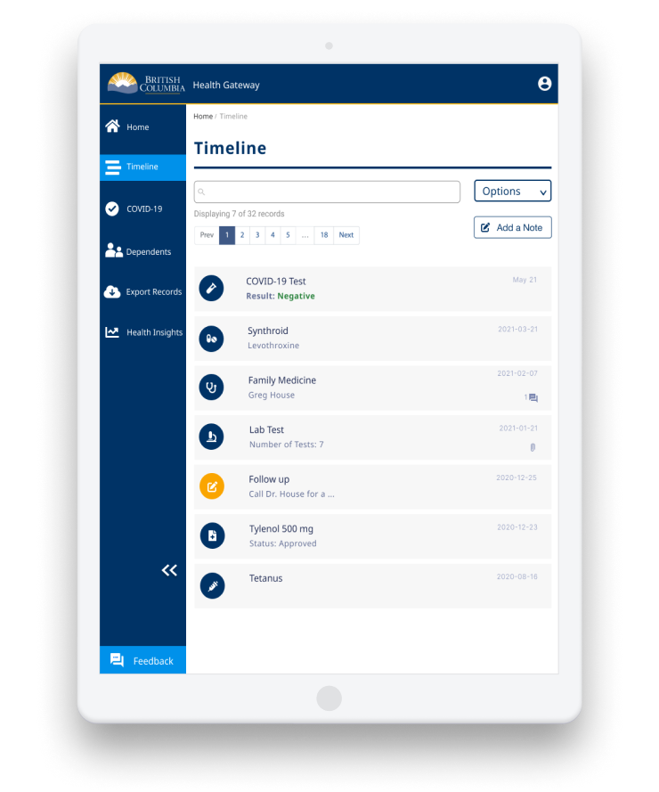
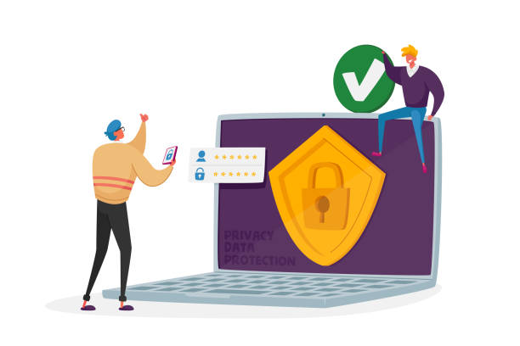
總結
個人健康資訊是用於 管理健康的敏感資訊
上網查看個人健康 資訊的方法
上網查看檢測結果時要留意的事情
什麼是Health Gateway 電子健康紀錄及其部分功能
如何保護您的網上個人健康資訊

Slide 53
問題?
Health Gateway 電子健康紀錄指引: https://www2.gov.bc.ca/gov/content/health/managing-your-health/health-gateway/guide

Slide 54
圖片來源
Screen captures were provided by iCON on slides 18, 29-30, 43-44, 46-49.
Unless cited, the images used in this presentation were from publicly available open sources.

Slide 55
© 2023 The University of British Columbia.
The work is licensed under Creative Commons Attribution-Non-Commercial-No Derivatives 4.0 International License
(http://creativecommons.org/licenses/by-nc-nd/4.0/).
It was created by UBC Digital Emergency Medicine. For permissions to use this work for commercial purposes please contact The University of British Columbia’s University-Industry Liaison Office.

Slide 56
再次感謝：
Thank you to the BC Ministry of Health Patients as Partners Initiative for their support.

