Slide 1
Using Apps to Support Your Health
iCON Digital Health Literacy, 2023-2024

Slide 2
Acknowledgements
This digital health literacy curriculum was developed by The University of British Columbia’s interCultural Online health Network (iCON).
iCON is supported by the B.C. Ministry of Health’s Patients as Partners initiative.
iCON has been working with multicultural communities for over 10 years.
iCON helps people with chronic disease self-management.
iCON also helps people develop digital literacy in order to access, assess, and use health resources online.
Thank you to the BC Ministry of Health Patients as Partners Initiative for their support.

Slide 3
Learning Objectives
Understand what apps are and how they can be used to manage your health.
Understand how to choose good quality apps.
Learn how to install and set up apps.
(Author unknown, n.d.)

Slide 4
What is an app?

Slide 5
What is an app?
When you use your smartphone, you will notice that upon unlocking your device, it usually displays a screen with several small icons. These icons are referred to as apps, which is the short form for applications.
Notes:
Have you ever used (example a communication app used a lot in the community)? If you have, then you are already using apps

Slide 6
What is an app?
Notes
Usually, each of your apps is displayed on your screen as an icon and the name of each app appears right below it.

Slide 7
What is an app?
Apps are like mini computer programs. They are tools to help you use your smartphone.
Apps make it possible to use your device for many different tasks, such as: writing notes, taking and viewing photos, browsing the web, reading the news, texting, audio and video calling, and more.

Slide 8
What types of apps are available?
There are many apps available. While each one has a unique interface and different features, a lot of these apps can be categorized depending on the main function they help you perform. Some categories of apps include:
Communication
Utilities
Entertainment
Health
And more…

Slide 9
What types of apps are available?
Communication apps
Utilities apps
Entertainment apps
Health apps

Slide 10
How apps can support your health

Slide 11
How apps can support your health
Apps can support your health in several ways:
By acting like health information tools, which assist in self-management of your health and chronic conditions.
By providing easier access to your healthcare provider through telemedicine and secure messaging apps.

Slide 12
How apps can support your health
Health apps provide a wide range of services. There are two main types of apps that can support your health:
Apps to help you to self-manage your health and wellness
Apps to access health care and view your personal health information

Slide 13
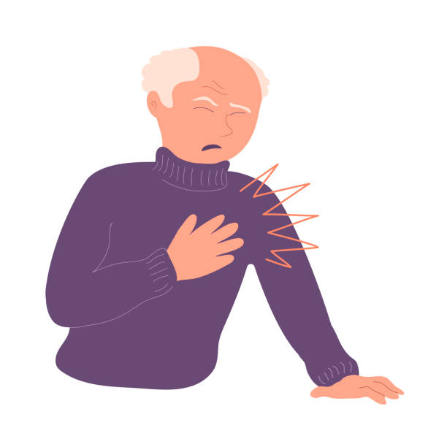
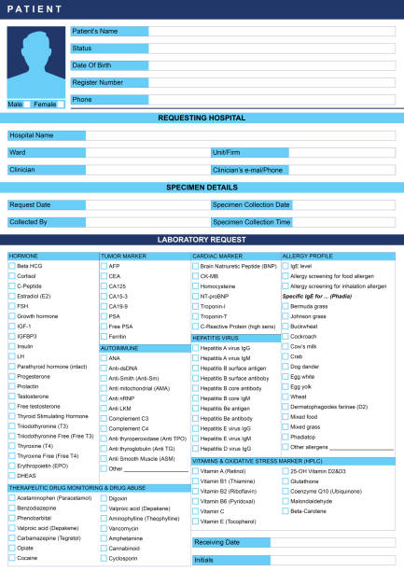
When could health apps be used?
Notes:
Charles was having chest pains, so went to his healthcare provider. During his visit, the healthcare provider measured his blood pressure and determined that a blood test was necessary. The healthcare provider later sent the lab requisition to Charles using the EMR messaging system (app).

Slide 14
When could health apps be used?
Notes:
Using the lab results, the healthcare provider determined that Charles had hypertension and emphasized the importance of maintaining his health. She recommended that Charles remain physically active, maintain a stress free lifestyle (meditation app) and remember to take his medications (medication app) regularly. She reminded Charles that there are many options of apps that he could use to support his health.

Slide 15
How can apps support your health?
Mental health
Medication management
Sleep
(Author unknown, n.d.)
Exercise
Health tracking
Access to care

Slide 16
How can apps support your health?
Mental health apps allow you to take a more proactive approach to your mental well-being. By giving you access to resources, they can support you to track your mental state, regulate your thoughts and emotions as well as assist in managing mental health issues.
Mental health
Medication management apps support you to keep track of your medication and prescriptions by providing reminders to help with medication adherence.
Medication management

Slide 17
How can apps support your health?
Sleep management apps are designed to help you improve the quality and duration of your sleep. These apps enhance your sleep by using features to track and monitor your sleep patterns.
Sleep
Exercise apps support you in maintaining an active lifestyle by tracking your progress and improving your physical health.
Exercise

Slide 18
How can apps support your health?
Health tracking apps are designed to help you monitor and manage your chronic conditions. They encourage you to practice preventative care by assisting you in maintaining your health and wellness and by fostering positive self-management skills.
Health tracking
For example, individuals living with diabetes may use apps that monitor their blood glucose, such as apps for continuous glucose monitoring (CGM).
6.8 mmol/L

Slide 19
How apps can support your health
Health apps provide a wide range of services. There are two main types of apps that can support your health:
Apps to help you to self-manage your health and wellness
Apps to access health care and view your personal health information

Slide 20
How do health apps help you access care?
Health apps may allow you to access care as some healthcare providers:
Use secure portal apps as a confidential messaging system with their patients.
Facilitate virtual care by allowing you to schedule and access some types of healthcare appointments.
May share information on health services near your location that you can access.
Access to care

Slide 21
How apps can support your health
An example of an app that allows you to view your personal health information is Health Gateway, which is developed by the B.C. provincial government. Through Health Gateway, you can access your:
Health and hospital visits
Medications
Lab results
Immunization history
COVID-19 proof of vaccination
And more…
Notes:
“And more” is a cue to explain that health gateway is being constantly developed

Slide 22
Precautions when using health apps
Often apps access your location or other data to track your progress to function optimally. You should be cautious when sharing any sensitive information while using apps.
Continual learning is helpful as apps gain new features and/or are updated.

Slide 23
Tips for choosing a quality app

Slide 24
Choosing a quality app
There are a wide variety of apps available, with varying levels of trustworthiness, quality, and functions. You can make an informed decision about which app to use by taking these measures:
Choosing trusted apps
Being careful about sharing sensitive information
Selecting apps that meet your goals

Slide 25
Choosing a quality app
There are a wide variety of apps available, with varying levels of trustworthiness, quality, and functions. You can make an informed decision about which app to use by taking these measures:
Choosing trusted apps
Being careful about sharing sensitive information
Selecting apps that meet your goals

Slide 26
Choosing trusted apps
☺
More trustworthy:
Less trustworthy:

Slide 27
Choosing trusted apps
☺
More trustworthy:
Designed by a reputable organization.
Has been downloaded by many users and has many positive reviews.
Does not try to sell you a product or service.
Clearly explains how your information will be protected through a privacy policy.
Less trustworthy:
Not designed by a reputable organization.
Has been downloaded by a small number of users and has many negative reviews.
Tries to sell you a product or service.
Is not clear about how your information will be protected, and may not have a privacy policy.
Notes:
Learn about the people or company that designed that app, such as whether they consult health professionals and whether their apps have been endorsed by trusted organizations. Where possible, download from reputable developers.

Slide 28
Choosing trusted apps
☺
☺
Less trustworthy
May or may not be trustworthy
More trustworthy
☺
Green Flags : more trustworthy. Red Flags : less trustworthy.
Notes:
While websites with certain endings might seem more credible, it is helpful to use more than one measure to assess trustworthiness of a website. It is good practice to read through the website and check the number of green flags against the number of red flags that come up, and then decide on the overall credibility of the website.

Slide 29
Choosing trusted apps
☺

Slide 30
Choosing trusted apps
☺

Slide 31
Choosing a quality app
There are a wide variety of apps available, with varying levels of trustworthiness, quality, and functions. You can make an informed decision about which app to use by taking these measures:
Choosing trusted apps
Being careful about sharing sensitive information
Selecting apps that meet your goals

Slide 32
Sharing sensitive information
Be cautious if you are asked to share sensitive information, such as:
Date of birth
Address
Personal Health Number (PHN)
Social Insurance Number (SIN)
Identification documents, such as passport or driver’s license
Personal financial information
Notes:
Sensitive information should only be shared with organizations or individuals that you trust, as it could be used for malicious intent.

Slide 33
Choosing a quality app
There are a wide variety of apps available, with varying levels of trustworthiness, quality, and functions. You can make an informed decision about which app to use by taking these measures:
Choosing trusted apps
Being careful about sharing sensitive information
Selecting apps that meet your goals

Slide 34
Selecting apps that meet your goals
Endorsed by someone you trust
Meets your health needs
Limits the request for sensitive information
Available in a language you are comfortable using
Minimizes the sharing of outdated information
Notes:
With millions of apps out there, finding the right app for you can be challenging. It is good practice to assess the quality of the app before installing it:

Slide 35
Installing apps

Slide 36
Installing apps
Usually, apps that help you perform basic functions on your device will come pre-installed when you purchase the device.
You also have the option of installing new apps on your phone.
Notes:
If you wish to use an App that is not pre-installed in your device, you will have to download it from the App store (Perhaps include this as speaker notes instead)

Slide 37
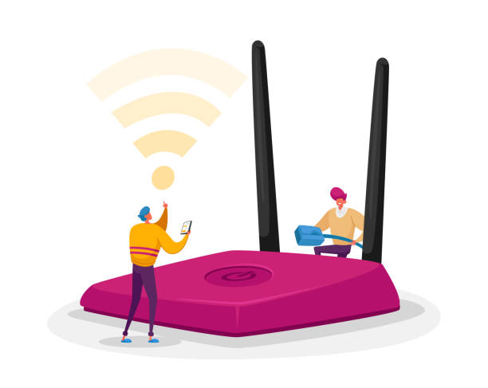
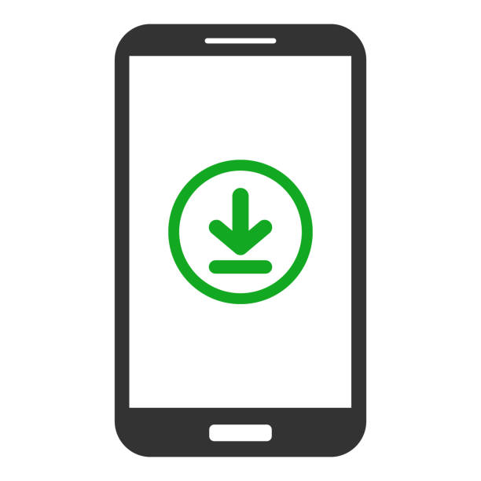
How to install apps
To install an app, your smartphone needs to be connected to the internet.

Slide 38
How to install apps
If there is an app you want to install, you can go to the app store on your smartphone.

Slide 39
How to install apps
App Store

Slide 40
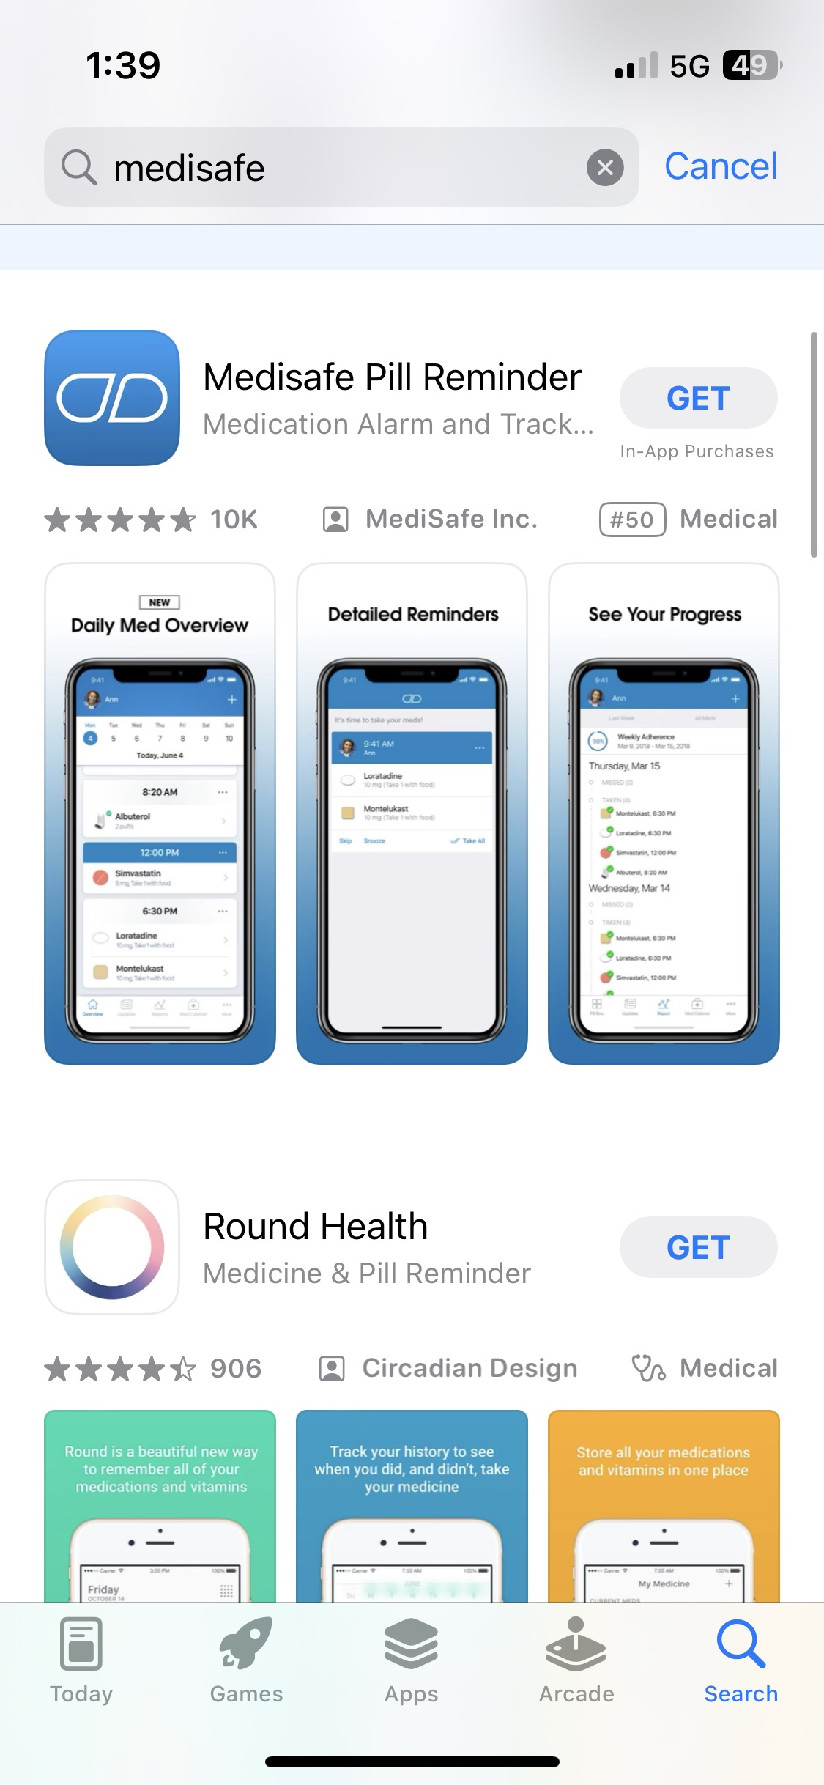
How to install apps
Medisafe
In the search bar, type the name of the app you wish to install.
(Author unknown, n.d.)

Slide 41
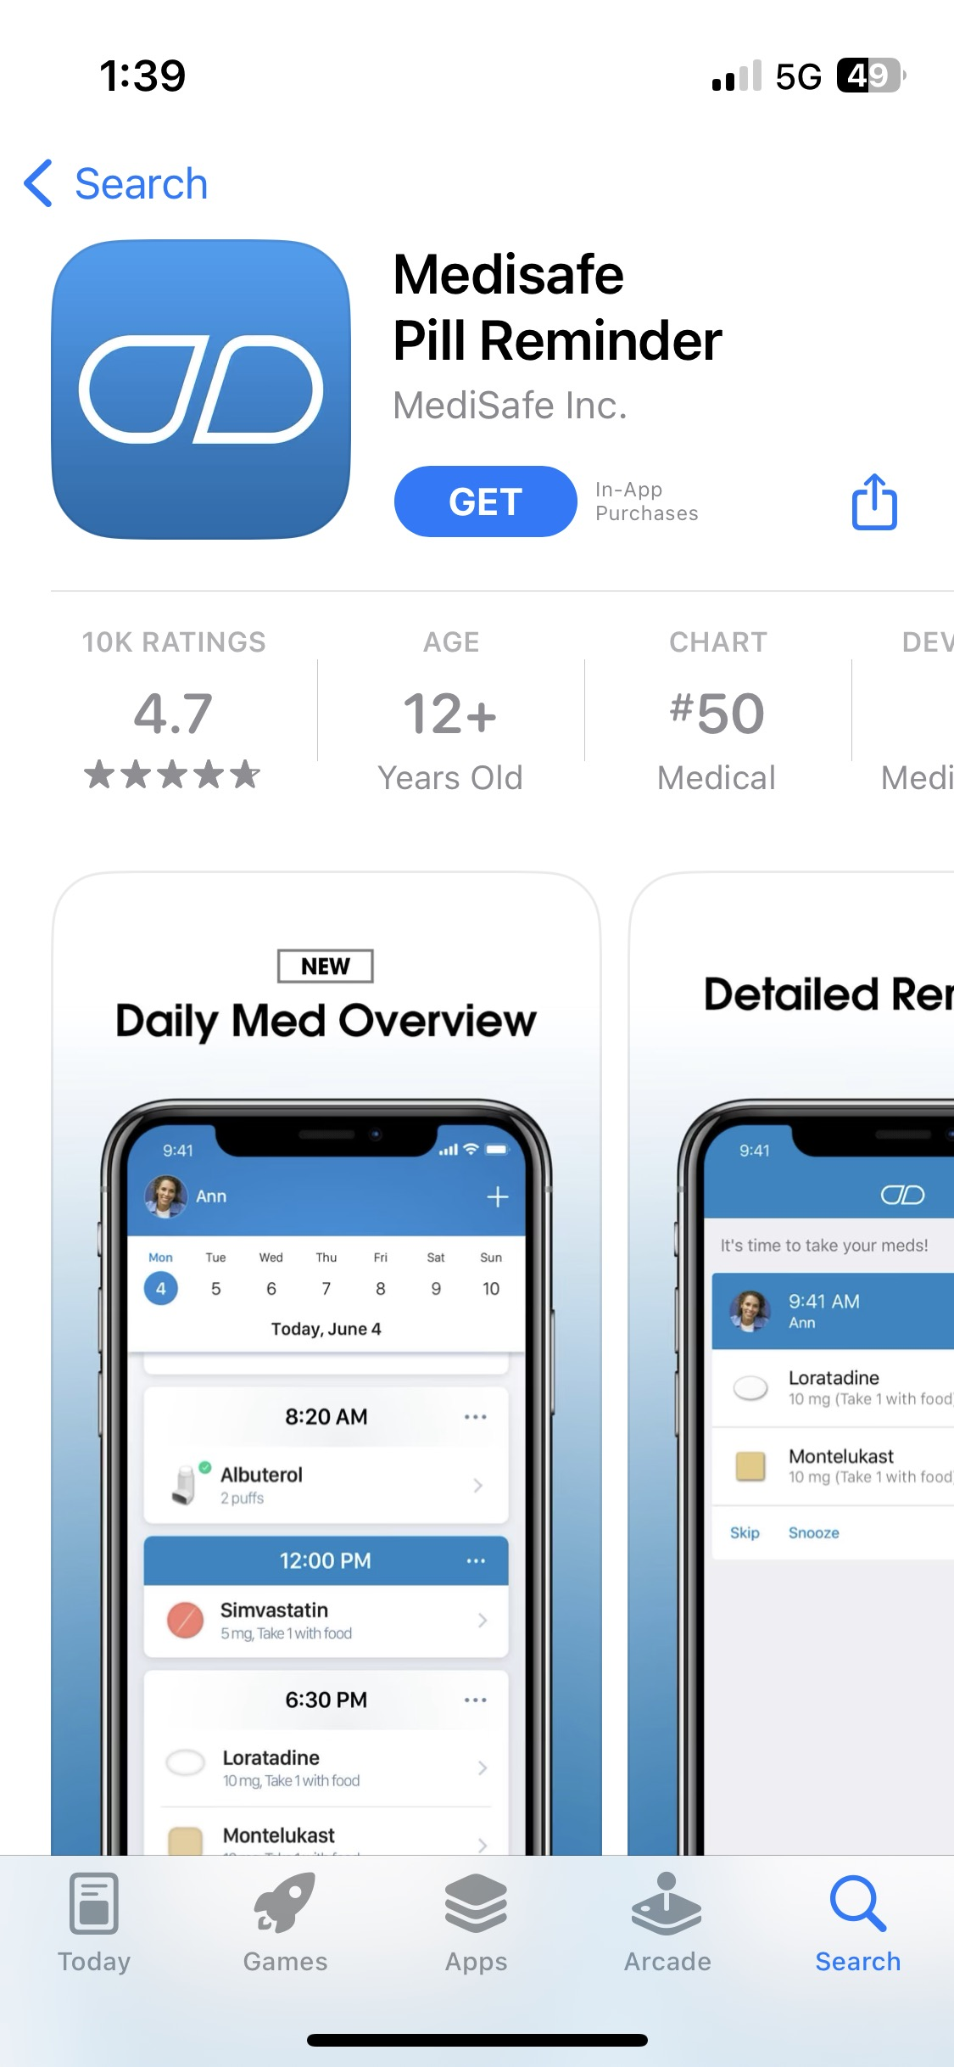
How to install apps
Select “Get” or “Install” to start downloading the app on to your device. Your device may prompt you to confirm installation.

Slide 42
How to install apps
After you install the app, you can open it by tapping on it from your home screen.

Slide 43
Using apps

Slide 44
Using apps: Setting up your app
Usually, the first time you use an app, it will prompt you to set up the app including creating an account and indicating your preferences. This may include:
Notification preferences
Permissions and restrictions preferences
Language preferences

Slide 45
Using apps: Setting up your account
Typically, when you are using health related apps, it may require you to set up the app in order to tailor it to your needs. This may include inputting some personal identifying information, such as your name and date of birth.
If the app prompts you to provide information, it is good practice to assess if it is safe to provide the information or ask someone you trust to verify.

Slide 46
Using apps: Creating a strong password
To create a strong password, follow these tips:
Try to make a password that cannot be easily guessed (avoid including personal information).
Use different passwords on different account and devices.
Keep your password private.
Use a minimum of 15 characters.
Use a combination of upper and lower case letters.
Include at least one number and one character, like !, # or $.

Slide 47
Using apps: Setting up your app
Usually, the first time you use an app, it will prompt you to set up the app including creating an account and indicating your preferences. This may include:
Notification preferences
Permissions and restrictions preferences
Language preferences

Slide 48
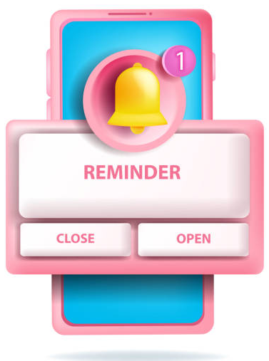
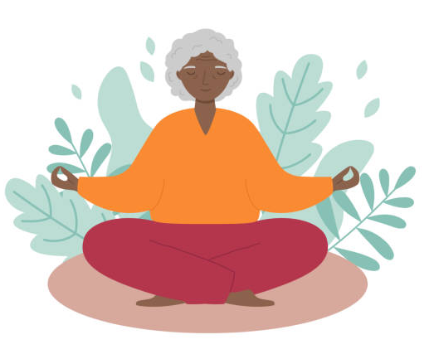
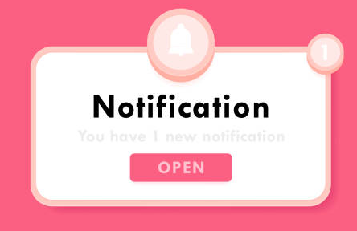
Using apps: Notification preferences
Notification preferences is a way for you to set up your apps so that you can choose the type of alerts you receive from any app. Your notification preferences can vary between apps.
Notes:
Images cue this: For example, if you are using a stress management app, you can set up the app notification so that you receive an alert when it is time for you to meditate.

Slide 49
Using apps: Notification preferences

Slide 50
Using apps: Setting up your app
Usually, the first time you use an app, it will prompt you to set up the app including creating an account and indicating your preferences. This may include:
Notification preferences
Permissions and restrictions preferences
Language preferences

Slide 51
Using apps: Permissions and restrictions preferences
In some instances, apps might require access to specific features on your phone to perform its intended functions optimally. For example, your maps app might ask for permission to access your location to show you the best route.
When they require permission, the app will send you a notification which you can allow or deny.
Notes:
May be worth mentioning that preferences (including notification preferences and permission/restrictions preferences) can be changed at any point

Slide 52
Using apps: Permissions and restrictions preferences

Slide 53
Using apps: Setting up your app
Usually, the first time you use an app, it will prompt you to set up the app including creating an account and indicating your preferences. This may include:
Notification preferences
Permissions and restrictions preferences
Language preferences

Slide 54
Using apps: Language preferences
Some apps are available in multiple languages.
To check if the app you are using is available in multiple languages, you can open the app, go into settings and see if the app has a language option.

Slide 55
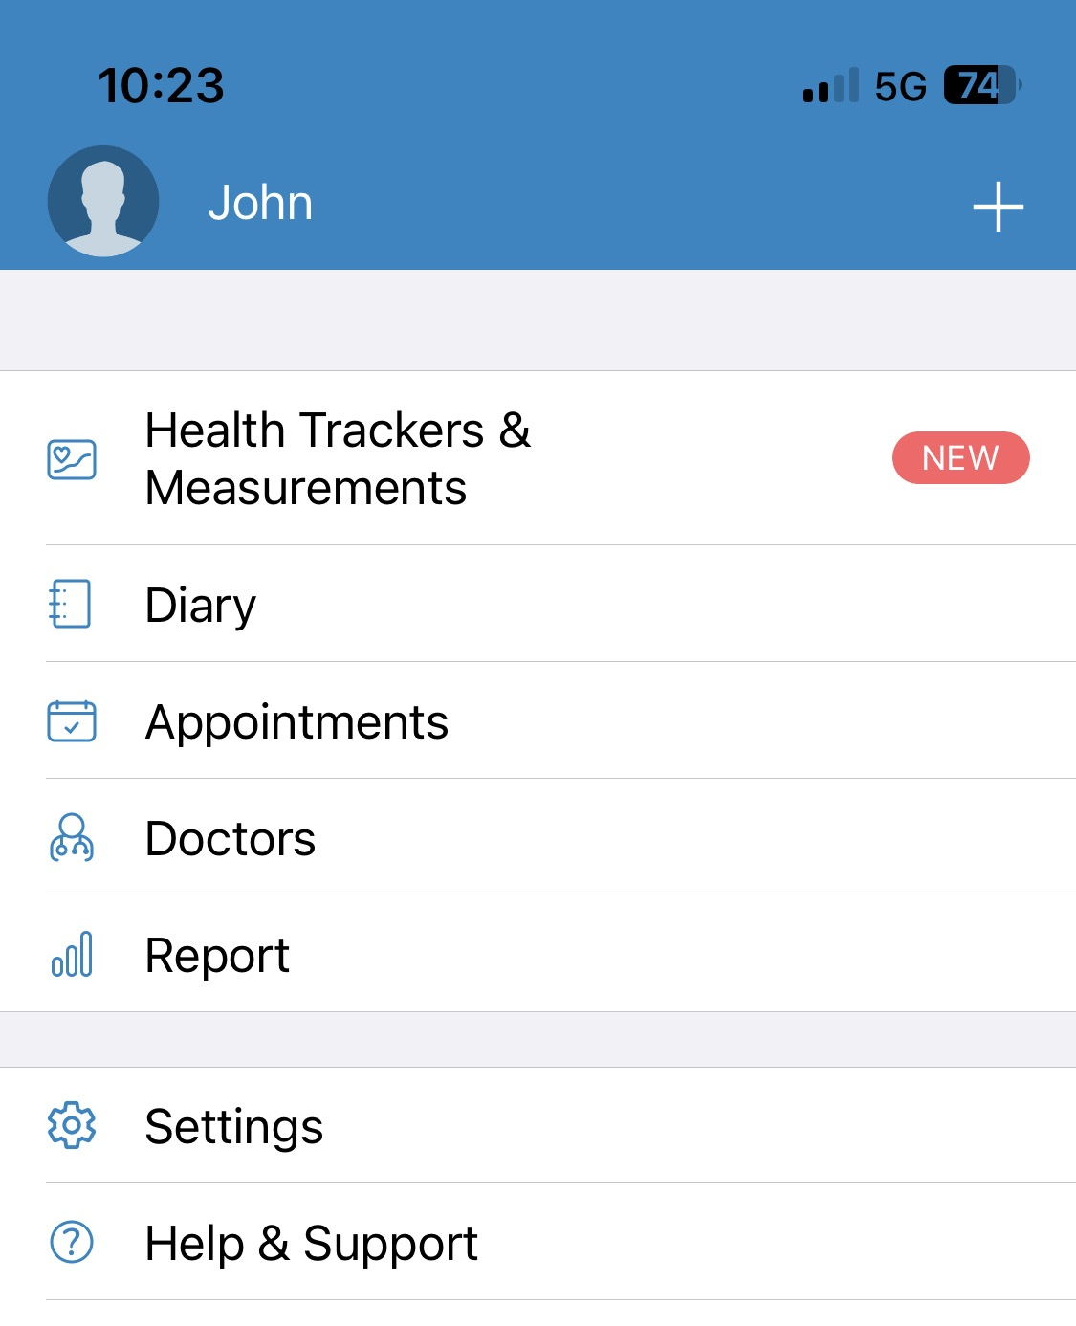
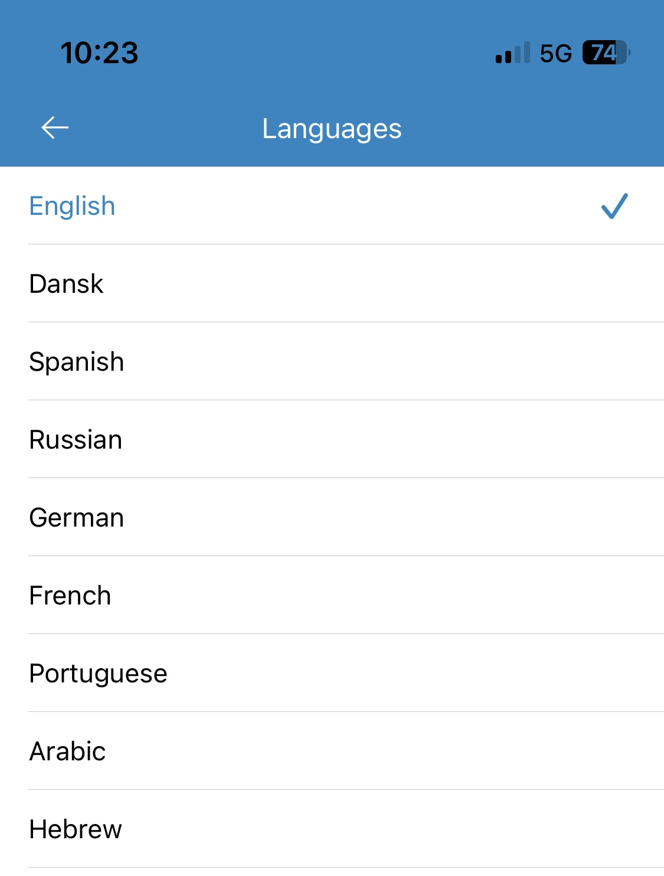
Using apps: Language preferences
(Author unknown, n.d.)

Slide 56
Uninstalling apps

Slide 57
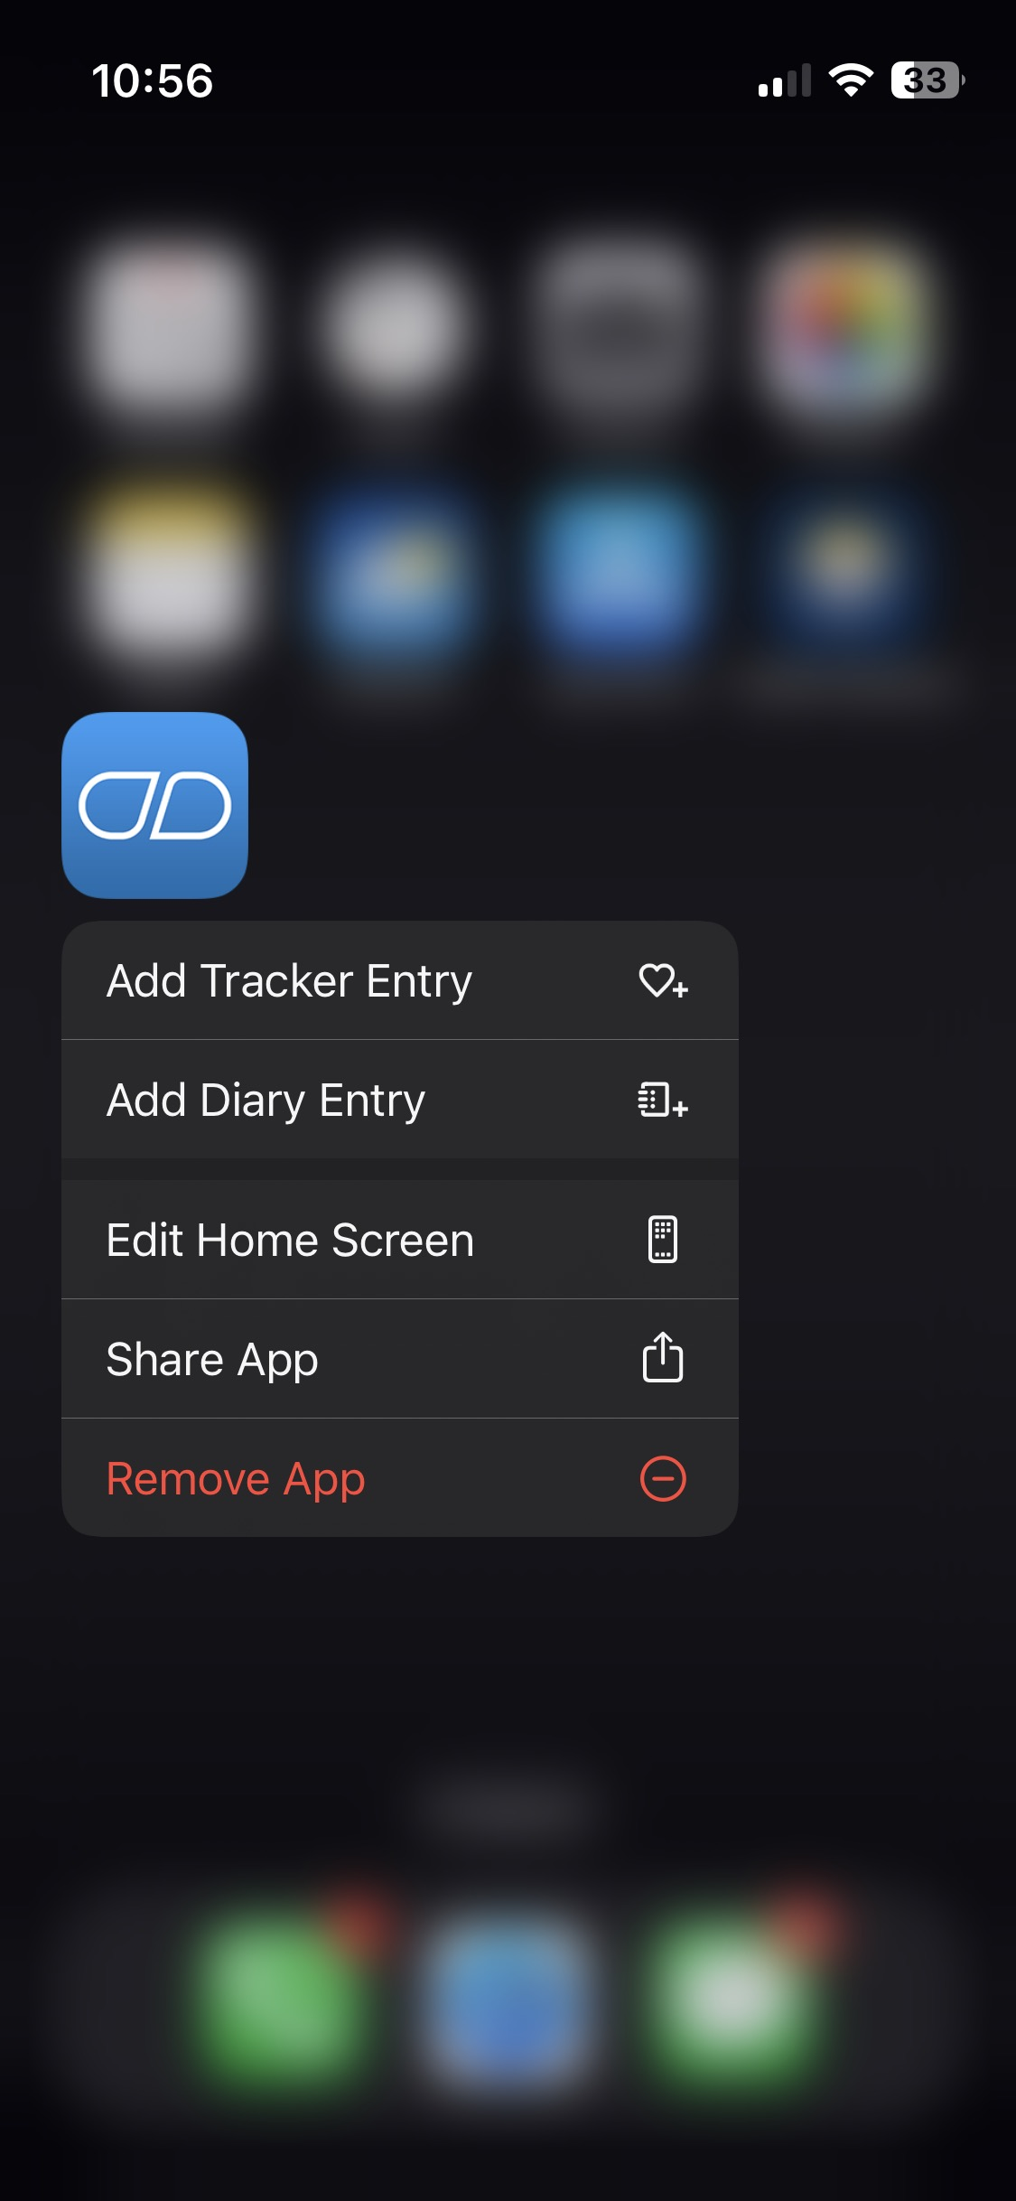
How to uninstall apps
To uninstall an app, tap and hold the app icon until you see a list of options appear.
Then select “Remove App”.

Slide 58
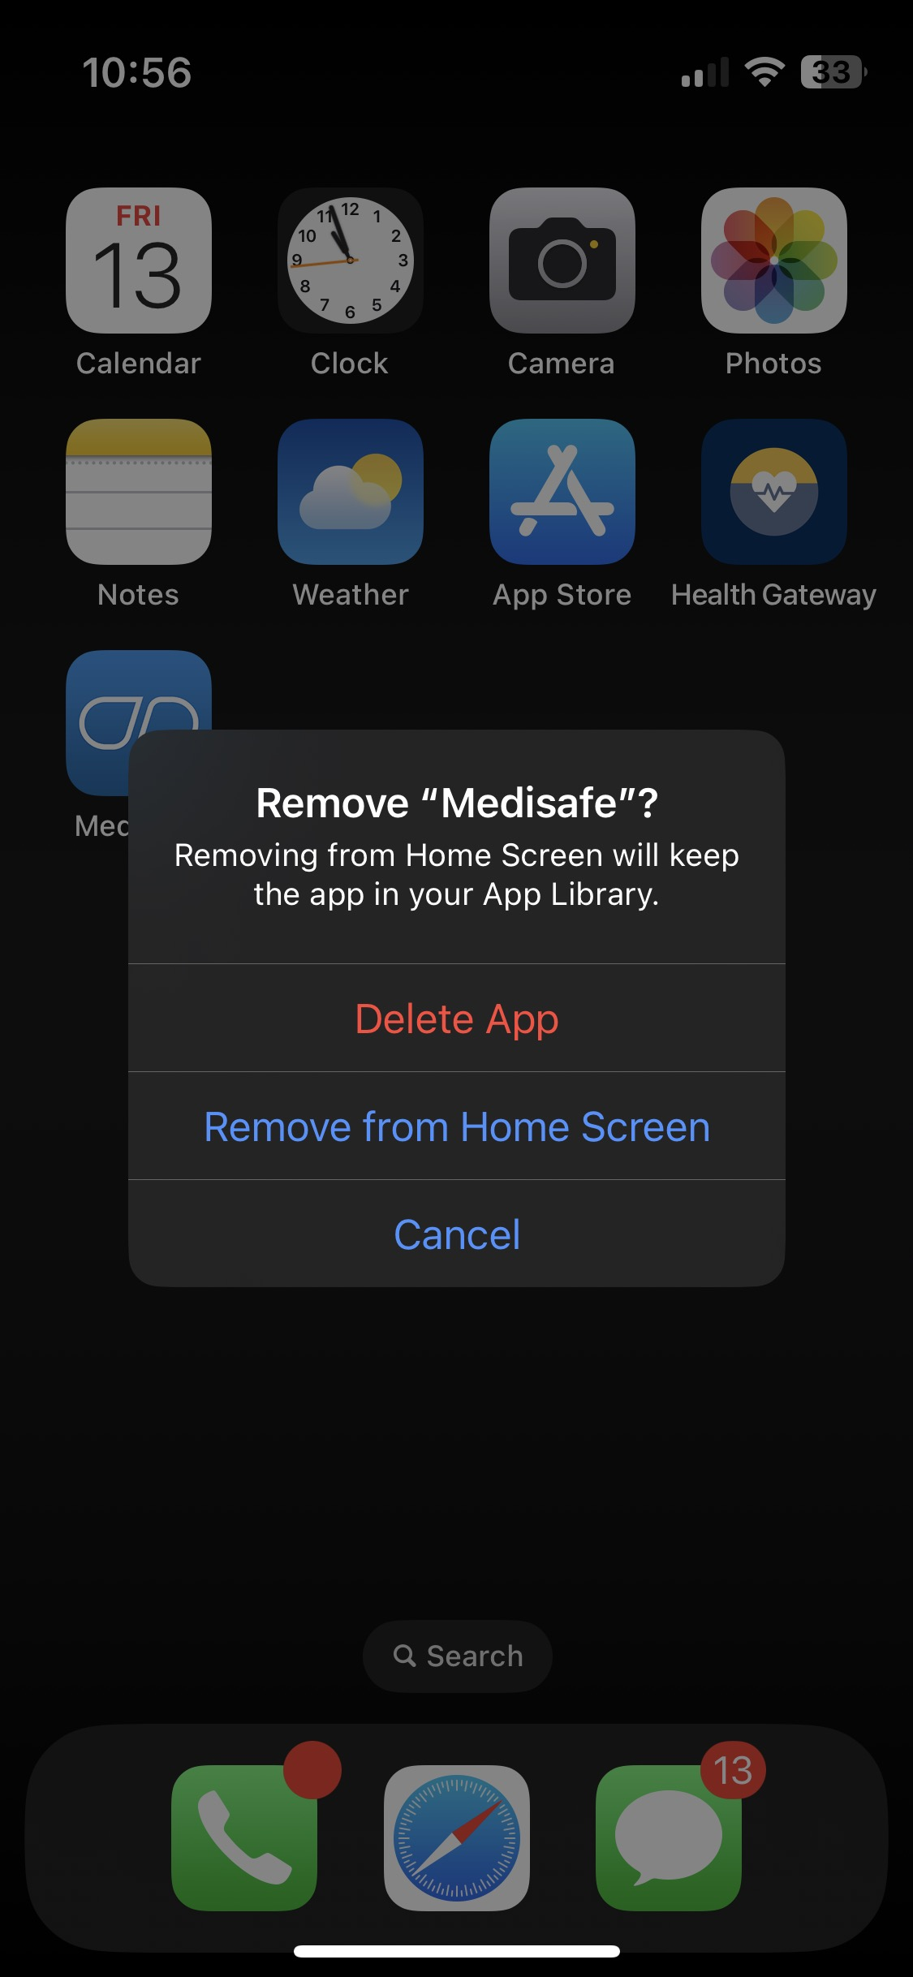
How to uninstall apps
Your phone will prompt you to confirm the uninstallation. To proceed, select “Delete App”.
If you wish to discontinue uninstallation, select “Cancel”.

Slide 59
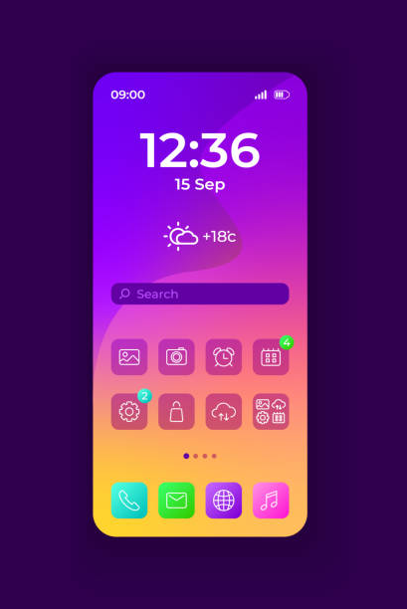
We learned:
What is an app
How apps can support your health
Tips for choosing a quality app
Installing apps
Using apps
Uninstalling apps

Slide 60
Questions?

Slide 61
Image Credits
Screen captures were provided by iCON on slides 6, 28-29, 37-41, 48, 51-54, 56-57.
Unless cited, the images used in this presentation were from publicly available open sources.

Slide 62
© 2023 The University of British Columbia.
The work is licensed under Creative Commons Attribution-Non-Commercial-No Derivatives 4.0 International License
(http://creativecommons.org/licenses/by-nc-nd/4.0/).
It was created by UBC Digital Emergency Medicine. For permissions to use this work for commercial purposes please contact The University of British Columbia’s University-Industry Liaison Office.

Slide 63
Thank you again to:
Thank you to the BC Ministry of Health Patients as Partners Initiative for their support.

