Slide 1
如何上网查看个人健康
iCON Digital Health Literacy, 2023

Slide 2
鸣谢
该数码健康知识课程由卑诗大学的安康健康网络（iCON）制作 「安康」健康网络得到卑诗省卫生厅的「患者为伴」计划的支持 「安康」健康网络与各多元文化社区合作已超过十年 「安康」健康网络帮助慢性病患者进行自我管理 「安康」健康网络亦帮助大家普及数码知识，以便他们获取、评估和使用网上的健康资源
Thank you to the BC Ministry of Health Patients as Partners Initiative for their support.

Slide 3
学习目标
了解什么是个人健康信息以及如何上网查看个人健康记录 了解您的网上个人健康记录是如何被保护 了解电子健康纪录及其使用方法
(Author unknown, n.d.)

Slide 4
大纲
什么是个人健康信息？ 如何上网查看您的个人健康信息？ 例如：上网查看检验结果 如何保护您的网上个人健康信息？ 例如： Health Gateway电子健康纪录
(Author unknown, n.d.)

Slide 5
什么是个人健康信息？

Slide 6
什么是个人健康信息？
个人健康信息是任何可用于识别您的身份，并能链接有关您个人医疗记录的敏感信息

Slide 7
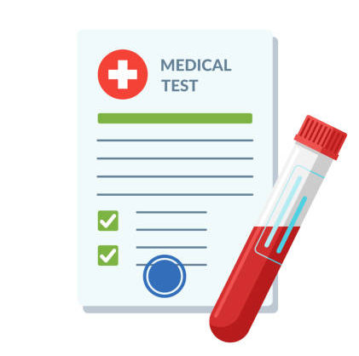
什么是个人健康信息？
病历
药物
检验结果
疫苗接种纪录
保健服务
识别个人资料

Slide 8
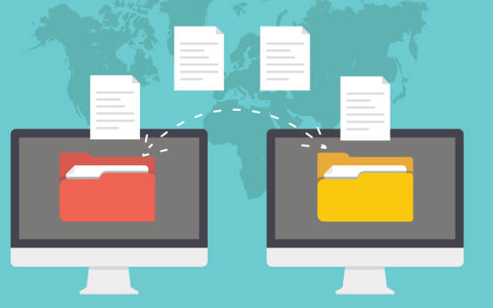
您的个人健康信息是如何被储存的？
您的个人健康信息通常会被诊所、医院或其他医疗机构储存为健康纪录。 医疗机构会利用这些健康纪录来助您管理健康或了解您的病历
Notes:
Note regarding records being stored convenient location: Each of your health care provider might store your health records in their own system. For example, your family doctor and cardiologist each have their own records. Pictures to cue speaker: Traditionally, your health records are stored as physical files at your health care provider’s office for them to access while providing care. The manner of storing data this way makes it challenging to keep track of your records, especially if you switch providers, or access alternative points of care.

Slide 9
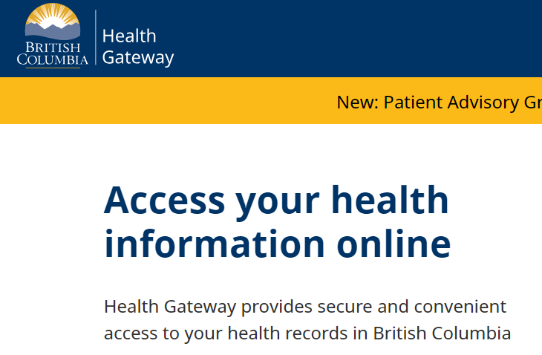
您曾经尝试过上网查看您的个人健康信息吗？
Notes:
Used by care providers: speaker to elaborate
Used by patients/caregivers: Have you ever gone online to check your lab report? If you have, you are already using health data platforms. Depending on which health data platform you use, you can assess a range of information, like your test results, immunization records, prescription etc

Slide 10
如何上网查看个人健康记录？

Slide 11
如何上网查看个人健康记录？
您能使用一系列的网上健康信息平台和健康信息工具来查看您的个人健康信息。 这些平台和工具能储存和整理您的个人健康信息。
健康信息平台是由值得信赖的健康机构提供，用于浏览网上个人健康信息，例如测试结果和病历。
健康信息工具让您能在自己的电子设备上输入及管理您的个人健康信息。
Notes:
Speaker should mention that the focus of the presentation will be on health information platforms.
Note: Speaker should refrain from interchanging the terms health information tools and health information platform during the presentation

Slide 12
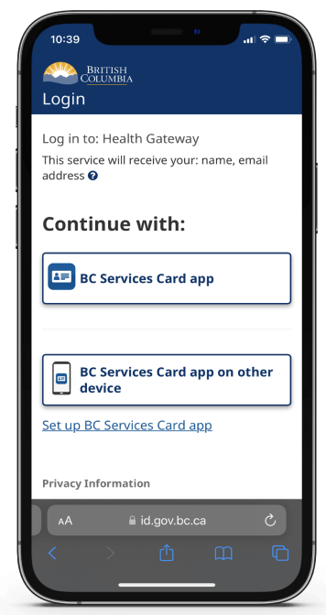
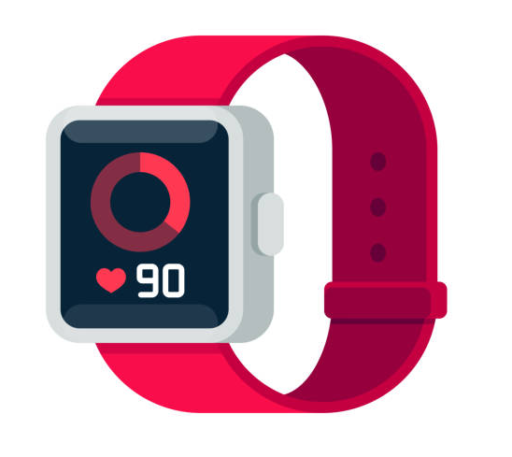
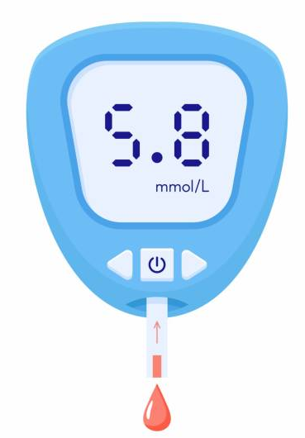
上网查看您的个人健康信息
平台
工具
Notes:
Highlight differences between health information platforms and health information tools using the example on the slides

Slide 13
上网查看您的个人健康信息
平台
工具
Notes:
Emphasis that the focus of the presentation will be on health information platforms
As a user of the health information platforms, your view of the platform looks different than that of your health care provider. While your version of the platform allows you to view a summary of your heath records, your health care provider has complete access to your health records and will have the ability to change your health record (example: add a prescription to your records)

Slide 14
上网查看您的个人健康信息的好处
轻松快捷地访问您的个人健康信息 十分方便，因所有信息都存在一个位置 由于容易访问更多您的个人健康信息，故有助您管理健康 鼓励患者参与管理健康的过程

Slide 15
上网查看您的个人健康信息的限制
电子平台仍在扩展中，从而包含更多类型的健康信息。所以目前未必能够找到所有健康信息。 随着平台不断更新，需要持续学习如何使用。 当您在网上查看结果时，缺乏临床指导和解释（在与医疗保健提供者讨论结果之前）。 与实体健康记录相比，您需要采取不同的防护措施来保个人健康信息 。
Notes:
Some examples during the presentation to illustrate this: E.g. imaging may be available in the future, having no clinical guidance and explanation can sometimes cause anxiety in patients and patients starting to use Dr. Google, doctors now need to stay even more updated on what the general public may know about diagnoses/treatment; elaborate on what is meant by the different precautions needed to protect personal health information e.g. privacy concerns

Slide 16
例子：上网查看您的检测结果
(Tankilevitch, 2020)

Slide 17
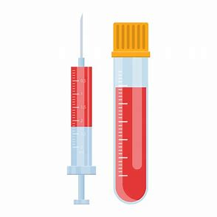
哪些检测结果可上网取得？
视乎您在哪里完成检测，有多个平台让你查看结果。 其中包括：
尿液及血液测试
宫颈癌或结肠癌筛查
病理学测试
Notes:
Give examples of the different platforms available to view your lab results: mycarecompass, health gateway etc

Slide 18
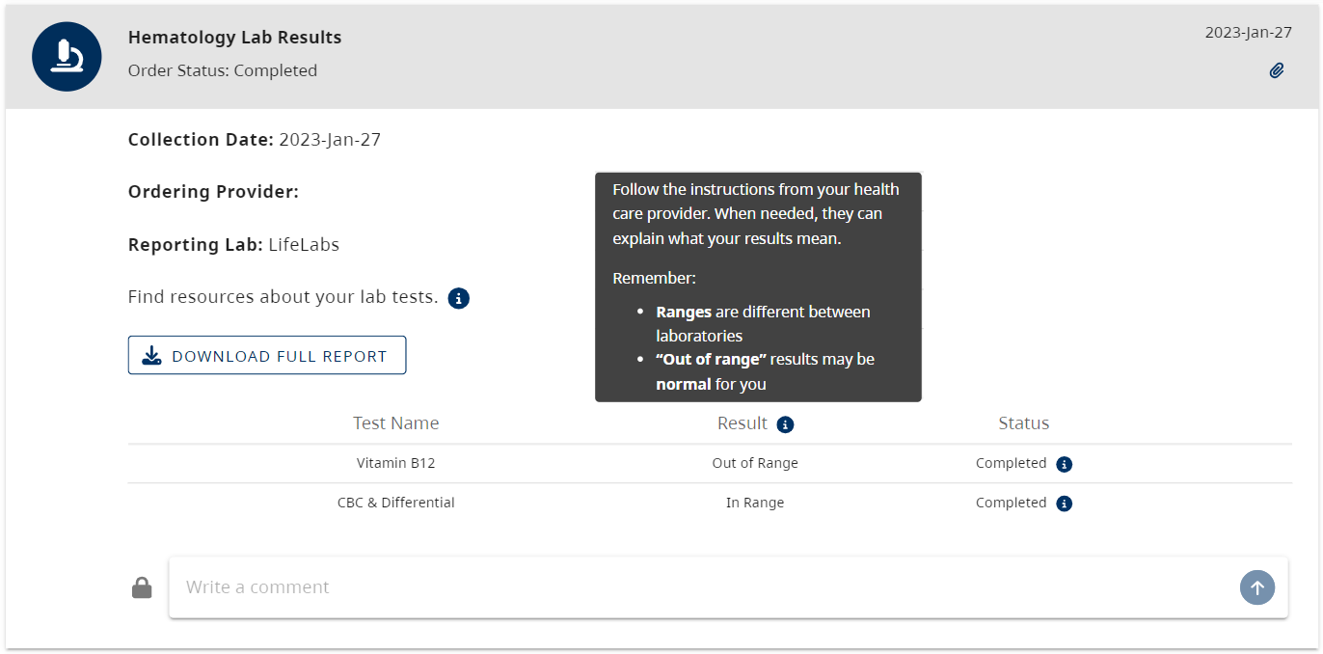
您能看到检测结果的哪些信息？
请按照您的医疗服务提供者的指示。 如有需要，他们可帮助解释您的检测结果。请留意：
不同实验室定义正常范围可能不同 根据您身体的状况，“超出范围”的结果有可能是正常的
进展
下载完整报告
結果
进展
Notes:
Speaker to explain information marked with arrow
Emphasize that by downloading the full report users can see the detailed numbers/values of their results

Slide 19
了解您的测试报告结果
平台通常会提供一些有关如何理解测试报告结果的说明。 您的医疗服务提供商也会收到您的测试报告结果。 如需加倍注意或采取进一步行动，您的医疗服务提供者将尽快与您联系以采取任何必要的跟进。 我们鼓励您下次复诊时，与您的医疗保健提供商讨论测试结果，以了解结果代表什么。
Notes:
Sometimes patients view their results even faster than their provider can read them e.g. patients see their urine culture results are positive and send emails and calls to their health care provider. This can increase the workload for your health care provider and slow down their ability to respond to you.

Slide 20
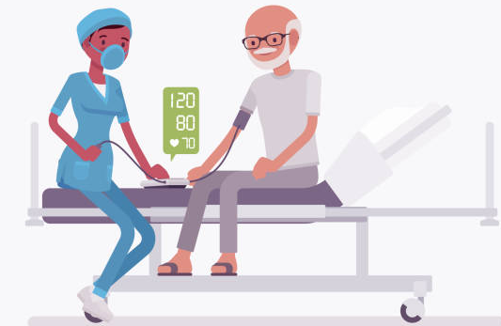
了解您的测试报告结果
70岁
男性
心脏病
Notes:
Screenshot of bloodwork – senior as a case study
Case study: Meet Joe – 70 year old, male with a heart condition. Due to his condition, the doctor is expecting his BP to be high. Use this to discuss next slide: multiple factors influence your results, and importance of looking at the trend of your results

Slide 21
了解您的测试报告结果
每个人的健康基线都是不同的 不同因素，如：年龄、性别、健康状况、既往病史（糖尿病、高血压等等）也会影响您的健康 对您来说，就算您的结果超出范围，也可能是正常的。 您的医疗保健提供商会能够解释结果对您代表什么
Notes:
Since unique factors can influence your results, the means used to monitor your “out of range” levels may vary person to person. Though for some patients tracking value of their results work, for other patients, it may be more important to look at the trend of their levels over time. For example, using data tracking apps to record blood sugar.

Slide 22
如何保护您的网上个人健康信息？

Slide 23
如何保护您的网上个人健康信息？
根据法律，存储个人健康信息的机构须遵守规则和政策，以确保您的信息安全。 您可以信任可靠的组织，例如政府机构和地区卫生当局，以确保您的个人健康信息安全无虞。
Notes:
Examples of government institutions- Msp, Health Gateway
Example of health authorities and agencies: Vancouver Coastal Health, BC cancer, Fraser Health

Slide 24
如何保护您的网上个人健康信息？
您可以采取以下措施来保护您的网上个人健康信息：
选择可靠的平台
小心共享敏感信息
用高强度密码
设置多重身份验证
Notes:
Speaker to elaborate on Point 1 (Being careful about sharing sensitive information) and provide an example.

Slide 25
保护自己：选择可靠的平台
☺
更为可靠：
不太可靠：

Slide 26
保护自己：选择可靠的平台
☺
更为可靠：
主要供民众浏览个人健康信息，不是为了赚钱或售卖产品
来自于有信誉的机构
经由其他专家认可
尝试教育民众数据是如何被政策保护的
不太可靠：
主要为了赚钱或售卖产品
不是来自于有信誉的机构
没有经由其他专家认可
没有清楚表明数据是如何被保护的，也可能没有私隐政策
Notes:
Less trustworthy sites may have malicious intents – For example, they may try to get you to pay for accessing your personal health information. However, this may not apply to all services that require pay because some credible services also require payment for medical records, such as immigration documents. Therefore it is important to exercise caution and careful judgements when making assessments.
Speaker to elaborate on how these trustworthy indicators/green flags look different across platforms. For example LifeLabs My Care Compass and Health Gateway would differ with regard to website ending (links to next slide), but both websites are endorsed by health professionals

Slide 27
保护自己：选择可靠的平台
以如下字母结尾的网站可能更为可靠
website.gov = 政府信息
website.org = 通常为非牟利机构
website.edu = 教育机构，例如大学
☺
以如下字母结尾的网站可能不太可靠
website.com = 商业生意
Notes:
Speaker emphasize that .gov as a generalized example
Website with .gov ending is a generalized ending for government website. Depending on the country/ province the government website belongs to, the .gov ending might have other extensions added to it (Example a website ending from the B.C. provincial government is .gov.bc.ca
When assessing websites, consider whether the websites are from a reputable organization, such as a health authority, and whether the websites were endorsed or suggested to you by a health professional you trust, such as your family physician.

Slide 28
保护自己：选择可靠的平台
☺
☺
比较不可靠
可能可靠 也可能不可靠
更可靠
☺
绿旗 ： 更可靠 红旗 ： 比较不可靠
Notes:
While websites with certain endings might seem more credible, it is helpful to use more than one measure to assess trustworthiness of a website. It is good practice to read through the website and check the number of green flags against the number of red flags that come up, and then decide on the overall credibility of the website.

Slide 29
保护自己：选择可靠的平台
https://www.lifelabs.com/
Notes:
Example of assessing the credibility of a website: This website ends with a .com, so it is good practice to pause and look for other red/green flags before deciding on it’s credibility.

Slide 30
保护自己：选择可靠的平台
关于我们
私隐声明
☺
Notes:
Look for and read the “about us”, “terms of service” or “privacy” sections of the website to assess the trustworthiness of the website. Additionally, this website belongs to LifeLabs, which is likely endorsed by health professionals you trust (e.g. recommended by your family physician).

Slide 31
保护自己：选择可靠的平台
如果您不确定平台是否可靠，您可以询问身边信赖的人来决定平台是否安全。

Slide 32
如何保护您的网上个人健康信息？
您可以采取以下措施来保护您的网上个人健康信息：
选择可靠的平台
小心共享敏感信息
用高强度密码
设置多重身份验证

Slide 33
保护自己：小心共享敏感信息
如您被要求分享以下敏感信息，請多加留意：
出生日期 地址 个人卫生号码 PHN 社会保险号码 SIN 身分证明文件，如护照或驾驶执照 个人财务资料
Notes:
Sensitive information should only be shared with organizations or individuals that you trust, as it could be used for malicious intent.

Slide 34
如何保护您的网上个人健康信息？
您可以采取以下措施来保护您的网上个人健康信息：
选择可靠的平台
小心共享敏感信息
用高强度密码
设置多重身份验证

Slide 35
保护自己：用高强度密码
要设置高强度密码，跟随以下步骤：
尽量设置一个不能被容易猜到的密码（避免使用个人资料） 在不同账户和设备使用不同密码. 勿让别人知道密码 使用至少15个字符 采用大写和小写字母 使用至少一个数字和符号，如 ！， # or $.

Slide 36
如何保护您的网上个人健康信息？
您可以采取以下措施来保护您的网上个人健康信息：
选择可靠的平台
小心共享敏感信息
用高强度密码
设置多重身份验证

Slide 37
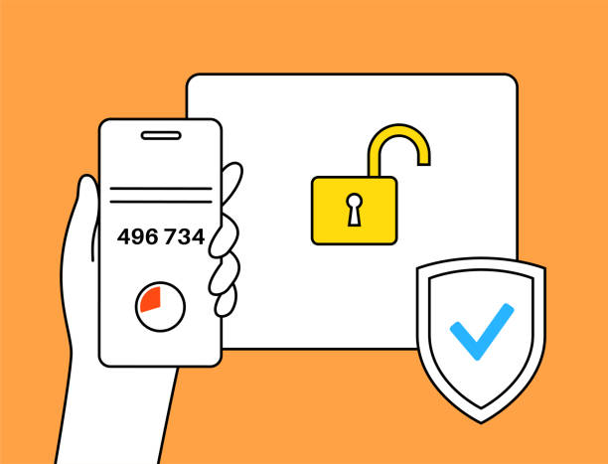
保护自己：设置多重身份验证
多重身份验证要求您除了输入密码以外，还要利用其他验证方法来登录您的帐号。
验证身份方法包括：
向您的设备发送提醒 要求您输入由电子邮件，讯息或电话发送的一次性密码 要求您用指纹或设备密码来解锁设备
Notes:
After entering your password as the first form of identity verification, websites may ask you to verify your identity by sending an alert to your device through email, text, phone call, or notification, or by asking for your fingerprint or device passcode.
This provides an extra level of security.

Slide 38
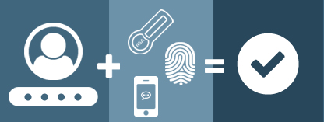
保护自己：设置多重身份验证
https://www.anetworks.com/what-is-multifactor-authentication/
密码
验证
成功登入
Notes:
After entering your password as the first form of identity verification, websites may ask you to verify your identity by sending an alert to your device through email, text, phone call, or notification, or by asking for your fingerprint or device passcode.
This provides an extra level of security.

Slide 39
例如：Health Gateway 电子健康纪录
(Author unknown, n.d.)

Slide 40
什么是Health Gateway 电子健康纪录?
卑诗省政府制作的平台供用户网上浏览个人健康信息。 允许您在一个地方访问多项个人健康信息。

Slide 41
Health Gateway 电子健康纪录可查看哪些内容？
通过 Health Gateway电子健康记录，您可以查看：
医院就诊 药物 检测结果 疫苗接种史 新冠肺炎疫苗接种证明 还有更多
Notes:
“And more” is a cue to explain that health gateway is being constantly developed

Slide 42
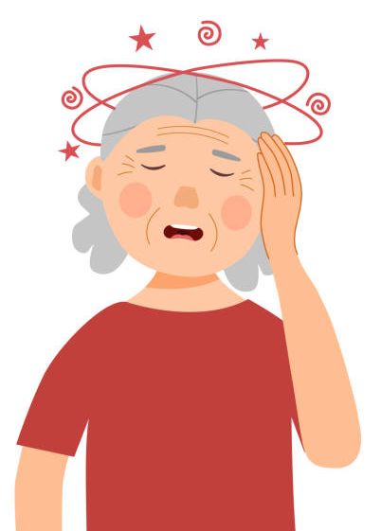
什么时候使用Health Gateway 电子健康纪录？
Notes:
Emily was having dizzy spells, so she had an appointment with her health care provider. During her visit, the doctor recommended she get her bloodwork done to check for possible causes. After completing her test, she can either wait for her health care provider to call her with the results, or she can visit the Health Gateway platform.

Slide 43
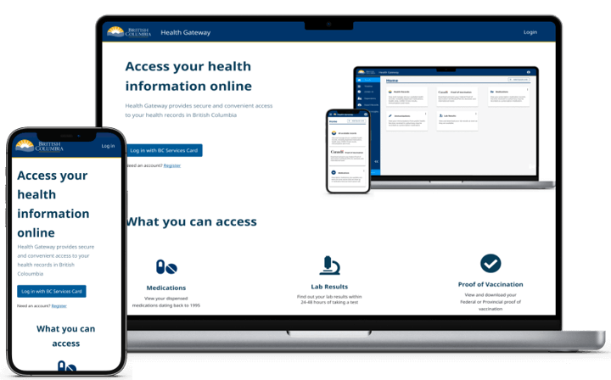
如何浏览Health Gateway 电子健康纪录？
您可以使用电子健康记录应用程序或浏览其网站：https://www.healthgateway.gov.bc.ca/

Slide 44
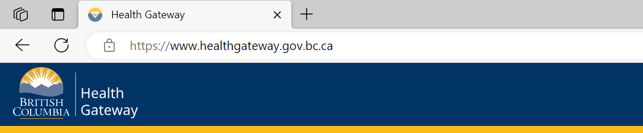
浏览Health Gateway 电子健康纪录
https://www.healthgateway.gov.bc.ca/

Slide 45
浏览Health Gateway 电子健康纪录：登入
您需要跟随几个步骤来登录Health Gateway 电子健康纪录。 这些步骤确保只有您才能登录您的帐号。
以下有两种方法来验证您的身份：
使用手机的B.C. Services Card 应用程序
输入用户名称，密码，以及B.C. Token显示的代号
(有关更多信息: https://id.gov.bc.ca/account/setup-instruction/)

Slide 46
Health Gateway 电子健康纪录：使用平台
Notes:
Talk through the different features, add caveat that screenshot might look different as it is constantly being updated

Slide 47
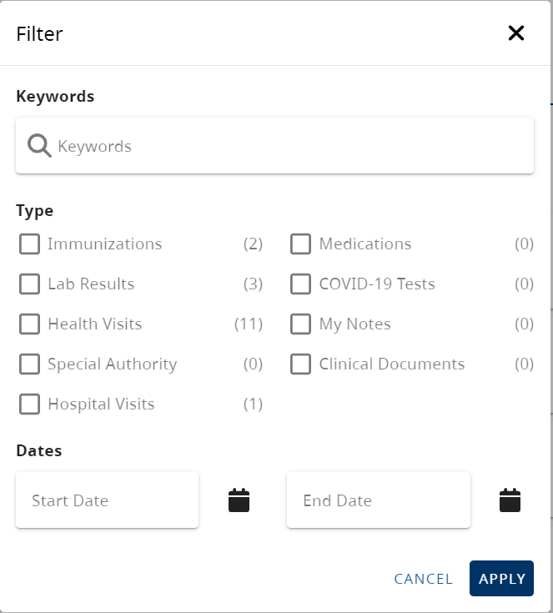
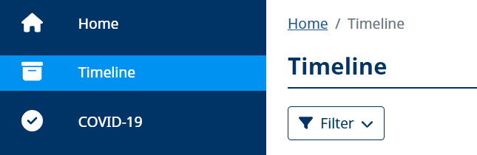
Health Gateway 电子健康纪录：使用平台
您可以点击“Timeline” 来筛选您想找的纪录

Slide 48
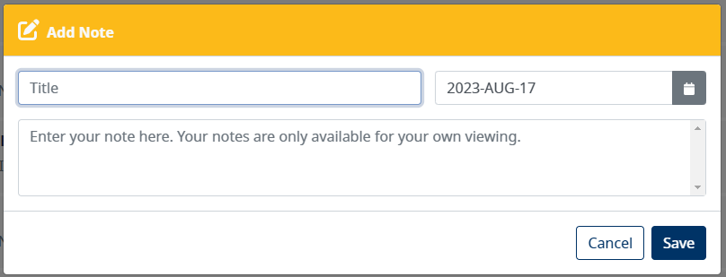
Health Gateway 电子健康纪录：使用平台
您可以为您的时间线及健康纪录添加注释。 这能帮助您追踪需要用作管理健康的信息。 只有您能看见您添加的注释（您的医疗保健提供者并不会看到你的注释）
Notes:
Cue speaker to mention of examples of notes they might want to add. Some example includes instruction for taking medication, questions for your doctors, additional details provided by your care provider during your appointment, any health readings to track/discuss with your doctor at your appointments

Slide 49
Health Gateway 电子健康纪录：使用平台
您可以下载健康记录的副本到您的设备作打印用途。 这令您可以于Health Gateway 电子健康记录外的地方储存您的健康信息。

Slide 50
备注
Health Gateway 电子健康记录是一个健康管理平台，这代表您不能删除，编辑或新增任何医疗纪录。
Health Gateway 电子健康纪录依然在拓展中。 这代表您未必能在此刻寻找到所有您的网上健康纪录。

Slide 51
总结

Slide 52
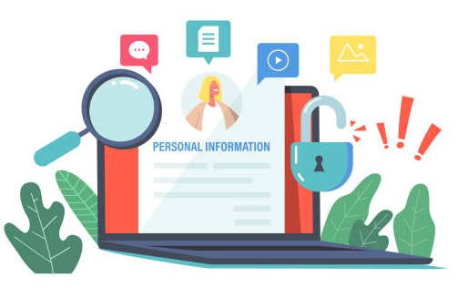
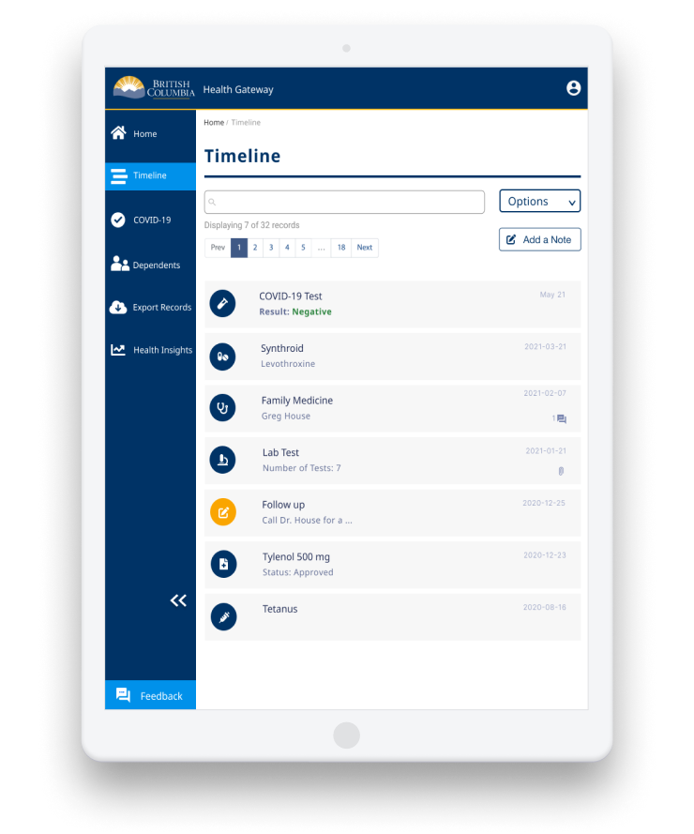
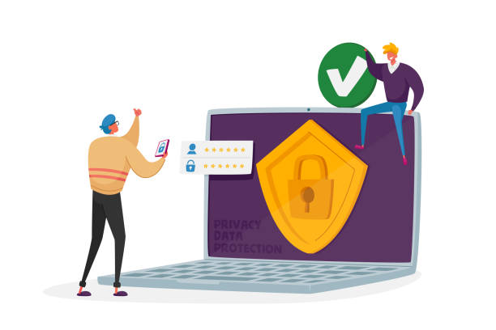
总结
个人健康信息是用于 管理健康的敏感信息
上网查看个人健康 信息的方法
上网查看检测结果时要留意的事情
什么是Health Gateway电子健康纪录及其部分功能
如何保护您的网上个人健康信息

Slide 53
问题？
Health Gateway 电子健康纪录指引: https://www2.gov.bc.ca/gov/content/health/managing-your-health/health-gateway/guide

Slide 54
图片来源
Screen captures were provided by iCON on slides 18, 30-31, 41-42, 44-47.
Unless cited, the images used in this presentation were from publicly available open sources.

Slide 55
© 2023 The University of British Columbia.
The work is licensed under Creative Commons Attribution-Non-Commercial-No Derivatives 4.0 International License
(http://creativecommons.org/licenses/by-nc-nd/4.0/).
It was created by UBC Digital Emergency Medicine. For permissions to use this work for commercial purposes please contact The University of British Columbia’s University-Industry Liaison Office.

Slide 56
再次感谢：
Thank you to the BC Ministry of Health Patients as Partners Initiative for their support.

