Slide 1
Accessing Your Personal Health Information Online
iCON Digital Health Literacy, 2023

Slide 2
Acknowledgements
This digital health literacy curriculum was developed by The University of British Columbia’s interCultural Online health Network (iCON).
iCON is supported by the B.C. Ministry of Health’s Patients as Partners initiative.
iCON has been working with multicultural communities for over 10 years.
iCON helps people with chronic disease self-management.
iCON also helps people develop digital literacy in order to access, assess, and use health resources online.
Thank you to the BC Ministry of Health Patients as Partners Initiative for their support.

Slide 3
Learning objectives
Understand what personal health information is and how you can access yours online.
Learn about how your personal health information is protected online.
Get an introduction to Health Gateway and how it can be used.

Slide 4
Outline
What is personal health information?
How can you access your personal health information online?
Example: Accessing your lab results online
How can you protect your personal health information online?
Example: Health Gateway

Slide 5
What is personal health information?

Slide 6
What is personal health information?
Personal health information is any sensitive information that can be used to identify you and link you to any of your medical information or services you have received.

Slide 7
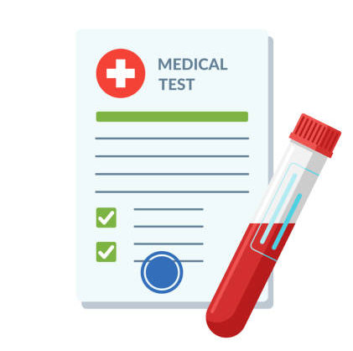
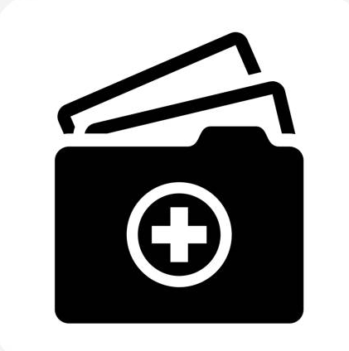
What is personal health information?
Medical History
Medication
Lab Results
Immunization Records
Health Services
Identifying Information

Slide 8
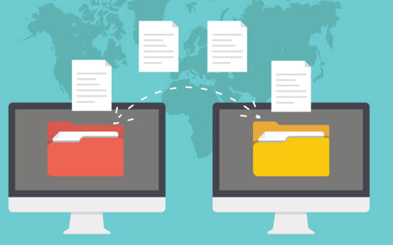
How is your personal health information stored?
Your personal health information is compiled into health records by clinics, hospitals, and other health service providers. Health records are used by health care providers to help manage your care and understand your medical history.
Notes:
Note regarding records being stored convenient location: Each of your health care provider might store your health records in their own system. For example, your family doctor and cardiologist each have their own records. Pictures to cue speaker: Traditionally, your health records are stored as physical files at your health care provider’s office for them to access while providing care. The manner of storing data this way makes it challenging to keep track of your records, especially if you switch providers, or access alternative points of care.

Slide 9
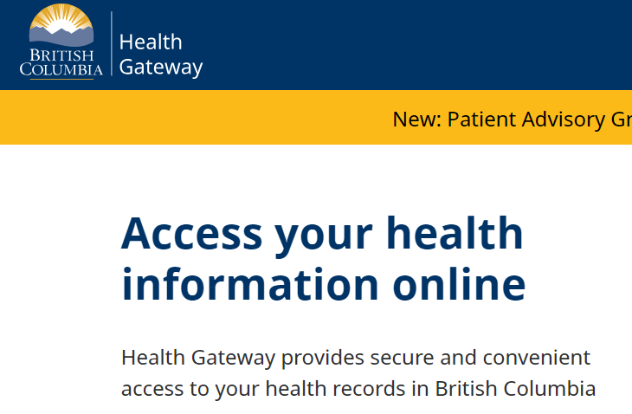
Have you ever accessed your personal health information online?
Notes:
Used by care providers: speaker to elaborate
Used by patients/caregivers: Have you ever gone online to check your lab report? If you have, you are already using health data platforms. Depending on which health data platform you use, you can assess a range of information, like your test results, immunization records, prescription etc

Slide 10
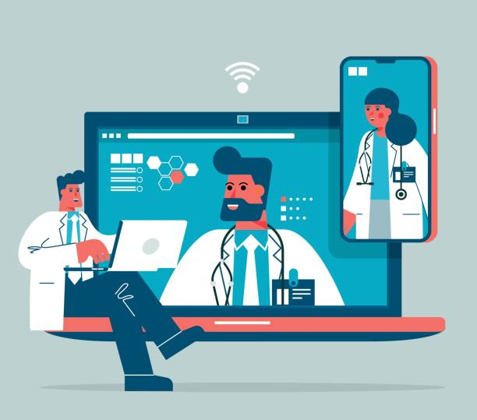
How can you access your personal health information online?

Slide 11
How do you access your personal health information online?
You can access your personal health information online using a range of platforms and tools, which are digital ways to store and organize individual health information.
Health information platforms are provided by trusted health organizations to access personal health information online, such as test results and medical history.
Health information tools are used to input and manage your personal health information on your own digital devices.
Notes:
Speaker should mention that the focus of the presentation will be on health information platforms.
Note: Speaker should refrain from interchanging the terms health information tools and health information platform during the presentation

Slide 12
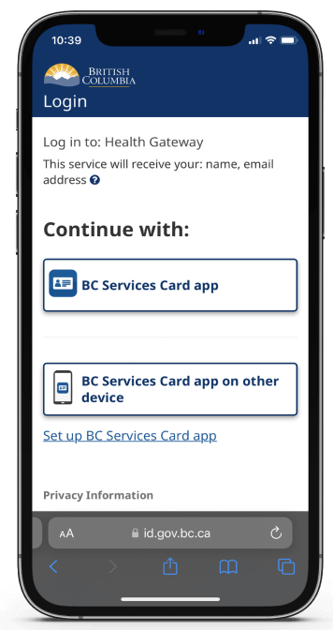
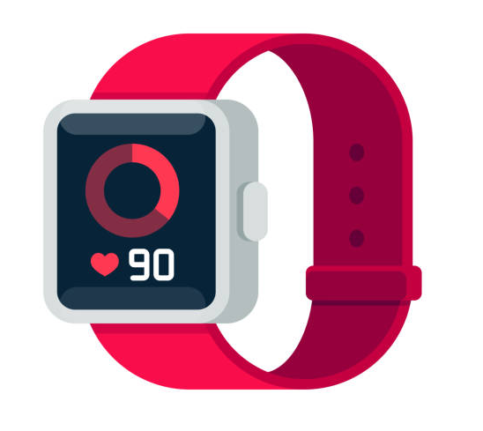
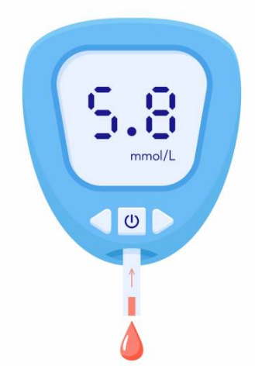
Accessing your personal health information online
Platforms
Tools
Notes:
Highlight differences between health information platforms and health information tools using the example on the slides

Slide 13
Accessing your personal health information online
Platforms
Tools
Notes:
Emphasis that the focus of the presentation will be on health information platforms
As a user of the health information platforms, your view of the platform looks different than that of your health care provider. While your version of the platform allows you to view a summary of your heath records, your health care provider has complete access to your health records and will have the ability to change your health record (example: add a prescription to your records)

Slide 14
Benefits of accessing your personal health information online
Easy and quick access to your personal health information.
Convenient as all your information is stored in one location.
Easier access to more of your personal health information helps you to coordinate your care.
Encourages collaboration and patient participation in managing care.

Slide 15
Limitations of accessing your personal health information online
Digital platforms are still being expanded to include more types of health information. This means that you may not be able to find all of your health information online at this time.
Continual learning is needed as the platform gets new updates.
No clinical guidance and explanation while viewing your results online (before you discuss your results with your health care provider).
Different precautions are needed to protect your personal health information online compared to paper health records.
Notes:
Some examples during the presentation to illustrate this: E.g. imaging may be available in the future, having no clinical guidance and explanation can sometimes cause anxiety in patients and patients starting to use Dr. Google, doctors now need to stay even more updated on what the general public may know about diagnoses/treatment; elaborate on what is meant by the different precautions needed to protect personal health information e.g. privacy concerns

Slide 16
Example:
Accessing your lab results online
(Tankilevitch, 2020)

Slide 17
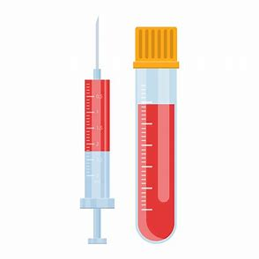
What lab results are available?
You can access your lab results using several different platforms depending on where you got your testing done.
Some types of lab results that are available online include:
Blood or urine tests
Cervix or colon cancer screenings
Pathology tests
Notes:
Give examples of the different platforms available to view your lab results: mycarecompass, health gateway etc

Slide 18
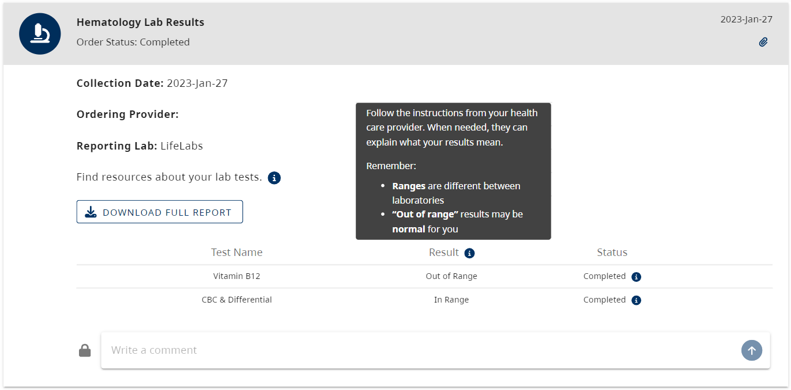
What information can you see about your lab results?
Notes:
Speaker to explain information marked with arrow
Emphasize that by downloading the full report users can see the detailed numbers/values of their results

Slide 19
Understanding your results
Usually, some guiding information on how to understand your results will be available on the platform.
Your health care provider will also receive your test results. If there is a result that requires attention or further action, your health care provider will contact you quickly to take any necessary next steps.
You are encouraged to discuss your lab results with your health care provider at your next appointment, so they can help you understand what it means for you.
Notes:
Sometimes patients view their results even faster than their provider can read them e.g. patients see their urine culture results are positive and send emails and calls to their health care provider. This can increase the workload for your health care provider and slow down their ability to respond to you.

Slide 20
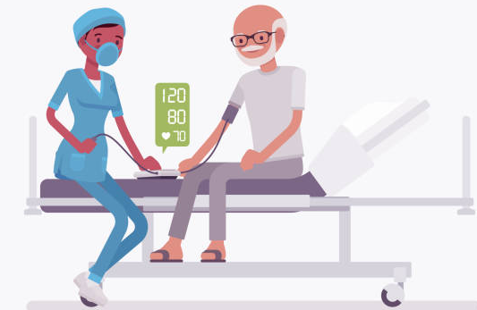
Understanding your results
70 years old
Male
Heart condition
Notes:
Screenshot of bloodwork – senior as a case study
Case study: Meet Joe – 70 year old, male with a heart condition. Due to his condition, the doctor is expecting his BP to be high. Use this to discuss next slide: multiple factors influence your results, and importance of looking at the trend of your results

Slide 21
Understanding your results
Every person’s baseline health is unique.
Multiple factors like age, gender, health status, pre-existing conditions (diabetes, high blood pressure, etc.) can influence your health.
Even though your results says “out of range”, this may be normal for you. Your health care provider will be able to explain what your results mean for you.
Notes:
Since unique factors can influence your results, the means used to monitor your “out of range” levels may vary person to person. Though for some patients tracking value of their results work, for other patients, it may be more important to look at the trend of their levels over time. For example, using data tracking apps to record blood sugar.

Slide 22
How can you protect your personal health information online?

Slide 23
How is your personal health information protected online?
By law, organizations that store your personal health information are required to comply with rules and policies to keep your information safe.
Credible organizations, such as government institutions and regional health authorities, can be trusted to keep your personal health information safe and secure.
Notes:
Examples of government institutions- Msp, Health Gateway
Example of health authorities and agencies: Vancouver Coastal Health, BC cancer, Fraser Health

Slide 24
How can you protect your personal health information online?
You can protect your personal health information online by taking these measures:
Choosing to use trusted platforms
Being careful about sharing sensitive information
Using a strong password
Setting up multi-factor authentication
Notes:
Speaker to elaborate on Point 1 (Being careful about sharing sensitive information) and provide an example.

Slide 25
Protecting yourself: Choose a trusted platform
☺
More trustworthy:
Less trustworthy:

Slide 26
Protecting yourself: Choose a trusted platform
☺
More trustworthy:
Primarily aims to provide access to personal health information, not to get money or sell products.
Is from a reputable organization.
Is endorsed by health professionals you trust.
Clearly explains how your information will be protected in a privacy policy.
Less trustworthy:
Primarily aims to get money or sell products.
Is not from a reputable organization.
Is not endorsed by health professionals you trust.
Is not clear about how your information will be protected, and may not have a privacy policy.
Notes:
Less trustworthy sites may have malicious intents – For example, they may try to get you to pay for accessing your personal health information. However, this may not apply to all services that require pay because some credible services also require payment for medical records, such as immigration documents. Therefore it is important to exercise caution and careful judgements when making assessments.
Speaker to elaborate on how these trustworthy indicators/green flags look different across platforms. For example LifeLabs My Care Compass and Health Gateway would differ with regard to website ending (links to next slide), but both websites are endorsed by health professionals

Slide 27
Protecting yourself: Choose a trusted platform
Websites with these endings might be more trustworthy:
website.gov = government information
website.org = usually a not-for-profit organization
website.edu = an educational institution such as a university
☺
Websites with this ending might be less trustworthy:
website.com = a commercial business
Notes:
Speaker emphasize that .gov as a generalized example
Website with .gov ending is a generalized ending for government website. Depending on the country/ province the government website belongs to, the .gov ending might have other extensions added to it (Example a website ending from the B.C. provincial government is .gov.bc.ca
When assessing websites, consider whether the websites are from a reputable organization, such as a health authority, and whether the websites were endorsed or suggested to you by a health professional you trust, such as your family physician.

Slide 28
Protecting yourself: Choose a trusted platform
☺
☺
Less trustworthy
May or may not be trustworthy
More trustworthy
☺
Green Flags : more trustworthy. Red Flags : less trustworthy.
Notes:
While websites with certain endings might seem more credible, it is helpful to use more than one measure to assess trustworthiness of a website. It is good practice to read through the website and check the number of green flags against the number of red flags that come up, and then decide on the overall credibility of the website.

Slide 29
Protecting yourself: Choose a trusted platform
https://www.lifelabs.com/
Notes:
Example of assessing the credibility of a website: This website ends with a .com, so it is good practice to pause and look for other red/green flags before deciding on it’s credibility.

Slide 30
Protecting yourself: Choose a trusted platform
☺
Notes:
Look for and read the “about us”, “terms of service” or “privacy” sections of the website to assess the trustworthiness of the website. Additionally, this website belongs to LifeLabs, which is likely endorsed by health professionals you trust (e.g. recommended by your family physician).

Slide 31
Protecting yourself: Choose a trusted platform
If you are unsure about whether a platform is trustworthy, ask someone you trust for help to determine if it is safe to use.

Slide 32
How can you protect your personal health information online?
You can protect your personal health information online by taking these measures:
Choosing to use trusted platforms
Being careful about sharing sensitive information
Using a strong password
Setting up multi-factor authentication

Slide 33
Protecting yourself: Avoid sharing sensitive information
Be cautious if you are asked to share sensitive information, such as:
Date of birth
Address
Personal Health Number (PHN)
Social Insurance Number (SIN)
Identification documents, such as passport or driver’s license
Personal financial information
Notes:
Sensitive information should only be shared with organizations or individuals that you trust, as it could be used for malicious intent.

Slide 34
How can you protect your personal health information online?
You can protect your personal health information online by taking these measures:
Choosing to use trusted platforms
Being careful about sharing sensitive information
Using a strong password
Setting up multi-factor authentication

Slide 35
Protecting yourself: Use a strong password
To create a strong password, follow these tips:
Try to make a password that cannot be easily guessed (avoid including personal information).
Use different passwords on different account and devices.
Keep your password private.
Use a minimum of 15 characters.
Use a combination of upper and lower case letters.
Include at least one number and one character, like !, # or $.

Slide 36
How can you protect your personal health information online?
You can protect your personal health information online by taking these measures:
Choosing to use trusted platforms
Being careful about sharing sensitive information
Using a strong password
Setting up multi-factor authentication

Slide 37
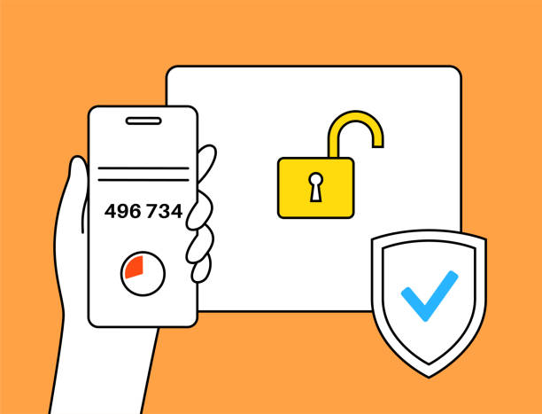
Protecting yourself: Use multi-factor authentication
Multi-factor authentication is when you are asked to use a password and verify your identity using another method to log in to your account.
Ways to verify your identity can include:
Sending an alert to your device
Asking you to enter a one-time code sent by email, text, or phone call
Asking you to unlock your device using your fingerprint or device passcode
Notes:
After entering your password as the first form of identity verification, websites may ask you to verify your identity by sending an alert to your device through email, text, phone call, or notification, or by asking for your fingerprint or device passcode.
This provides an extra level of security.

Slide 38
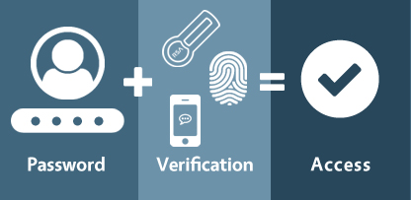
Protecting yourself: Use multi-factor authentication
https://www.anetworks.com/what-is-multifactor-authentication/
Notes:
After entering your password as the first form of identity verification, websites may ask you to verify your identity by sending an alert to your device through email, text, phone call, or notification, or by asking for your fingerprint or device passcode.
This provides an extra level of security.

Slide 39
Example: Health Gateway
(Author unknown, n.d.)

Slide 40
What is Health Gateway?
Health Gateway is a platform developed by the B.C. provincial government for users to access their personal health information online.
Health Gateway allows you to access many types of your personal health information in one convenient digital location.

Slide 41
What can you access using Health Gateway?
Through Health Gateway, you can access your:
Health and hospital visits
Medications
Lab results
Immunization history
COVID-19 proof of vaccination and test results
And more…
Notes:
“And more” is a cue to explain that health gateway is being constantly developed

Slide 42
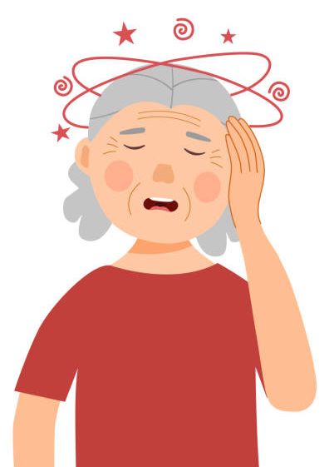
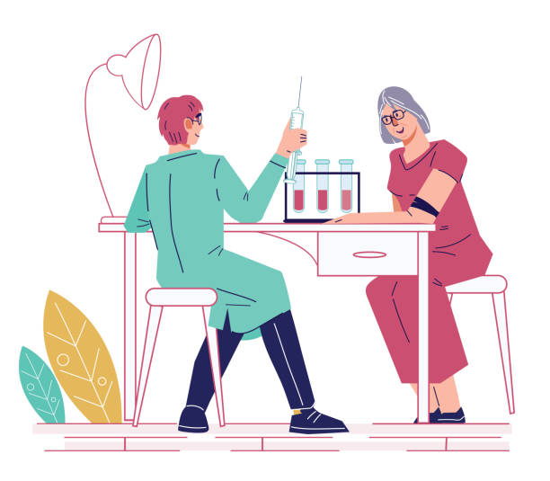
When could you use Health Gateway?
Notes:
Emily was having dizzy spells, so she had an appointment with her health care provider. During her visit, the doctor recommended she get her bloodwork done to check for possible causes. After completing her test, she can either wait for her health care provider to call her with the results, or she can visit the Health Gateway platform.

Slide 43
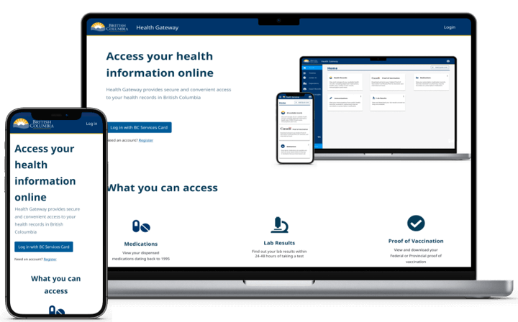
How do you access Health Gateway?
You can access Health Gateway either using the Health Gateway app or by visiting their website: https://www.healthgateway.gov.bc.ca/

Slide 44
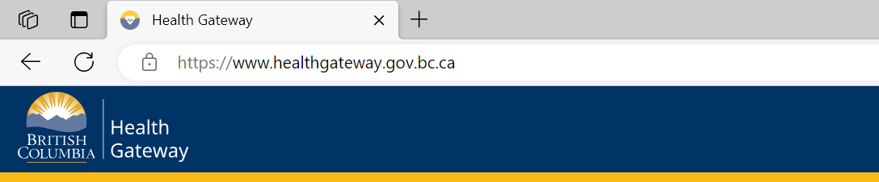
Accessing Health Gateway
https://www.healthgateway.gov.bc.ca/

Slide 45
Accessing Health Gateway: Logging in
There are several steps required to login to Health Gateway. These steps protect your privacy by ensuring that only you can log in to your account.
There are two ways to verify your identity:
Using the B.C. Services Card app on your mobile device
Entering a username, password and a code from a small device called a B.C. Token
For more information: https://id.gov.bc.ca/account/setup-instruction/

Slide 46
Health Gateway: Using the platform
Notes:
Talk through the different features, add caveat that screenshot might look different as it is constantly being updated

Slide 47
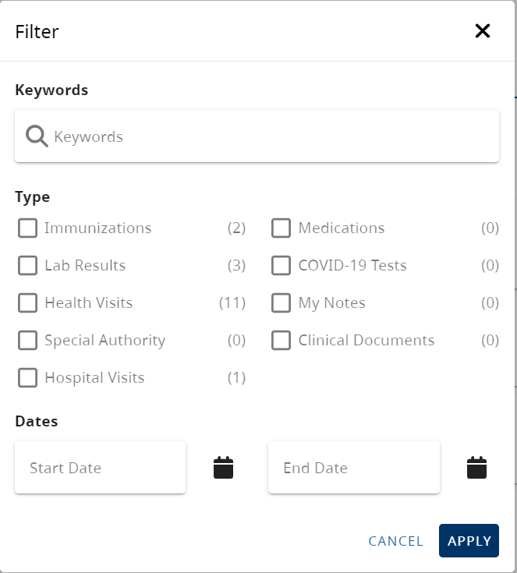
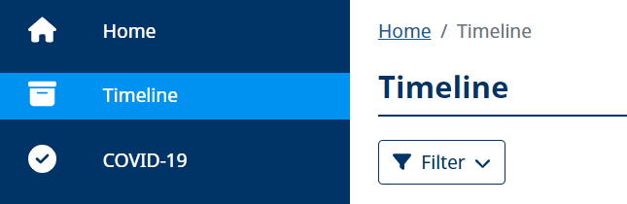
Health Gateway: Using the platform
On the platform, you can filter through your records to find what you are looking for using the “Timeline” tab.

Slide 48
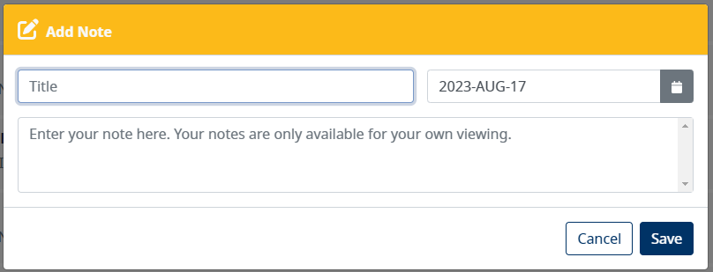
Health Gateway: Using the platform
You can add notes to your timeline and on your results. This can help you to keep track of any information you need to manage your health.
Only you can see the notes you add (your healthcare providers will not be able to see your notes).
Notes:
Cue speaker to mention of examples of notes they might want to add. Some example includes instruction for taking medication, questions for your doctors, additional details provided by your care provider during your appointment, any health readings to track/discuss with your doctor at your appointments

Slide 49
Health Gateway: Using the platform
You can export your records by downloading a copy of your health records to your device, which you can then print. This allows you to store a copy of your health information outside of Health Gateway.

Slide 50
General notes
Health Gateway is meant to be a health management platform for you, which means you cannot delete, edit or add to your actual health records.
Health Gateway is still being expanded to include more types of health information. This means that you may not be able to find all of your health information online at this time.

Slide 51
Summary

Slide 52
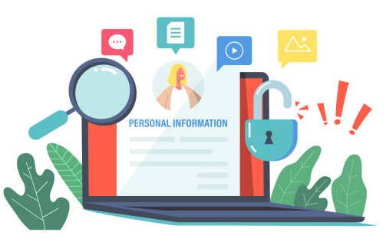
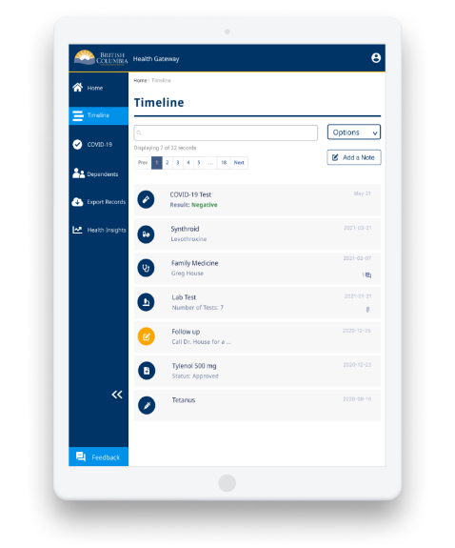
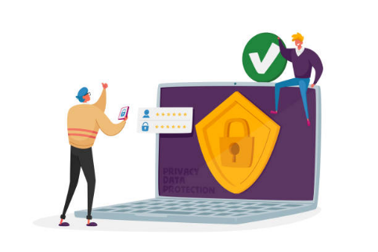
Summary
Personal health information is sensitive information used to manage your care.
Ways to access your personal health information online.
Tips to keep in mind when viewing your lab results online.
How your personal health information can be protected online.
What Health Gateway is and some of its features.

Slide 53
Questions?
Health Gateway support guide: https://www2.gov.bc.ca/gov/content/health/managing-your-health/health-gateway/guide

Slide 54
Image Credits
Screen captures were provided by iCON on slides 18, 29-30, 43-44, 46-49.
Unless cited, the images used in this presentation were from publicly available open sources.

Slide 55
© 2023 The University of British Columbia.
The work is licensed under Creative Commons Attribution-Non-Commercial-No Derivatives 4.0 International License
(http://creativecommons.org/licenses/by-nc-nd/4.0/).
It was created by UBC Digital Emergency Medicine. For permissions to use this work for commercial purposes please contact The University of British Columbia’s University-Industry Liaison Office.

Slide 56
Thank you again to:
Thank you to the BC Ministry of Health Patients as Partners Initiative for their support.

